Slide 1

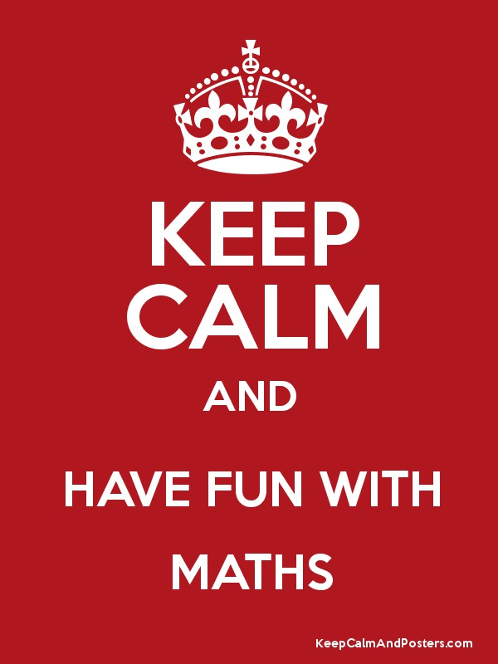
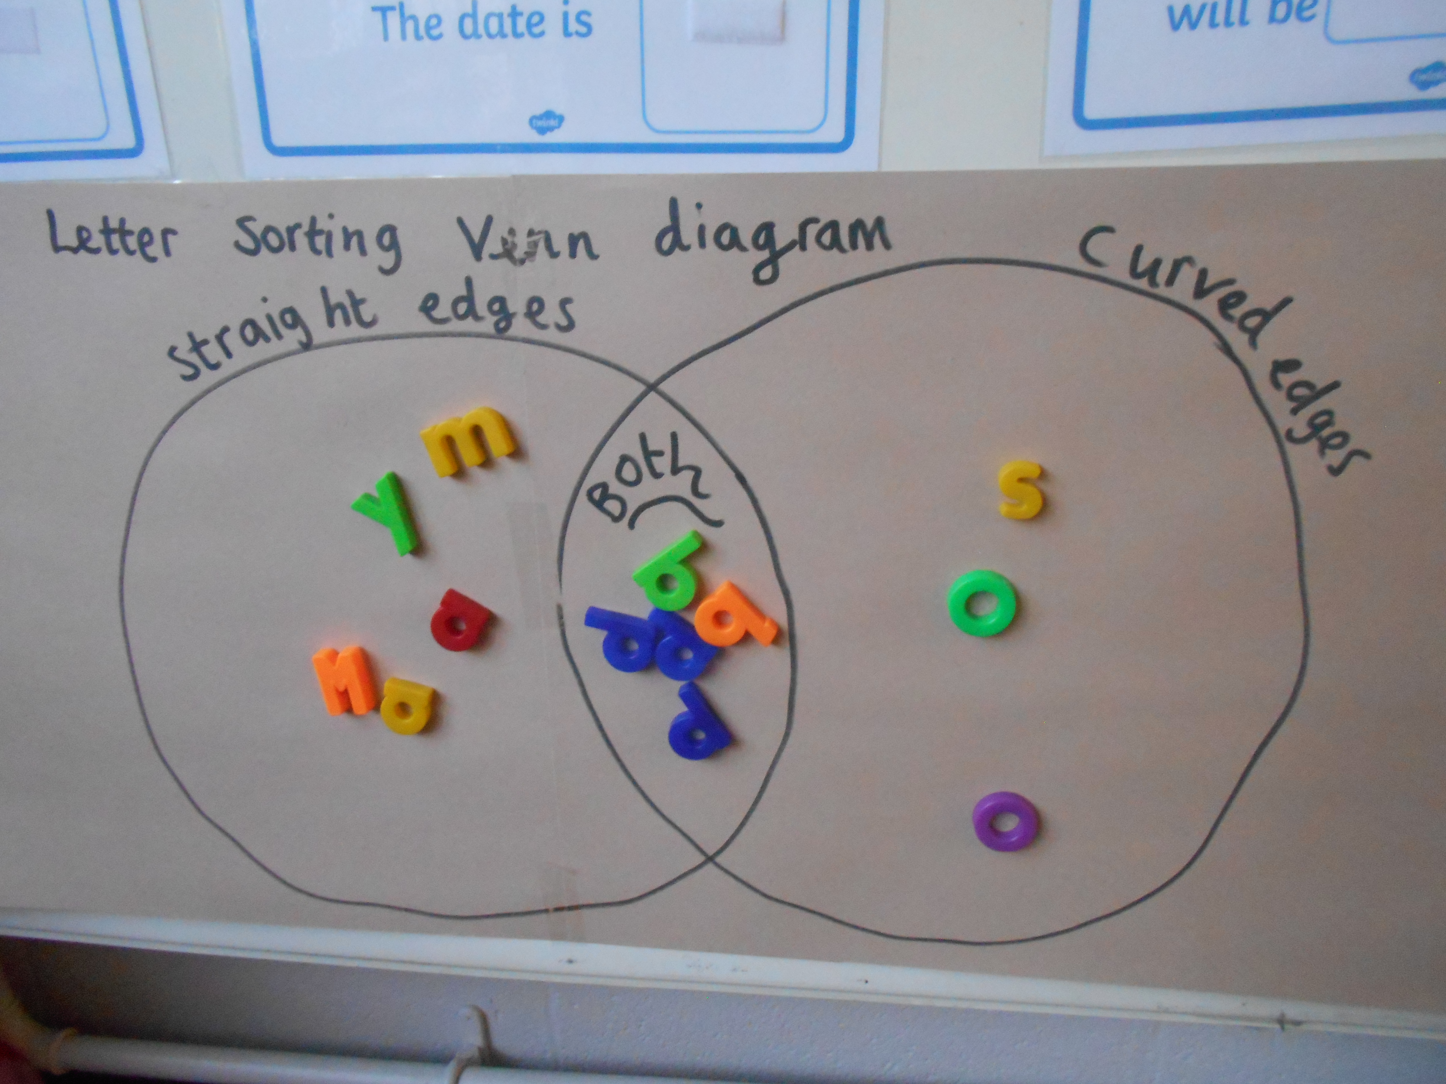
Practical Maths Workshop

Slide 2
Aims of Today’s session
To understand the Maths Curriculum from Year 1 to Year 2.
To get an insight into what maths looks like a Carlisle Infant School.
To know how support your child at home to develop their maths knowledge.

Slide 3
The Goal
Children need to understand our number system, starting with counting numbers, building an understanding of how our numbers work and fit together. This includes exploring place value and comparing and ordering numbers then
applying this understanding
in different contexts.

Slide 4
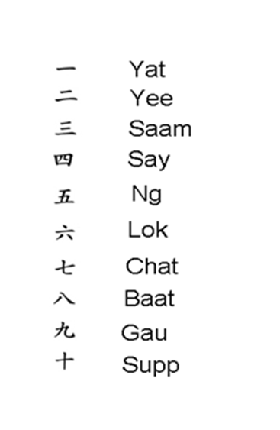
Abstract
‘Existing in thought or as an idea but not having a physical or concrete existence’.

Slide 5
The Current Maths Curriculum
Children should:
Become fluent in the fundamentals of mathematics; through varied and frequent practice with increasingly complex problems. Pupils can then develop conceptual understanding and the ability to recall and apply knowledge rapidly and accurately.
Reason mathematically by following a line of enquiry, conjecturing relationships and generalisations and developing an argument, justification or proof using mathematical language.
Solve problems by applying their mathematics to a variety of problems with increasing sophistication, including breaking down problems into a series of simpler steps and persevering in seeking solutions.

Slide 6
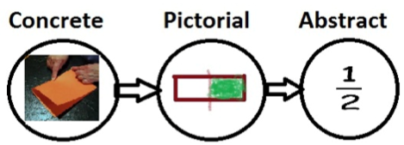
Concrete
Pictorial
Abstract

Slide 7
The EYFS Outcomes
Children count reliably with numbers from one to 20, place them in order and say which number is one more or one less than a given number.
Using quantities and objects, they add and subtract two single-digit numbers and count on or back to find the answer.
They solve problems, including doubling, halving and sharing.
Children use everyday language to talk about size, weight, capacity, position, distance, time and money to compare quantities and objects and to solve problems.
They recognise, create and describe patterns.
They explore characteristics of everyday objects and shapes and use mathematical language to describe them.

Slide 8
Year 1 Maths Objectives
1 Count to and across 100 from any number
2 Count, read and write numbers to 100 in numerals
3 Read and write mathematical symbols: +, - and =
4 Identify "one more" and "one less"
5 Use number bonds and subtraction facts within 20
6 Add and subtract 1-digit and 2-digit numbers to 20, including zero
7 Recognise, find and name a half
8 Recognise, find and name a quarter
9 Measure and begin to record length, mass, volume and time
10 Recognise and know the value of all coins and notes
11 Use language to sequence events in chronological order
12 Recognise and use language relating to dates
13 Tell the time to the half-hour, including drawing clocks
14 Recognise and name common 2-D shapes
15 Recognise and name common 3-D shapes

Slide 9
Year 2 Math Objectives
I can count in steps of 2,3 and 5 from 0 and in tens from any number
I can read and write numbers up to 100 and beyond using numerals and words
I can recognise the place value of each digit in a two-digit number
I can identify, represent and estimate numbers
I can compare and order numbers from 0 to 100 using greater than and less than
I can use place value and number facts to solve problems
I know my number bonds for number 20
I can add and subtract one-digit and two-digit numbers mentally
I can add and subtract multiples of 10 and two-digit numbers mentally
I understand adding and subtracting rules
I can check my answers using inverse operations
can add 2-digit numbers to two-digit numbers
I can subtract 2-digit numbers from 2-digit numbers
I I know pairs of numbers that make 100
I can add and subtract two two-digit numbers mentally
I can solve problems with addition and subtraction
I know the multiples of 2
I know the multiples of 10
I know the multiples of 5
I can write multiplication statements
I can write division statements
I understand multiplication and division rules
I can solve problems with multiplication and division
Fractions
Shape
Measure

Slide 10
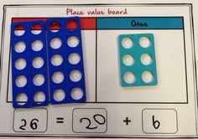
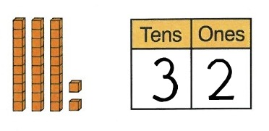
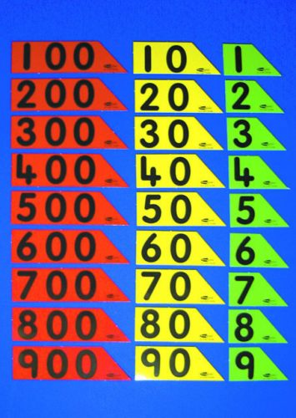
The Vital foundation to build on….
Place value is at the heart of the number system. All digits have a value and a secure understanding of this will enable children to use and understand different calculation methods.

Slide 11
How to develop place value at home?
Counting!
Counting actual objects
Estimating game – guess how many objects are there? How to you know? Would 100 be a good guess?
Sequence and pattern games. 1, 2, 4, 5 what number have I missed out? 5, 10, 15, 25, 30 what number have I missed out?
Guess my number. Children have to ask questions to find out the answer. Is it bigger than 50? Is it odd and even? Using a hundred square can support children when first starting to play this game. www.primarygames.co.uk/pg2/splat/splatsq100.html
Describing numbers in hundred, tens and ones. My number has 4 hundreds 6 tens and 8 ones. What is it?
One more/one less number games.
Ordering random numbers.
Which number is bigger 54 or 14? How do you know?
Throwing numbers using your hands- hundreds, tens and ones.

Slide 12
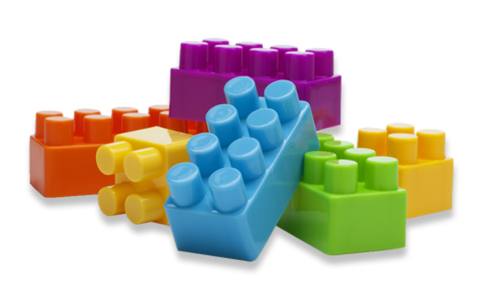

Slide 13
Using Place Value Charts
1 2 3 4 5 6 7 8 9
10 20 30 40 50 60 70 80 90
100 200 300 400 500 600 700 800 900
1000 2000 3000 4000 5000 6000 7000 8000 9000
Notes:
Activity: Give out place value charts and counters Demo activities involving partitioning and combining.

Slide 14

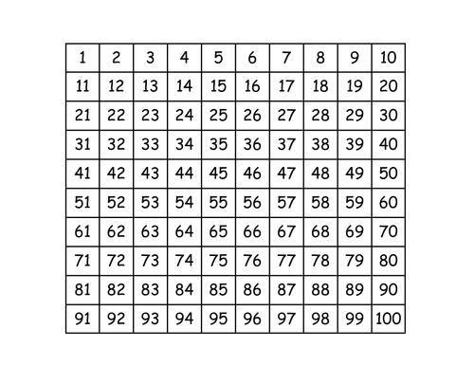
How to use pictorial resources?
Number lines for jumping forward and backward help the children create a visual image in their head for adding on and taking away.
Hundred Square – finding patterns, adding in multiplies of tens and ones, counting in tens from any number forwards and backwards.

Slide 15
Number Facts
Number bonds to 1, 2, 3, 4, 5, 6, 7, 8, 9,10, 20 and 100.
Play games using fingers, objects where you hide some and they have to guess how many you are hiding? I have 6 you have ?
Double facts
Halving facts
Counting in steps 2s, 3s, 5s, 10s, 100s, 1000s, 1/2s

Slide 16
Reasoning
Reasoning is fundamental to knowing and doing mathematics. Some would call it systematic thinking. Reasoning enables children to make use of all their other mathematical skills and so reasoning could be thought of as the 'glue' which helps mathematics makes sense.
It brings together number knowledge, with language understanding and problem solving. It is a complex process which often involves sequencing a number of stages in order to find the answer.

Slide 17
How would you solve these?
35 + 42
25 + 27
28 + 59
145 + 127
  Jack has 150 football cards. Tammy has 161. How many do they have altogether?
  Ben scored 234 points in the game. Natasha scored 141. How many points did they score in total?

Slide 18
How would you solve these?
67 - 45
67 – 59
178 – 99
467 - 325
  Sophie scored 227 points on the computer game. Nafisat scored 158. How many more points did Sophie score?
  Ben had 360 stamps in his stamp collection. Aden had 276. How many more stamps did Ben have?

Slide 19
How would you solve these?
24 × 50
24 × 4
24 × 15
136 × 9
  Sophie had 18 stamps. Jenny had 5 times as many. How many stamps did Jenny have?
  George had 36 football stickers. Adam had 4 times as many. How many stickers did Adam have?

Slide 20
Peter has 4 books.
Harry has five times as many books as
Peter. How more many books has Harry?
4
4
4
4
4
4

Slide 21
How to develop reasoning at home?
Asking questions all the time about how they reached a specific answer.
  Is 15 an odd or even number? How do you know?
  Is 56 bigger than 32. How do you know?
  123 is a three digit number. Explain your thinking?
Give a statement and ask the children if it a right or wrong?
5 + 6 = 10 Is that right or wrong? How do you know?
Solving word problems where the children have to interpret the language and decide what to do.
Using three numbers find the odd one out
40 15 30

Slide 22
Other mathematical concepts… fractions, shape, space and measure.
Finding shapes in the environment and asking the name of them and how do they know? Focus on using the key features to identify them so they can find regular and irregular shapes.
Practice telling the time focusing on counting in 5s, looking at the different hands and relating to digital time.
Cooking – weighing and measuring different amounts and comparing it using different units.
Measuring – measure their height and note it so you can compare the difference. Use language such as smaller then, bigger than, wider than.
Fractions – cutting up food into equal amounts. Eating parts of it, how much is left and how much have we eaten?
Using money all the time. Adding up amounts using different coins. Matching coins to a concrete amount. Asking the children would you like five 10ps or a 50p coin? Can they explain the difference between them.

Slide 23
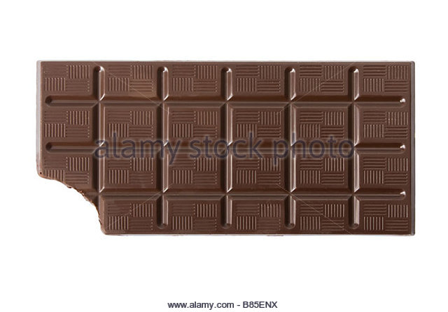
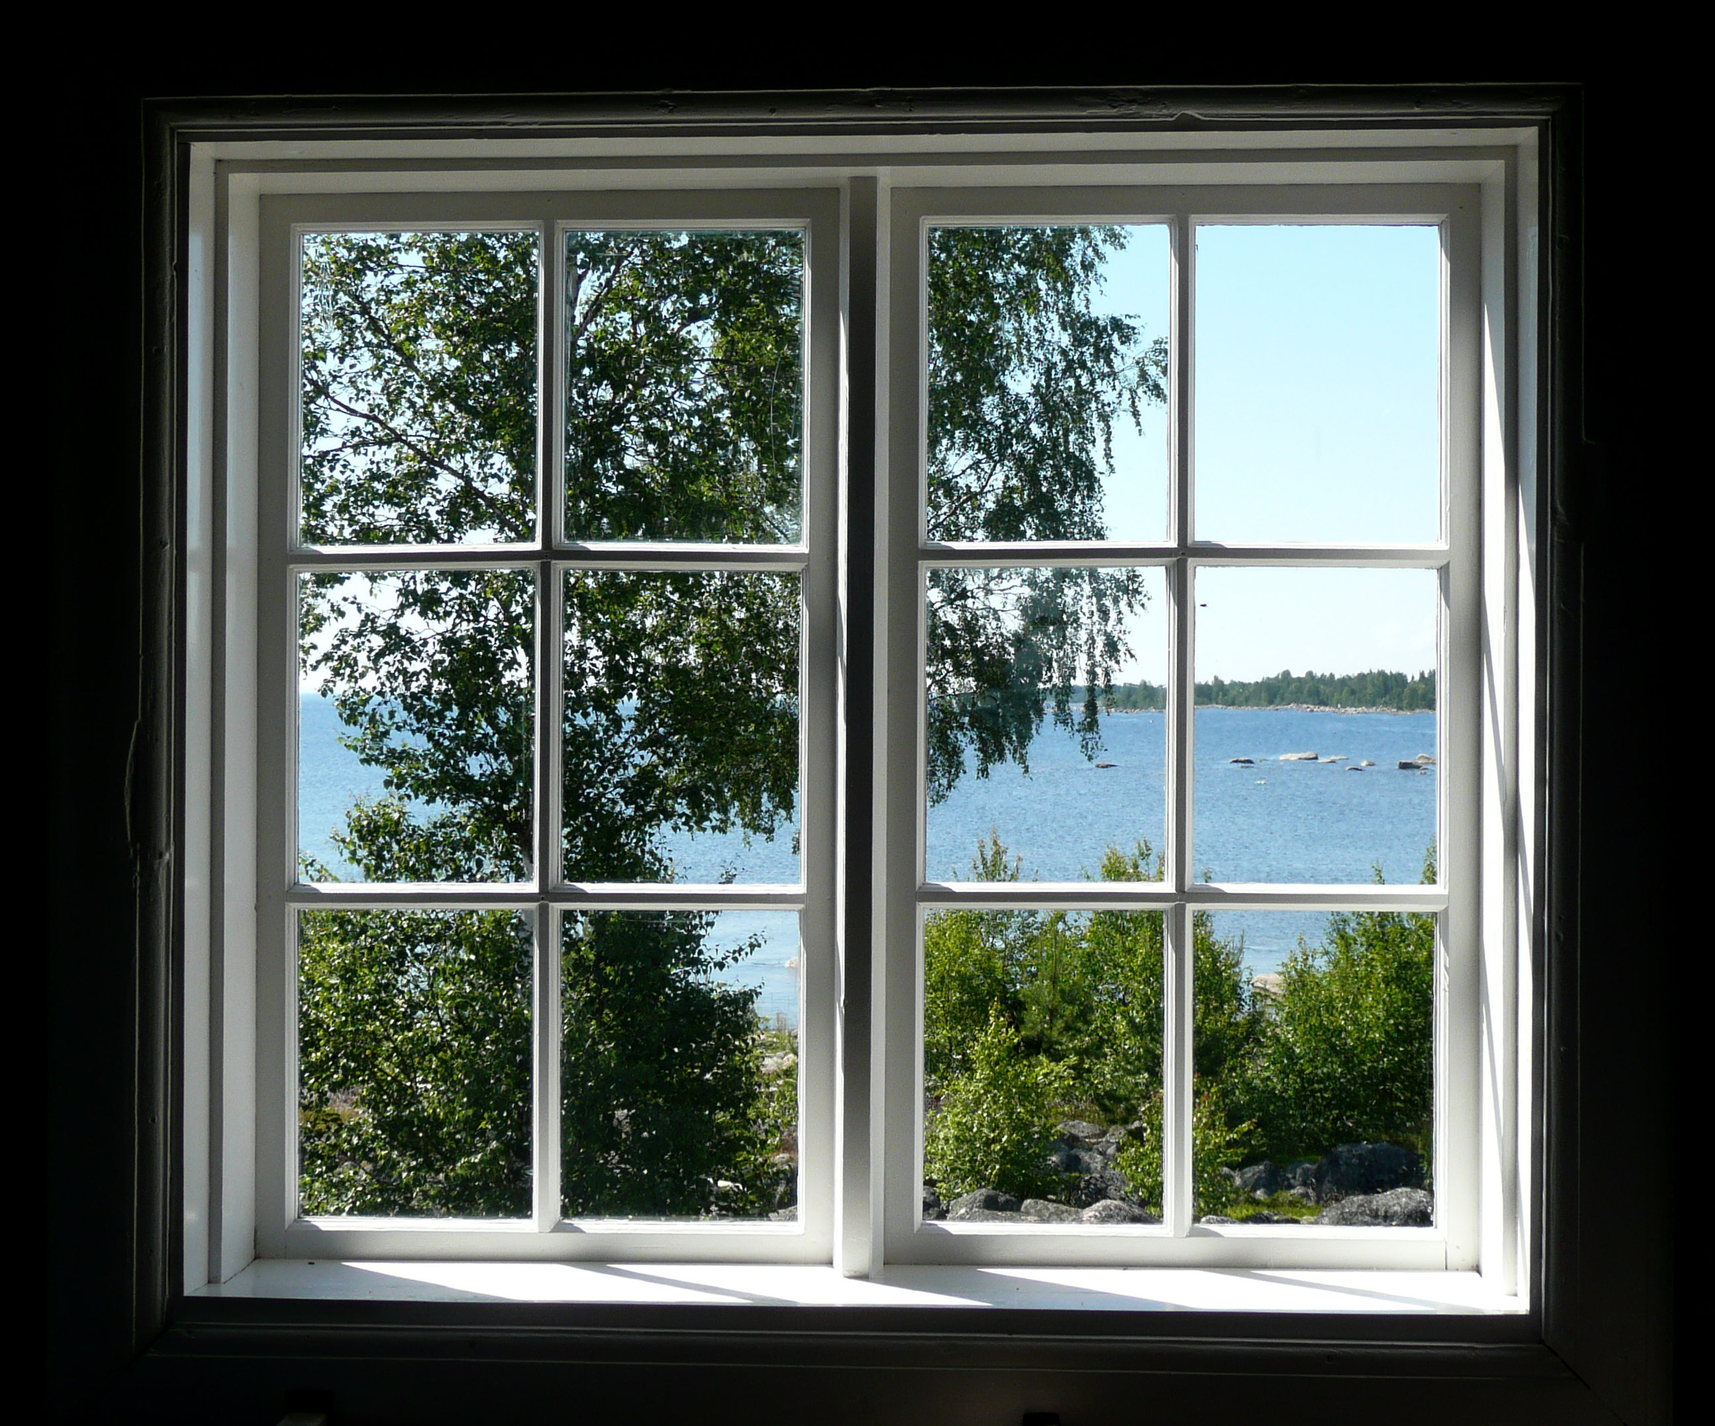
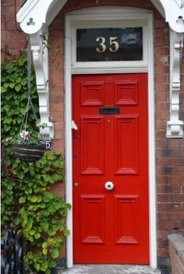
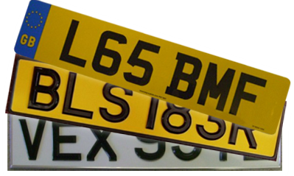
Maths in the Environment
How many parts in the window?
How do you know?
Could you work it out without counting them individually?
If I drew the curtain on half of them how many would be showing? How do you know?
How much of the chocolate bar has been eaten? How do you know?
How much is still left to eat?
Could you equally share what is left with a friend?
What number is that?
Is it bigger or smaller than 50?
Is it odd or even? How do you know?
Tell me something you know about that number?
Tell me the numbers in this number plate?
Using these digits what is the biggest/smallest number you can make?

