Slide 2
Emotion Coaching
‘’Emotion Coaching is a way of helping people, children and adults, to understand the different emotions they experience, why they occur and how to handle them.”

Slide 3
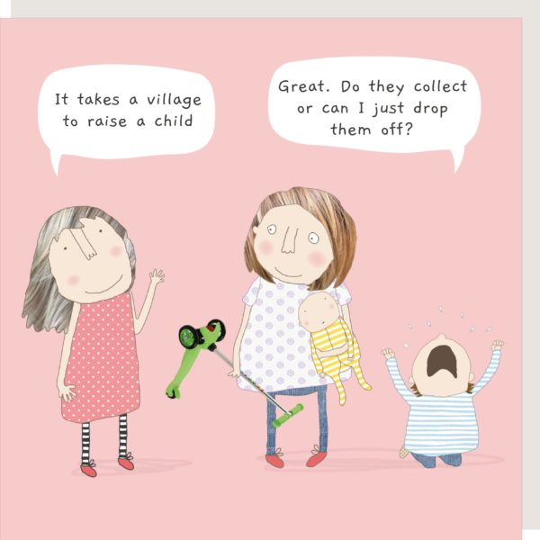
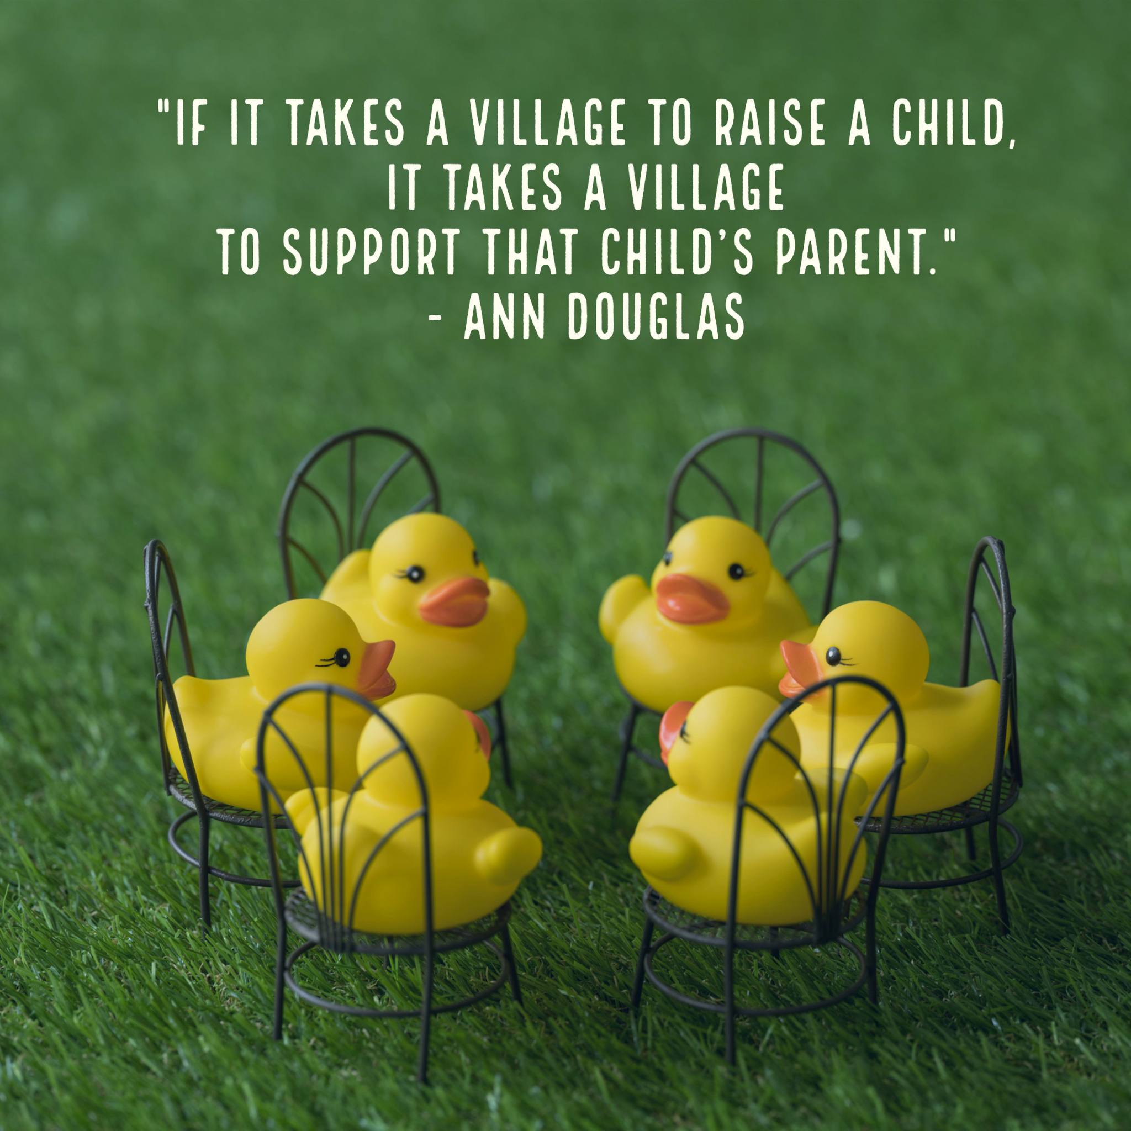
How can this help?
Helps everyone, child, you as a parent, you as a person and others around you.
Supports times when you and your child are finding behaviour tricky to manage.

Slide 4
Why do we need Emotion Coaching?

Slide 5
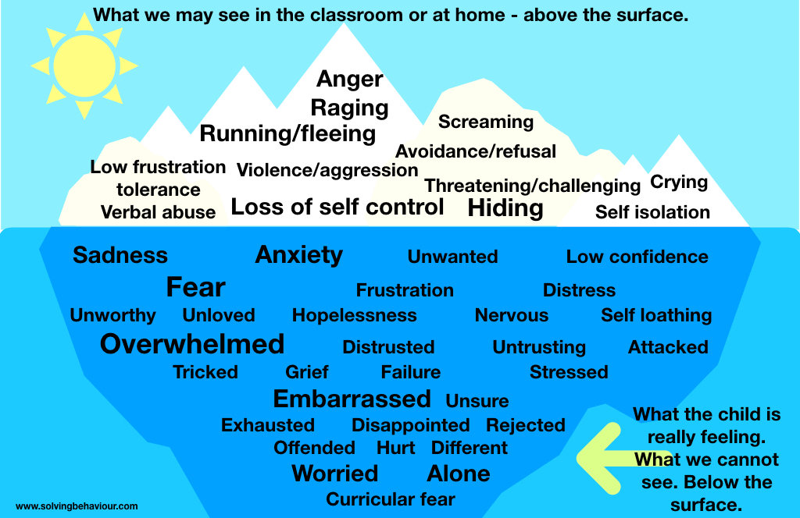
All behaviour is communication

Slide 6
Dr Daniel Siegel presenting a Hand Model of the Brain

Slide 8
Notes:
From birth children are learning to recognise and regulate their emotions, particularly negative or difficult ones and to interact with others.
Link to our own childhood

Slide 9
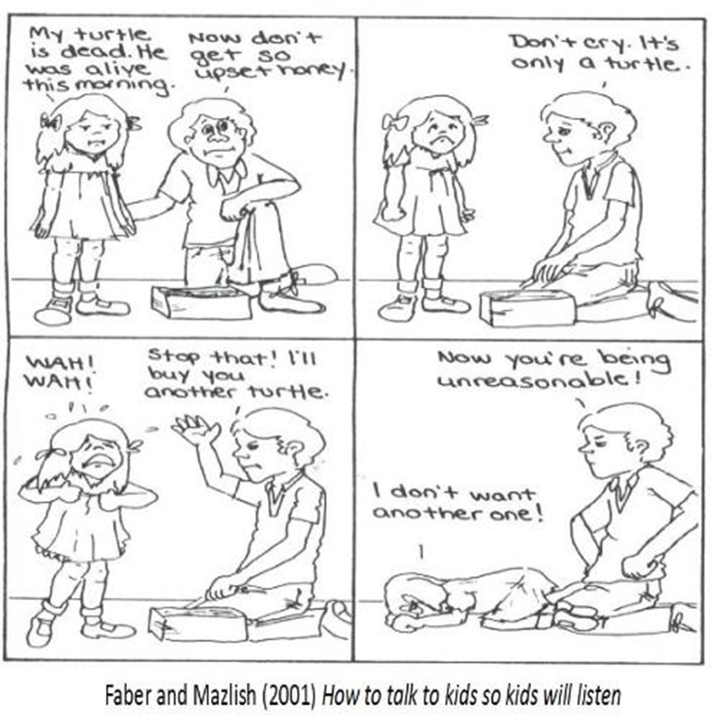
Instead of denying the feeling…

Slide 10
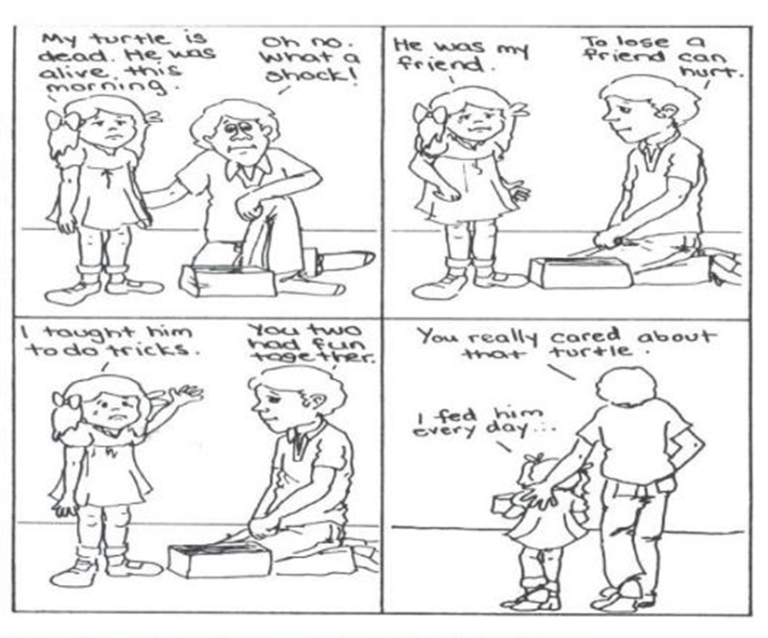
...recognise the feeling and empathise

Slide 11
Effects of dismissing and disapproving styles of dealing with emotions upon children
•Child learns ‘what I am feeling is not right, my assessment of the problem is wrong, I must not feel this way’
•Child does not learn to trust their own feelings affecting decision-making
•Not given opportunities to experience emotions and deal with them effectively so grow up unprepared for life’s challenges.
•Not given opportunities to self-regulate or problem-solve
•Can lead to suppression of natural emotions, less or lack of self-regulation, reliance on distraction to get rid of emotion.
•Generates more negative feelings – resentment, guilt, shame, anger.

Slide 12
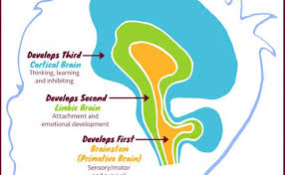

Slide 13
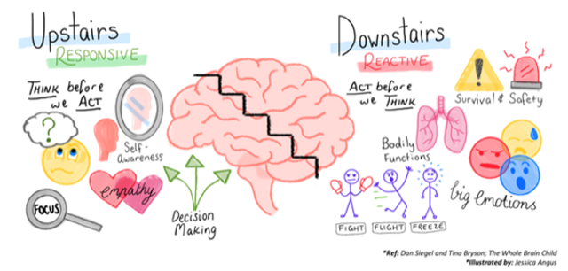
Notes:
Amygdala fires off
Downstairs brain is active
and stress hormones flood the body.
This causes the upstairs brain
to flip its lid.
Amygdala fires off
Downstairs brain is active
and stress hormones flood the body.
This causes the upstairs brain
to flip its lid.When we are in a feeling place we have no capacity to think.

Slide 14
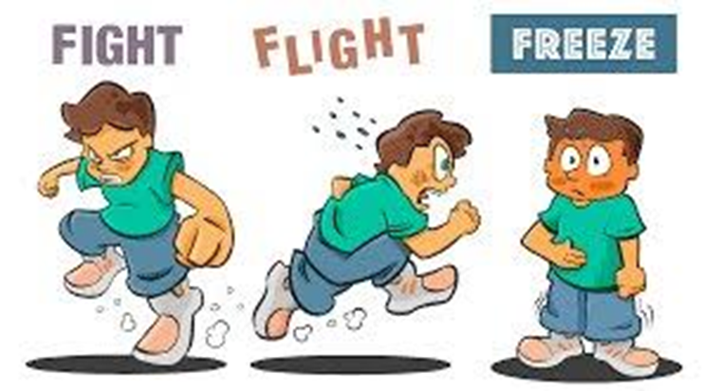
Fight Flight Freeze
The fight flight freeze response is the basic, ‘primitive’ part of the brain (amygdala) that is well
developed at birth as a survival mechanism.​ The instinctive stress responses which are controlled by the ‘primitive brain’ are to:
•Face it and fight (FIGHT)​
•Flee from a dangerous situation (FLIGHT)​
•To freeze (FREEZE)​
This is a normal chemical response in the brain. When this happens the thinking brain switches off and neurological responses focus on getting out of the way of trouble before it gets you.
Adrenaline floods the body which means there are physiological responses; the heart beats faster, pupils dilate, blood flows to large skeletal muscles, breathing rate increases, less blood flow to digestive system. Cortisol (stress hormone) is also released more slowly and can stay in the body for days.
When in a hypervigilant state it does not take much to enter fight, fight or freeze mode. Prolonged exposure to cortisol (particularly during early childhood) can mean that our bodies are physiologically more ready to respond to perceived threats.

Slide 15
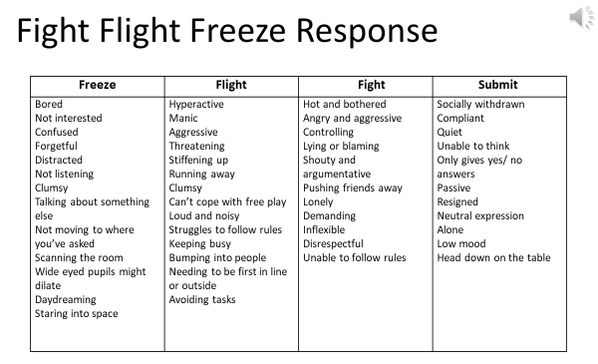

Slide 16
Name it to tame it

Slide 17
Connect and re-direct
Regulate (them and you)
Calm the flight, flight, freeze response
2. Relate
Connect through attuned, sensitive, relationships. Empathise and validate feelings so they feel seen, heard and understood.
3. Reason
Now they are calm and connected, they may be able to engage in reason and learning

Slide 18
Regulate - a way of soothing
How can we help a child or young person feel regulated, not so stuck with negative feelings?
It is impossible to sit still with nervous energy.
Repetitive, sensory or physical activities soothe the stress centre of the brain, such as:
Breathing techniques
Drinking and eating chewy food
Walking
Stretches
Deep pressure

Slide 19
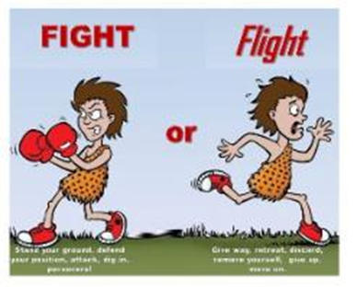
Co-regulation
The lowest part of the brain needs to be regulated first:
A way to do this is through rhythm: Patterned, repetitive rhythmic activities or somatosensory activities:
Fight impulse:
Pushing, deep touch pressure activities
Flight impulse:
Running, jumping, proprioceptive activities
These might include:
Walking, running, dancing, singing, deep breathing, colouring, trampolining, swinging, drumming, tug of war, bouncing on a fitness ball, walking along balance beam, balance board, measuring heart rate…
(Step 1 & 2 of Emotion Coaching – recognising a child’s emotion, empathising with them, labelling and validating the emotion)

Slide 20
“I can see you and I’m going to stay near you to make sure you stay safe”
Grounding and Calming Strategies:
Grounding helps keep someone in the present. It works by focussing outward on the external world. You can think of it as distraction, centring, a safe place or looking outward.
Strategies include:
–Counting breaths in and out, watching clouds, counting backwards from 20
–Counting how many steps they can walk with a beanbag on their head
–Placing a cool cloth to their face
–Playing 54321 game

Slide 21
Emotion Coaching Style
‘Tunes in’ to the child’s emotions
Gives guidance on how to cope with the feelings and what to do
Provides opportunities for learning and reflection
Leads to internal, self-regulation
Notes:
To summarise, these are the key principles of emotion coaching:
We all have feelings and we need to recognise them in ourselves and others.
Empathising with a child’s point of view doesn’t mean agreeing with them, but viewing things from their perspective.
Emotion coaching involves looking for physical and verbal signs of the emotion being felt.
It is safe to engage in a problem-solving process and we can find solutions to our problems
All feelings are natural and normal but need to be regulated and expressed constructively. So although all emotions are ok – not all behaviours are.
Behaviour is recognised as communication and moments of undesirable or inappropriate behaviour are considered to be opportunities for teaching.
Coach when the child is calm enough for words – this means first supporting regulation, the first of the 3 Rs.
Think about how this style of interacting with a child may relate to the feelings of safety being expressed by the children in the videos we watched earlier…
-When a trusted adult is able to make a connection with the child and support them to feel safe, this can help them to learn how to manage those big, overwhelming feelings.

Slide 22
How do we do Emotion Coaching?
Having awareness of your own emotions
“Put on your oxygen mask
first before putting it on the child”
Empathise, validate, understand!
“Proposing solutions before empathising is like trying to build the frame of a house before you lay a firm foundation” (Gottman)
Notes:
The emotional world of the adult involved in Emotion Coaching is as important as the emotions being experienced by the child in their emotional moment.
-Emotion Coaching works best when emotional moments are approached by the adult in a calm and well-regulated manner. -Demonstrating calm in tone, words and body language is important – you are modelling the behaviour you want to see.
-This of course, is often easier said than done, especially when coping with behaviours that may be confusing, anger inducing or unsafe, and also when time is limited.
-In addition to supporting a child to regulate, we also need to be able to self-regulate.

Slide 23
Emotion Coaching – 4 steps
Connect
Tune in to the child’s feelings and your own
Acknowledge
Validate the feeling and label them. Name it, to tame it!
Limits (if necessary)
Remind the child of acceptable/unacceptable behaviours
Make a Plan (together)
Problem solving and finding solutions!
Notes:
is script illustrates how the 4 steps of emotion coaching can be used within an interaction with a child. The ‘Connect’ and ‘Acknowledge’ steps focus on the 2nd R - ‘Relate’, and the ‘Limits’ and ‘Make a Plan’, focus on the 3rd R - ‘Reason.’
The 1st step is to ‘Connect’ with the child by tuning into their feelings. You’ve had to stop doing your favourite activity and I am wondering if that has made you feel angry - I can see you are clenching your fists and your face is red.
The 2nd step, ‘Acknowledge,’ is a further development of step 1 and involves validating and labelling feelings: I’d be frustrated or angry too if I had been interrupted from something I enjoy. Notice too how the adults validates the child’s feeling through normalising.
The 3rd step, ‘Limits’, means setting limits where necessary by reminding the child of acceptable and unacceptable behaviours: It’s ok to be frustrated, it’s not ok to say mean things as it upsets others
The 4th step, ‘Make a plan’, involves problem-solving and findings solutions together: When I feel frustrated, I find it helpful to count down from 20. Let’s try it together now. In this case the adult is also modelling positive coping.
We are now going to look more closely at each of these steps in turn.
-For children with language difficulties, simplifying language is important and using supporting visuals.

Slide 24
Emotion coach when in a calm enough state to hear the language
1. Connect
2. Acknowledge
3. Limits
4. Make a plan
“You’ve had to stop doing your favourite activity and I am wondering if that has made you feel angry - I can see you are clenching your fists and your face is red. I’d be frustrated or angry too if I had been interrupted from something I enjoy. It’s ok to be frustrated, it’s not ok to say mean things as it upsets others. When I feel frustrated I find it helpful to count down from 20. Let’s try it together now”.

Slide 25
Step 1- Connect
Look for physical and verbal signs of the emotion being felt in the child e.g. sighing, fiddling with worksheet, scrunching up face…
Tune in to your own emotion – press the “pause button”; stop and think
Try to take on the child’s perspective – “a moment in their shoes”

Slide 26
Step 2- Acknowledge
LABEL - Use words to reflect back the child’s emotion – this communicates that you understand how they are feeling
e.g. “I can see that you’re feeling a bit frustrated….” or
“I’m wondering whether…..”
EMPATHISE - Use words to empathize or validate the child’s emotion – this communicates that it is OK to feel like that
e.g. “I would feel like that too if….” or “It’s normal to feel like that….”
Allow them to calm down.

Slide 27
Step 3: Limits (if needed)
All emotions are OK
…BUT…
certain behaviours cannot be accepted.
Notes:
‘We can’t behave like that even though you are feeling annoyed because it is not safe’

Slide 28
Step 4: Make a Plan
When the child is calm and ready, it may be appropriate to explore how they could manage those emotions next time they occur.
There are 3 parts to this:
a) Exploring . What happened? How were you feeling when…?
b) Problem Solving. Let’s think of other ways that you could..?
c) Solutions. Next time you feel like that – what will you do?
Notes:
Step 4: Make a Plan
-Emotion Coaching endeavours to teach resilience and step four is important to reinforce the idea that children have the capacity within themselves to develop self-regulation skills to cope with their own emotional worlds.
-In step 4, the Emotion Coaching adult works with the child to consider what they could do when they feel the strong emotions next time.
-Wherever possible, new solutions should be driven by the child, but there are times, especially when the child is new to the process, when some ideas will need to be given about how to control their temper or manage their fears - Developing a calming toolbox.
-For example, ‘I wonder whether it would be a good idea to go to the special beanbag in the corner next time you feel like this? Then I can come and help you figure out how to manage your frustrations next time.’
-We need to scaffold alternative ideas and actions that could lead to more appropriate and productive outcomes.
-Suggesting a next step might be sufficient at times but problem solving could involve many more steps, and be used as an opportunity for learning about self management, social skills etc. - Comic strip conversation approaches fit in well with this step.
-The aim is to empower the child to believe that they can overcome difficulties and manage feelings and behaviour by giving them a choice about how they will respond next time.

Slide 29
We have our own background music for how we experience children’s feelings

Slide 30
