Slide 1

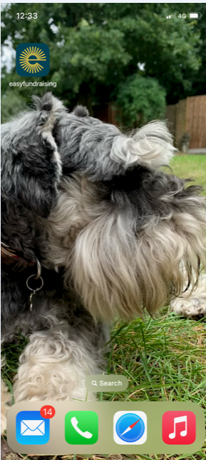


Could you help raise funds whilst online shopping – sign up today
Easyfundraising is so easy to use when you shop online. It costs you nothing, but can raise good amounts of money for us.
There are over 7000 companies involved including Amazon, M & S, John Lewis and many , many more.
It’s quick and easy to sign up either online or using their app.
Google them today!
Easy
to use app
Brands pay a commission because when you start your shop from the easyfundraising website or app, they can see we sent you to them. If you make a purchase, a commission is generated, and we turn that into a donation - magic!
End result – an easy donation to school
When you log into a participating online store it will prompt you - so you just need to tap and continue shopping

Slide 2

School Lottery sign up
Another easy way to support the school is to sign up to the School Lottery - tickets for the lottery cost just £1 per week. There is a guaranteed cash winner for our school every week and the chance to win the £25,000 jackpot. For every ticket you play 76% goes to our school and prizes. Visit schoollottery.co.uk to sign up.
Amazon wish lists on our website
We have just updated our wishlists on the fundraising page of our website – there are now year specific wishlists for you to choose from – if you kindly donate an item from a year group wishlist it will be specifically given to your child’s class / year group when it arrives.
https://www.hamptonhill.richmond.sch.uk/fundraising#donations

Slide 3
We have a jar in the school Reception which collects all foreign currency as well as obsolete currency.
Since it’s inception which Mrs Lane organised and manages for us, it has raised £ 1125 for the school.
Another easy way to raise money without any outlay.
Please do check when you return from a holiday abroad if you have leftover currency you can donate.
And of course if you find any old disused UK currency at home this can also be donated.

