Slide 1
Welcome
Understanding mathematics at primary school
Maeve Duffy
Year 4 Year Group leader
Maths, Design and Technology Subject Leader

Slide 2
Session aims
To gain an insight into the Mastery approach
How it works in our school
Ideas for supporting maths at home
Next steps
Demo of key learning in KS2 (Autumn term)

Slide 3
Our Journey
Primary Teaching for Mastery Work Group.
In our fifth year – ‘sustaining’
This involves workshops, lesson observations, rejigging the way we approach and teach maths to ensure consistency across the school, observations of us.
Working with and mentoring other year groups/ Constant evaluation and reflection.

Slide 4
How did you learn maths at school ?
Did you learn as a whole class?
Did everyone get the same work?
Were resources available?

Slide 5
What’s Changed
since we were at school?
A MATHS MASTERY APPROACH
Mastering maths means pupils acquiring a deep, long-term, secure and adaptable understanding of the subject.
Give pupils the best chances of mastering maths.
Children taught to require a solid enough understanding of the maths to enable them to move on to more advanced material.

Slide 6
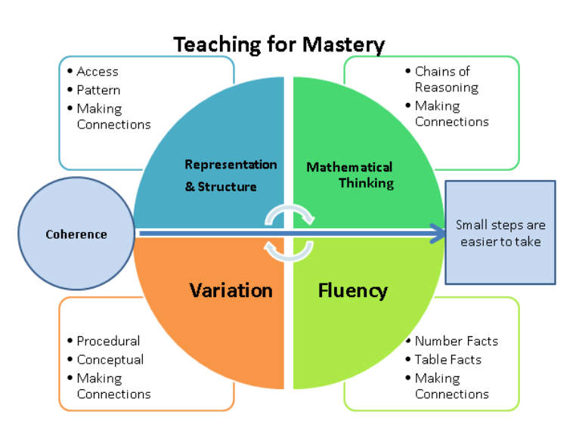
The Five Big Ideas

Slide 7
Fluency: The foundation of everything
“maths fluency” - applying mental arithmetic accurately and quickly.
Understanding of numbers (demo focused on this)
their size
Relationships between them
how they are affected by operations such as adding, subtraction, multiplication and division.
Number facts, times tables, making connections.
More than than just memorisation of facts. It encompasses a mixture of efficiency, accuracy and flexibility.

Slide 8
If children are not fluent in basic facts, then when solving complex problems the working memory is taken up by calculating basic facts and children have less working memory to focus on solving the actual problem.

Slide 9
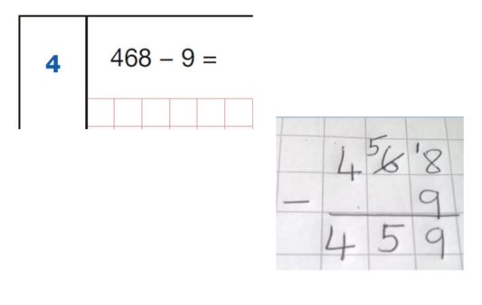
Examples:
Bridging to 10, 100.
Constantly using number bonds and times table and division facts. .

Slide 10
What do we do at school to help with fluency?
Foundations happen in year 1 and 2. We are building on these foundations by:
Daily times table practice- logical order.
Weekly times tables speed test
Fluency is embedded into every lesson.
Efficient (quick and accurate) strategies are modelled and encouraged.
Rainbow Maths

Slide 11
What can you do at home?
TTRS
Daily number bond and times table practice (inverse!)
Resources:
Multiplication Mastered
https://www.thumbsupformastery.com/

Slide 12
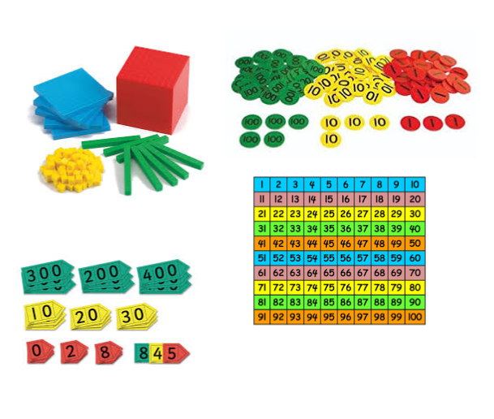
Representation and Structure
l
Manipulatives used to
represent the maths concepts.
This will be shown first hand
by the children later.
Understanding doesn’t happen automatically, they are modelled and used in most lessons
Eventually, the children need to be able to do the maths without the representation. We want to help children move to the abstract (solving the maths with just numbers).

Slide 13
Variation
Variation
Small step by step approach.
Making connections
Pattern spotting

Slide 14
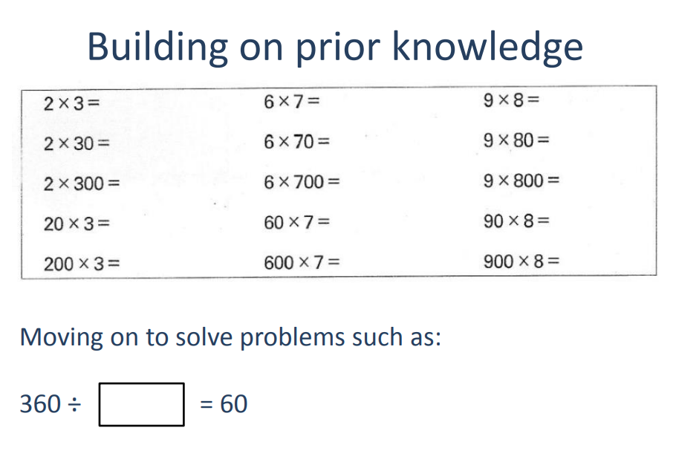
Examples:
‘’ I know 36 divided by 6 is _______ so this answer must be ____times greater. ‘’

Slide 15
Mathematical Thinking
Central to deep and sustainable learning of mathematics.
Whole class discussion
Patterns spotting, looking for relationships/connecting ideas and reasoning logically, explaining and proving.
Repetition used throughout session.

Slide 17
Coherence
Sequencing concepts in a logical order.
Lessons broken down into small steps.
Focussing on one key point in each lesson allows for deep and sustainable learning.
REVISITING as much as possible (revision at the start of lessons).

Slide 18
Most importantly, how does this benefit the children…

Slide 19
How does this benefit the children
Teaching for mastery in maths rejects the idea that a large proportion of people ‘just can’t do maths’.
It looks to build confidence and to show children that with hard work they can succeed.

Slide 20
Will children who find maths difficult be left behind?
Aims to ensure all children have a secure and deep understanding of maths, by building up maths concepts in small and logical steps.
They use mathematical vocabulary freely, don’t mind making mistakes and get used to explaining what they’re doing.
Everyone contributes, but no one dominates.

Slide 21
How will children who are already doing well in maths be challenged?
Emphasis on depth and breadth, not speed and acceleration.
Challenge children who grasp concepts quickly are provided with relevant sophisticated problems, rather than by accelerating them through new content from other year groups.

Slide 22
What can you do?
Tips for helping at home
Its important to help your child develop a growth mind set in mathematics
Maths is not just about getting things “right” every time.
A lot of maths involves problem solving which is not a quick and easy exercise - pupils need to build up persistence and resilience.
As a parent - encouraging mistakes being made and viewing this a normal learning process, rather than a negative experience.
Support children with any activities they bring home. Take care to look at the methods and models being used at school.

