Slide 1

Year 6
Meet the Teachers
September 2025

Slide 2
Meet the team:
Miss O'Connor
(year group leader) 6OC
Mrs Crinnion
(Tuesdays)
Miss Delaney 6D
Miss Manning 6M
We do not have a general class LSAs but we do have a small number of LSAs in the year group who are allocated to support particular children as guided by the SENCO.

Slide 3
Expectations in Year 6
Independence
Role models for the younger years
Ready to Learn
Resilience
Part of whole school life
Setting an example every day
Engaged in learning
Growth Mindset
Leaders
Responsibilities
An exciting, pacey year of huge positive, personal growth.

Slide 4
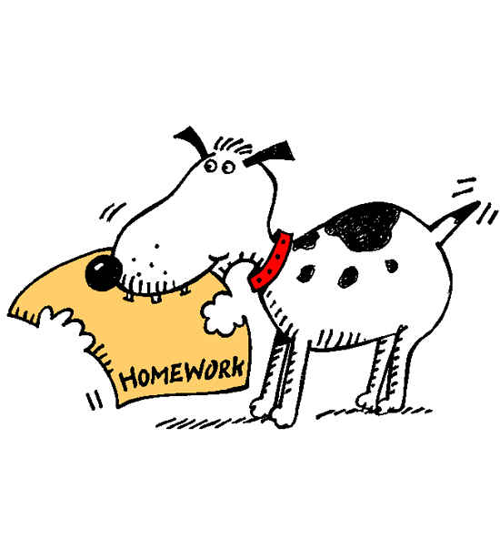
Homework
English
Weekly spellings (set Mondays)
Reading daily
Home-school diary signed daily and used (due in every day but will have a checking day)
Readtheory (log-ins to follow).
Topic Project due in October. (Migration to be set soon)
Maths/Grammar/Reading homework set on Mondays and due Mondays (after half term) These will be set in SATs revision guides.
Maths
Times tables (Miss Manning set)
Revision guide activities (later in Autumn term)
Please don't do past SATs papers 2023-25 as we use them to guide us.
Topic related research set now (Migration)
From Autumn 2- revision guides will be given out for pupils to use. Sometimes these will be set as homework.
PLEASE CHECK COMMUNICATIONS via Arbor

Slide 5



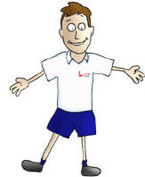
*Handwriting pen (blue not biro) /frixon pen for writing up English work
*Pencils
*Ruler
*Small Pritt stick
Eraser
sharpener
Please name all equipment
Reading book – every day.
Equipment
Healthy snack
Water bottle
Trainers for PE days only
*No jewellery/wristbands (small earring studs allowed).
*Healthy snack - keeps children going until lunch

Slide 6
Expectations!
We will continue to aim for the highest standards for our children.
Spelling, reading, any homework is expected to be done every week to the child's best possible standard.
PE kit for every PE lesson. (spare used stock will be given to wear ‘if available’ on that day).
Diaries in every day. Reading to be logged and must be in on the diary day. We will stamp it once a week.
An aspirational attitude is essential.
Work hard and be the best version of yourself.
Super, smart school uniform. Please support us with this. If you are struggling financially with the school uniform, please speak confidentially to us. If you qualify for PPG we might also be able to help.

Slide 7
How you can help at home
Reading/read to your child (listen or just encourage/oversee)
Times tables (Times tables -the school website has maths website resource links) We have rhymes too. All times tables should be fluent by the end of year 4.
Spelling (set on Mondays, tested on Mondays- 30 points spelling contract)
Support homework and presentation of work.
Encourage a positive attitude and resilience (I can't do it....yet!)
Encourage independence.
Please help us by supporting our policies (h/w, uniform, behaviours, attendance).
Be proud of our school and being part of our community outside our gates and around the community / parks etc.
Please support our fundraising efforts- joining in.
Plenty of sleep

Slide 8
Why is there a decline in reading for pleasure?
Games and online distractions
Rise in social media
Find books boring
Lack of time
Not being read to from an early age by adults (at home and school)
Seeing reading as a process for learning rather a pleasure activity
‘Reading for pleasure' is being confused with 'literacy' by many parents at home who commonly don't realise that the more it's pushed as a school subject, the less likely a child is to choose to do it. In the school environment, the national curriculum focuses on reading skills above reading pleasure. However, when pleasure drives reading, children achieve more.

Slide 9
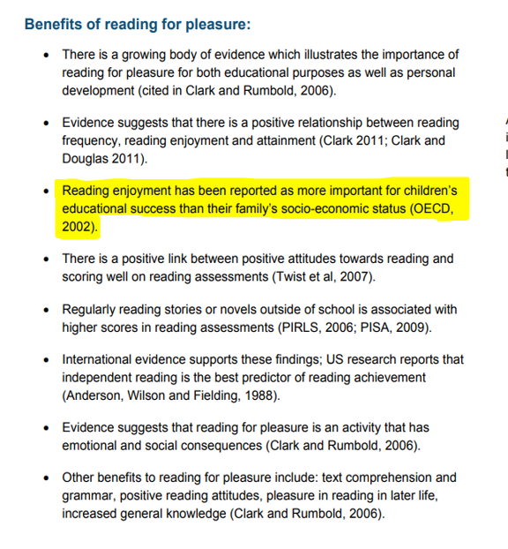

Slide 10
Impact of reading
Amount of reading | 20 mins | 5 mins | 1 min
Number of minutes per year | 3600 | 900 | 180
Number of words per year | 1.8 Million | 282,000 | 8000
Hours read by the end of primary school | 851 | 212 | 42
Performance on tests | 90% | 50% | 10%

Slide 11

Reading improves teenagers’ vocab,
whatever their background, say researchers
NEWS
22 November 2017
Teenagers who read in their spare time know 30% more words than those who don’t read much nor ever.

Slide 12
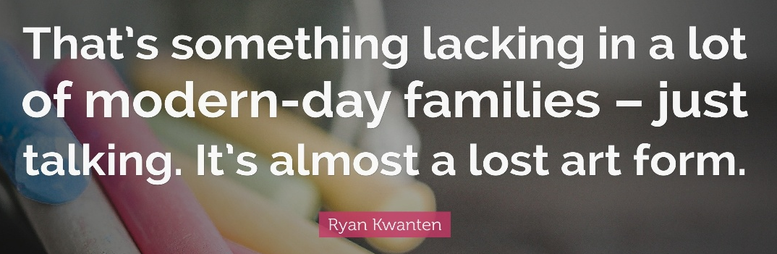
What you can do to help develop comprehension…
Comprehension of the world will develop comprehension in reading…
Ways you can develop comprehension –
Talking a lot at home… about everything
Develop cultural capital by going out (this does not have to cost money)
Reading together and discussing books together
Why do you like this book?
What do you think will happen next?
What do you think about this character?

Slide 13
Three ways you can help build fluency at home…
Read and follow – the adult reads the text and the child follows along with their finger. This helps the child with word recognition and models to them how they should read with fluency.
My turn, your turn – take turns reading a page or a paragraph. Here you are modelling how to read with fluency, flow and expression.
Echo Reading – as you read, the child copies. It is important here to pace yourself and read at a rate that your child can keep up with.
Let’s have a go!

Slide 14
Typical year 5 / 6 spellings
embarrass
conscience
parliament
accommodate
guarantee
privilege
necessary
pronunciation
Times Tables
By year 4, all pupils are required to know their times tables up to and including 12x12. These should be able to be recalled quickly and out of their order. The corresponding divisions should also be known. Please work with your child to help them achieve this level of fluency which will make all of their understanding in maths easier for them.

Slide 15
Behaviour Systems
Every child should aim to get team points and raffle tickets during the week. The class teacher will set the 'focus' for that week.
eg: kindness, focus, quality of work, starting
promptly.
Focus on the positive!
Team points from staff for good behaviour around the school
Recognition in class to highlight good behaviour.
Range of rewards for behaviour both for individuals and groups/classes.

Slide 16

Polite reminder:
You are responsible for your child's mobile phone and the messages they send and what they are able to read.
Please help us to protect your child and others from inappropriate use of the mobile and messages.
Whatsapp – for aged 13 and over
Smart Phone free school so please fill in the new permission form sent out via Arbor

Slide 17

Dates for the Diary so far
Swimming – starts 18th September
Junior Citizenship- (Twickenham) – 2nd October (pm-we might be a bit late back- 3.45pm approx)
Individual and sibling photos – 9th October
Parents eves – week of 13th October – Monday (6OC) and 16th October (Thursday) tbc
Hampton Court Trip – 23rd October
School Journey (Swanage ) - 29th June – 3rd July.
Cycling Proficiency - Spring term (starts Feb 2nd)
Classes will be split into 15 pupils per session and letters will be sent beforehand.
A working and correctly sized bike/helmet needed all of the relevant week.

Slide 18
Year 6 Sats 2026
Week beginning Monday 11th May until Thursday 14th May 2026
An information evening will be held in early Spring term.
Tests will be in SPAG, Reading, Maths.
Writing is teacher assessed and moderated by the LEA Moderators.

Slide 19
Secondary school applications deadline
October 31st 2025
Contact the relevant schools for their open days/evenings/ procedures for this.

Slide 20
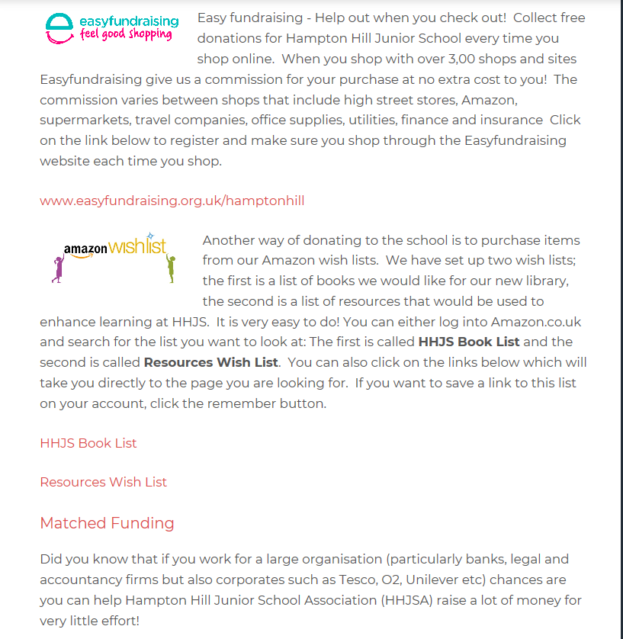
Fundraising – please help our school raise funds

Slide 21
PPG- Pupil Premium Grant
Parents/carers are eligible for it if:
1. pupils are registered for free school meals
2. have been registered for free school meals at any point in the last 6 years
3. are or have been in care
4. parents are in the armed forces
Benefits of the funding-it helps provide any extra support for the children so they can fulfil their full potential. We can also help fund school trips, residential trips, after school clubs and music lessons for those children.
Children will not know they receive the grant- it’s confidential amongst the adults who need to know.

Slide 22
Any questions?
Don't forget, if you want anything clarified or you are unsure of something, however small, just ask! Use the home-school diaries or student@.....
At present, we will be using a stamp to mark the home school diaries so if there is a message in the diary for your class teacher, please tell your child to tell them – thank you for your support.

