Slide 1
Supporting Your Child's Transition
Lorraine Blake - SENCo at Carlisle Infant School
Tracey Bannister - SENCo at Hampton Hill Junior School
Joseph Digger – Mental Health Support Team
MENTAL HEALTH SUPPORT TEAM (MHST)
Emotional Health Service
Achieving for Children
42 York Street
London TW1 3BW

Slide 2
Introduction to the MHST
The Mental Health Support Team (MHST) is an early intervention, multi disciplinary team of clinical specialists, mental health clinicians and education wellbeing practitioners (EWP) who provide mental health support to children, young people, families/carers and staff in school settings, within Kingston and Richmond. The teams are delivered by Achieving for Children as part of the Emotional Health Service.

Slide 3
What is this workshop all about?
This workshop aims to help you support your child’s transition to their new class or school.
We will consider:
Why change can be challenging for some
What common worries can be for children and their parents
How to support your child with worries
How to prepare your child for September
Notes:
Reasoning behind the workshop -

Slide 4
Why can change be challenging?
As human beings, we like predictability. We like our routine. It helps us to feel relaxed as it reduces the amount of thinking, predicting and preparing we have to do.
When change happens, our routine changes. This can be destabilising at times due to unpredictability. If we predict negatives in our future, it can bring on a sense of anxiety.
Is this something you can recognise in your child?
Overestimation of threat
Underestimation of ability to cope
Anxiety =

Slide 5
Moving into a new Year/School…so what?
There are some differences that children will need to get used to as they transition:
A new approach to learning.
New teachers and teaching styles.
New classroom and new entrance to the school.
Some differences in expectations, rules and routines.
We want this to be a positive transition
To better understand why this is so significant leads us to look at attachment theory.

Slide 6
School as the secure base
In addition to their primary attachment relationship with you. Your child also forms an attachment to their school and this acts as an additional secure base through:
Providing safety
Providing emotional security in fear-provoking situations
Promotes opportunities for social contribution
This enables school to be a place where they can feel safe to explore and their learning can thrive.
Starting a new year means that some of the safety and security they felt in their previous class is gone, and a new relationship must be established. This can take some time and whilst they learn to feel safe in their new environment, some uncertainty and unsettled emotions are normal.
Notes:
This is of course a lot more significant when they move into secondary school - but for a lot of children starting a new year/new teachers can take time.

Slide 7
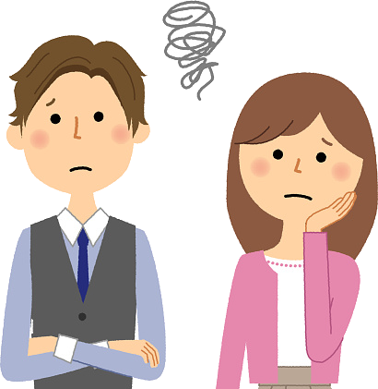
What are the usual worries of changing year group?
What do think common worries about changing year groups are for children?
What are your worries as parents?

Slide 8
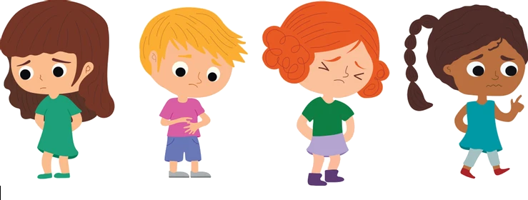
Understanding worries, fear and anxiety
All humans experience fears at different points in their lives. This is a normal part of development.
A moderate amount of anxiety helps us to do well. Too much or too little anxiety keeps our performance lower. E.g. some anxiety is needed to be prepared for your first day and remember everything you need but too much might lead someone to procrastinate and end up not preparing at all.
Therefore keeping worries at a manageable level is important. We can do this through supporting children to use a range of strategies that help them to avoid becoming overwhelmed.

Slide 9
The Cognitive Behavioural Model
The CBT model can help us understand how worries can form a vicious cycle BUT also how we can best intervene and manage worries
Thoughts
Behaviours
Feelings
Physical responses

Slide 10
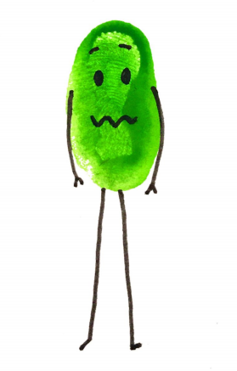
A vicious cycle
These responses create a vicious cycle that maintain anxiety
Thoughts
“Something bad might happen to me”
“What if my parents don’t pick me up from school?”
Behaviours
Avoid school
Check parents’ plans
Reassurance seeking
Feelings
Anxious
Worried
Sad
Physical responses
Heart racing
Shaky
Feeling sick
Headache

Slide 11
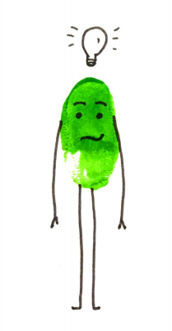
How can we help?
We can help by intervening at all 4 levels…
Thoughts
Behaviour
Physical responses
Emotions

Slide 12
Intervening at the level of…
Emotions
We do this through providing time and space to listen and talk about feelings.

Slide 13
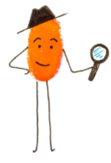
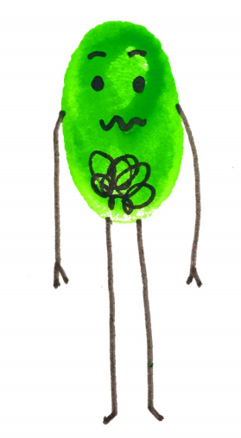
Emotions
Be a detective…
Children do not always tell us how they are feeling but paying attention to their behaviours can tell us a lot:
Notice the behaviour, be curious about what is happening for them.
Wonder aloud about what might be happening for the child
Name feelings around events
Notes:
We are going to start with emotions
You may see that your child is more prone to ‘tantrums’ or behaviour is presenting more challenge. Younger children do not always make the connection between what they are thinking and how they are feeling and we see it demonstrated in their behaviour instead.
We need to support them in making the connections by framing them in language.
This supports their emotional literacy and helps them to recognise their feelings in situations like this in the future.

Slide 14
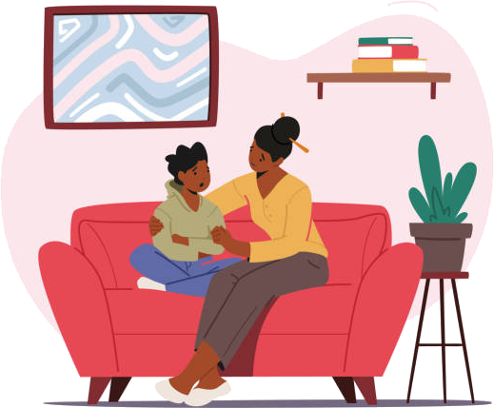
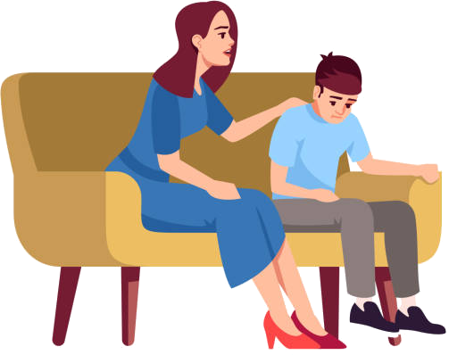
Talking tips: The conversation
Remember: You don’t have to fix the emotion, or solve the problem, simply listening and acknowledging is often enough.
Asking questions – being curious:
“I wonder if you’re feeling ______ ?”
“I wonder if you’re worried about ______?”
“I imagine that would feel ________”
Empathising
Normalising, making suggestions
“lots of children feel / think about ______ when they are worried. Is that like what’s going on for you?”
Check their understanding
“does that make sense?” but also yours – “have I understood that you feel ______ because of ______?”
Labelling emotions
Notes:
Asking questions – being curious:
This will elicit a deeper conversation than are you okay and provide understanding and hopefully a possible solution.
Empathising
We want to empathise and show understanding to the emotion without sympathising or agreeing with danger around situation (e.g. not ‘oh wow, going to school is really scary!’ but ‘Those sound like some really difficult thoughts / feelings to be having’
Normalising, making suggestions
Sometimes children can be reluctant to talk about their worries and may need some help to know that their worries are normal, or to start the conversation - if you aren’t quite right, they’ll usually correct you with what they’re actually thinking/feeling
Check their understanding – “does that make sense?” but also yours – “have I understood that you feel ______ because of ______?”
Labelling emotions which again will add to their emotional literacy skills.
This can be as simple as naming emotions, but there are other ways such as having a worry jar or worry monster, or somewhere else to write or draw worries and feelings, which I’ll talk about more on the next slide.
Make it fun or rewarding, if this is something they struggle with or haven’t done a lot of before making it fun or rewarding with charts or rewards will motivate them to have these conversations

Slide 15
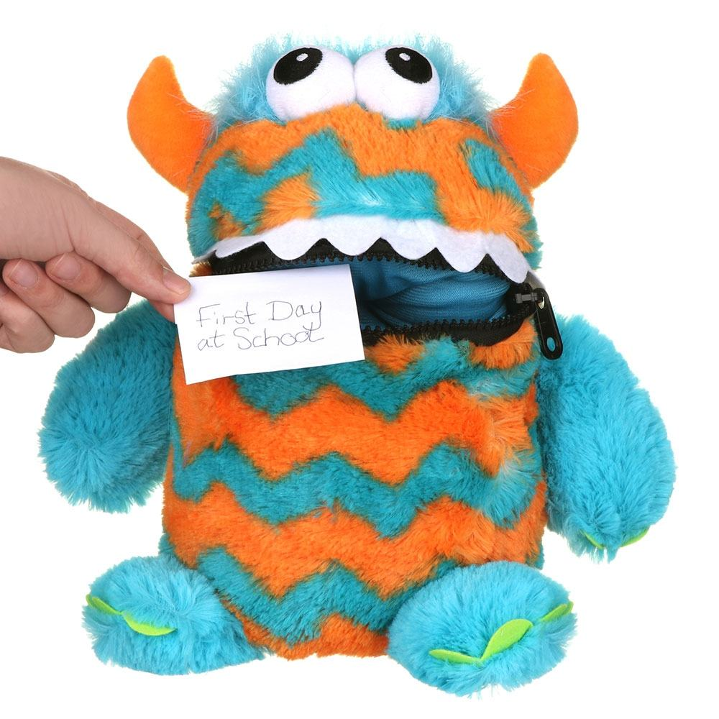
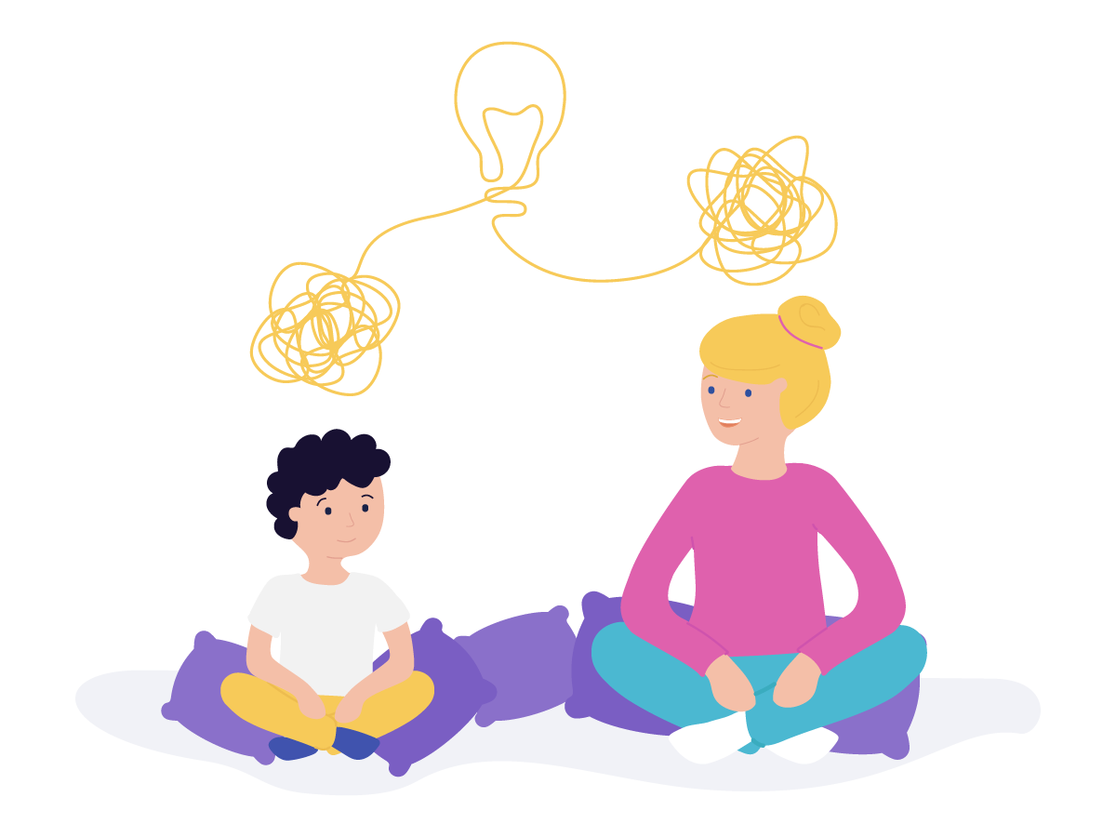
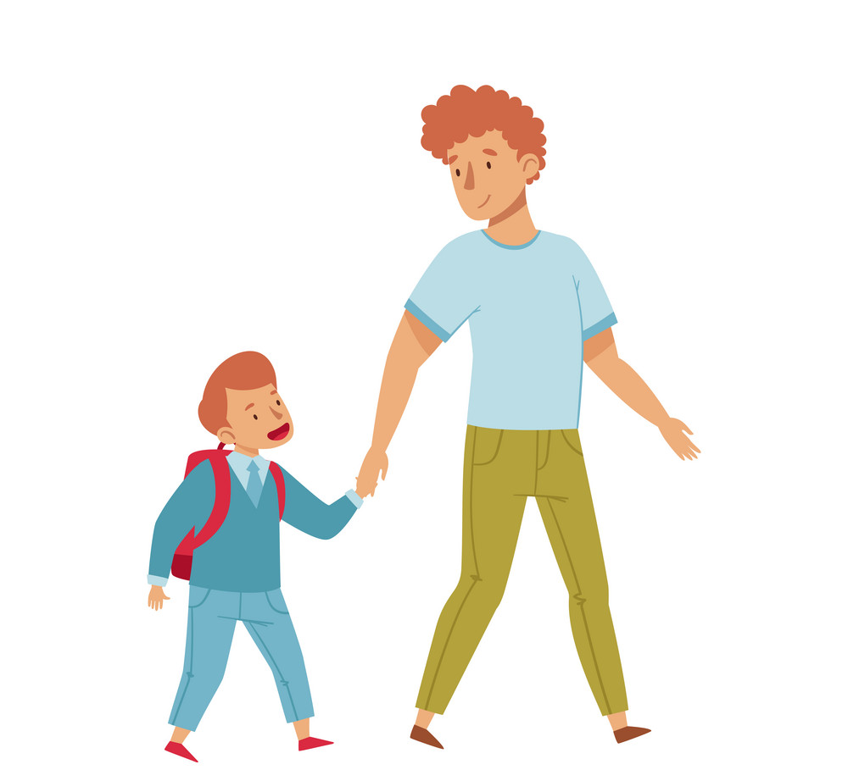
Talking Tips
Emotions
Pick your moment & make it rewarding
The ‘right’ time will differ for everyone
Talking about worries can be hard, scary, or boring - what might make it more appealing for your child?
Notes:
Pick your moment
Sitting down to talk about thoughts and feelings will work well for some children
For other children, it can be easier to talk at other times when it doesn’t feel like the attention is on them e.g. on a walk, in the car, while cooking
Don’t feel the need to get the answers straight away - you can try a question here, and a question there
Make it fun or rewarding
This can be hard, scary or boring - try to find ways to make it more appealing
For younger children - use dolls, cartoons, toys, drawing
For older children - perhaps combine with a trip to their favourite cafe
Suggest that once you’ve talked for a bit you can watch a film they like, or play a game together

Slide 16
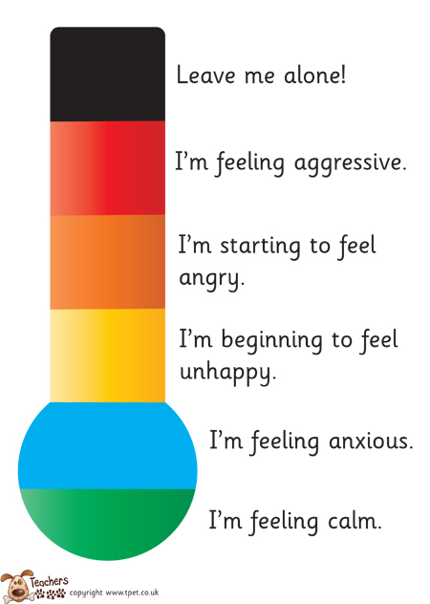
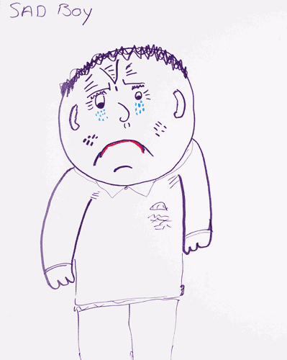
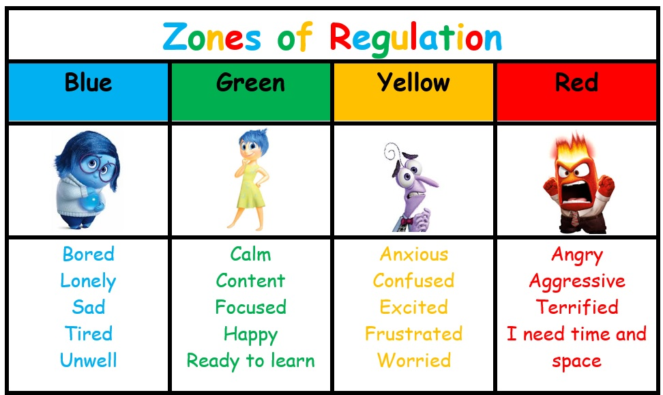
Be creative

Slide 17
Intervening at the level of…
Thoughts
We do this through utilising thought balancing and thought challenging

Slide 18
Thoughts
Thought balancing
In addition to reflecting on worries it is helpful to invite children to think about what they are looking forward to:
After school clubs – New topics – school trips
This supports worries to be acknowledged but also balanced out by more helpful thoughts and positives

Slide 19
What if? – Then I can!
Thoughts
Sometimes worries start with ‘what if…?’ questions. These questions do not usually get answered and instead continue to spin round in our minds and end up making us feel more worried.
It can help to support children to think about some ‘what if?’ worries and then come up with a ‘then I can…’ solution, by thinking about what they have done in similar situations that helped previously. This can help children to feel more confident that even when we have worries, there is a way they can cope with the challenges they are facing.
‘What if…?’ worry
‘Then I can…’ solution
What if I don’t understand in the lesson?
Then I can put my hand up and ask the teacher. They will be happy that I am playing attention and asking for help. Everyone gets confused sometimes. School is about learning!

Slide 20
Intervening at the level of…
Physical responses
We do this through utilising relaxation strategies and exercise

Slide 21
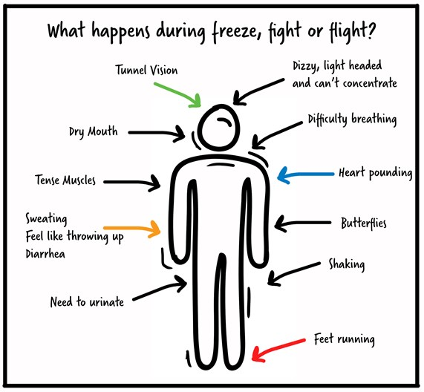
What does anxiety feel like in the body?
Notes:
Change - important - awareness

Slide 22
Notes:
Introduced toolbox in the workshop - we all need our emotional toolbox -

Slide 23
Emotions & Behaviours
All feelings and emotions are important. It is very normal to feel a mixture of emotions.
No matter what the emotion is, it is always important to validate, normalise and show understanding.
It is key to separate emotions from the behavioural response.
That is why it is important to grow our emotional awareness and remind ourselves of our toolbox…
Notes:
All feelings and emotions are important. It is very normal to feel a mixture of emotions.
Often we can categories emotions into negative and positive. Some negative emotions may be anger, jealousy or sadness. Compared to happiness, feeling calm and relaxed or excited. The key message that we would like to send to children, and ourselves is that…
No matter what the emotion is, it is always important to validate, normalise and show understanding.
A really common example is Jealousy. We have all felt jealous. It is a very normal emotion. Often we can automatically push or deny certain emotions, “Oh you shouldn’t feel jealous. There isn’t any reason for you to feel jealous. You are as good at running as your brother”. It is very difficult to stop feeling a certain way. Often by feeling validated and understood by others that emotion can feel a lot smaller.
It is key to separate emotions from the behavioural response.
That is why it is important to grow our emotional awareness and remind ourselves of our toolbox…

Slide 24
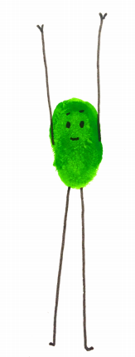
Physical responses
Progressive muscle relaxation
(relaxing stretches)
As we noted worries can have a physical impact on our bodies and often lead to our bodies becoming tense. Focusing on alleviating this tension can support our body to send a signal to our brain letting us know we are relaxed and safe. This can help us to think more clearly.
Taking different body parts and tensing and relaxing them helps to do this. If you want to be creative you can encourage children to use their imagination to make it more enjoyable for example….

Slide 25
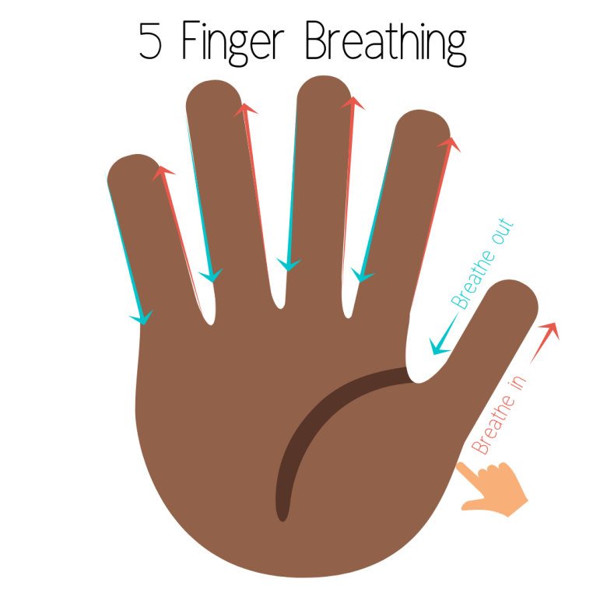
Physical responses
Deep breathing
Deep breathing is another excellent way to help re-set our bodies and keep them calm when we are feeling worried. Giving children something concrete to focus can make this easier.
Remember to remind them to breathe in through their nose and out through their mouth

Slide 26
Physical responses
54321 Grounding
When we are feeling worried we tend to be worrying about something that has happened in the past or jumping way in to the future. It can be helpful to reconnect to the present moment and environment. One way to do this is through our senses.
The 5 4 3 2 1 exercise is a grounding activity that invites us to notice:
5 things we can see
4 things we can touch
3 things we can hear
2 things we can smell
1 thing we can taste

Slide 27
Intervening at the level of…
Behaviours
We saw earlier that the most common behaviour in the anxiety cycle is avoidance. To overcome anxiety, we need to do the opposite - face our fears with exposure to situations that make us feel anxious.

Slide 28
Behaviour
This is going to be AWFUL!
Overestimation of threat
Underestimation of ability to cope
Anxiety =
I won’t be able to handle this
Notes:
Thinking back to the anxiety equation - exposure allows children to learn that the situation isn’t as bad as they’re thinking, and that they can cope better than they think.

Slide 29
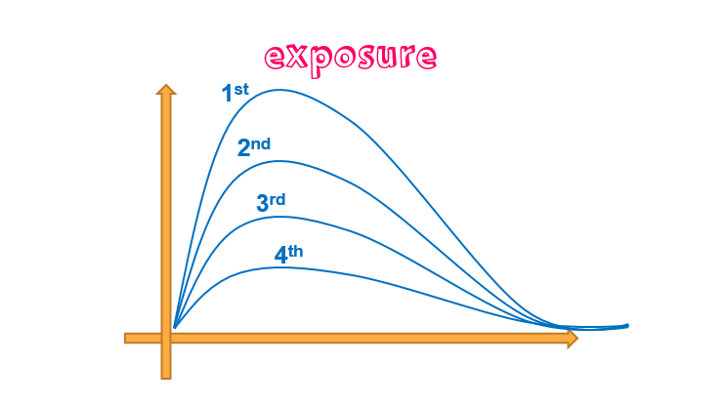
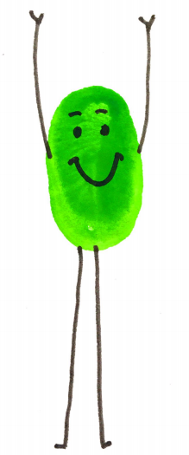
Behaviour

Slide 30
Behaviour
Graded exposure
A step by step approach
Notes:
However, it is important that you do this gradually in a step by step approach to make sure they do not feel overwhelmed.
This is called graded exposure.

Slide 31
Behaviour
The step by step plan
Step | Fear Rating | Reward
Ultimate goal: To walk through the KS2 gate alone | 10 | Trip to the cinema
Walk through the KS2 gate alone 2 / 4 days a week | 8 | Watch favourite TV programme
Walk through the KS2 gate with parent halfway | 6 | Pizza night with family
Walk through the KS2 gate with parent | 5 | Cycle ride with Dad
Walk through the KS1 gate alone 2 / 3 / 5 days week | 4 | Bake a cake with Mum
Walk through the KS1 gate with parent | 3 | Ice cream
Notes:
Blank background for animations. - Changing gates - using the other gate

Slide 32
Behaviour
See your resource pack
How to: the step by step plan
Decide top goal and rate the anxiety for the situation (0-10)
Think together of smaller steps to take towards fear
Rate these steps (0-10) and place in order from least to most anxiety provoking
Attach rewards that are suitable to each step
Begin on first step on ladder, repeat as many times as needed to feel comfortable
If a step feels too hard – think of a step below that would be slightly easier but still challenging
Rate each step again after you’ve completed - is it lower than their original rating?
What have they learned from carrying out this step?
Continue to the next step
Notes:
In your resource pack you can find this guide on making a step by step plan with your child

Slide 33
Building Confidence
Promote independence- can they start doing a few more things for themselves or to help you out?
Can you help them to push their boundaries gently (trying new foods, going to new places)?
Model trying new things yourself and having a go at unfamiliar situations- model being positive about trying new things.
Point out and label times when your child has been brave- try recording these times to reflect back on- stick them to fridge or on display in their room
Identify something small that they want to get better at and work towards this slowly over the summer- record the progress.
Notes:
Engage parents with ideas about what they can do to support building independence.

Slide 34
Summary
We have focused on the four core areas of the CBT model to help children with the transition into Year 3:
Feelings
Thoughts
Physical responses
Behaviours
Notes:
So, we have focused on the four core areas of the CBT model to help children and young people manage feelings of anxiety.
Feelings: We introduced the talking tips such as asking questions, always being curious, making suggestions and labelling their emotions.
Physical response: Introduced deep breathing techniques to use in moments of distress and worry.
Thoughts: Noticing and understanding their worried thoughts to then encourage positive coping self-talk.
Behaviour: Reducing the behavioural avoidance by facing their fears in a gradual safe way by creating the step by step plan.

Slide 35
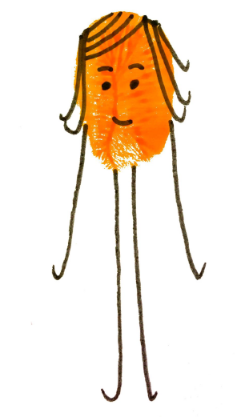
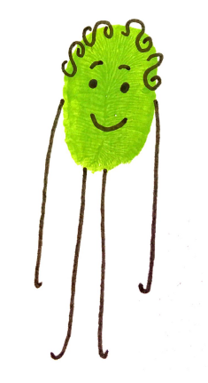
Looking after yourself

Slide 36
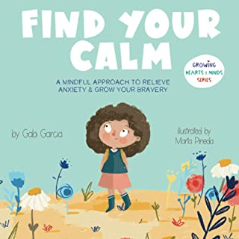
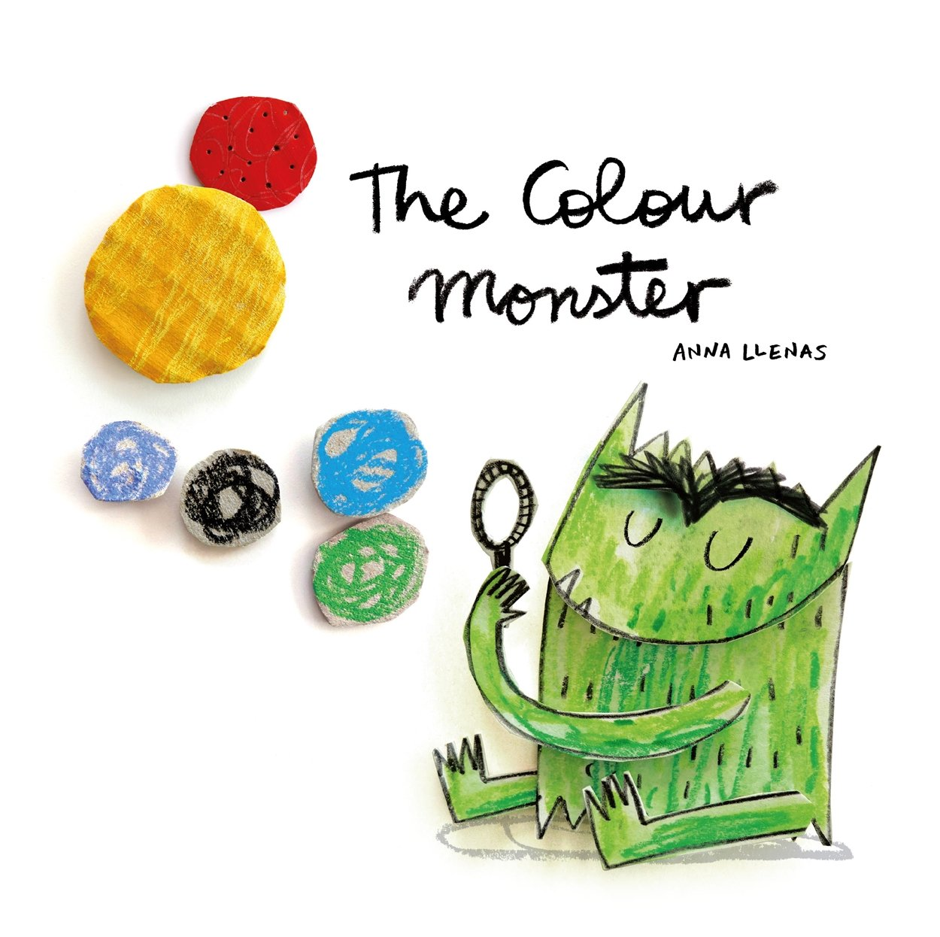
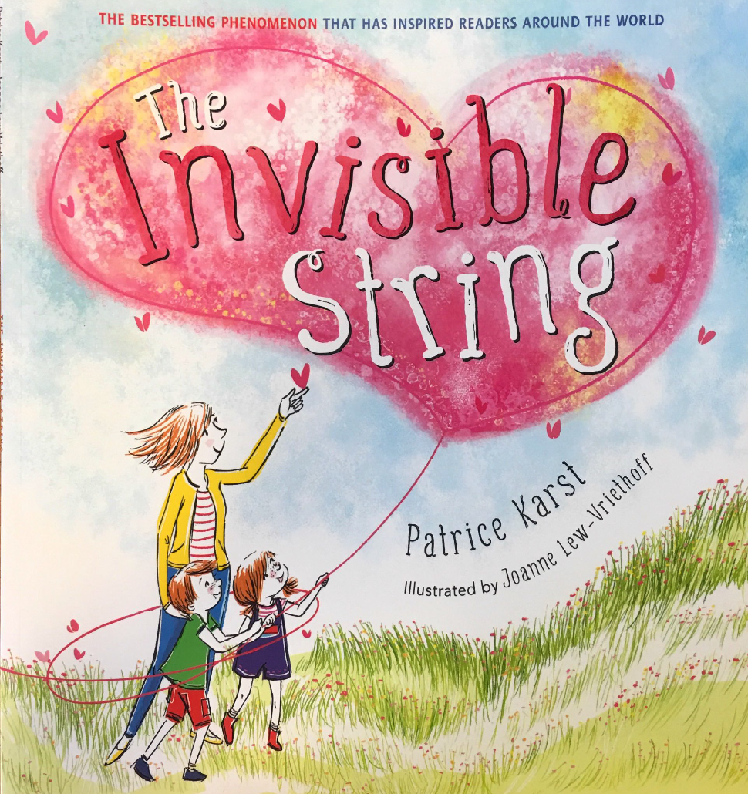
Check your local library…
Resources

Slide 37
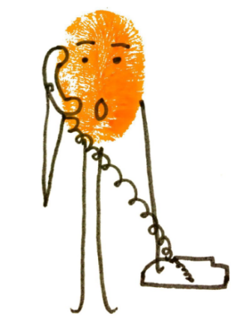
Seeking further support
If you are worried about your child’s wellbeing make sure you ask for help.
Who should I ask?
Speak to your schools - Mental Health Leads
Speak to your GP
Call the Single Point of Access for advice or to make a referral
You can contact SPA to request support, or to report a concern about a child or young person.
From 8am to 5.15pm, Monday to Thursday, and 8am to 5pm on Friday call 020 8547 5008
Out of hours, phone 020 8770 5000

Slide 38
Notes:
Explain worksheet for parents to complete with their children…

Slide 39
How can school support this secure base and successful transitions?
Reception and Year 1 Transition visits:
New class teacher visits children in their current classes to share a story
Children visit their new teacher and classroom for an activity
Children visit their new teacher and classroom for a whole morning ​
Transition passports are given to all children on the SEND register – these will be sent home so they can be shared frequently with your child over the Summer holiday.
Transfer of Information - class teachers and SENCo
Pupil Profiles and SEN Support Plans (Individual Education Plans) pass on helpful information about children to their next class teacher.
Regular informal visits to new classroom to allow children to explore and become familiar with key locations (coat pegs, toilets, door for home school transition).
Opportunities to celebrate and share children’s work with new key adults.
Small transition groups – Mental Health Support Team and school staff deliver these.

Slide 40
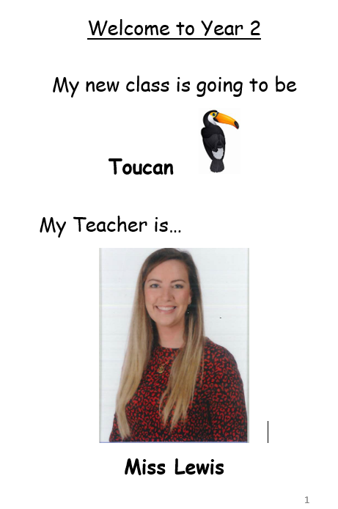
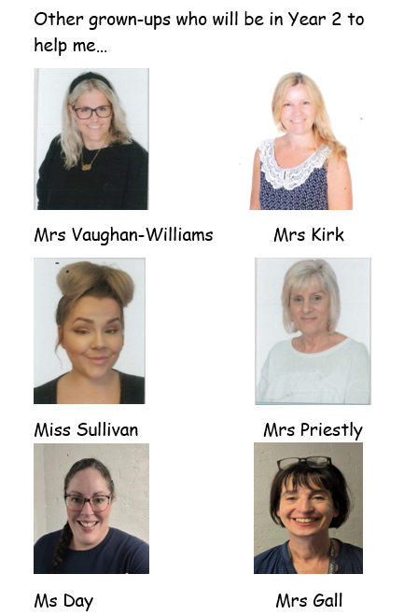
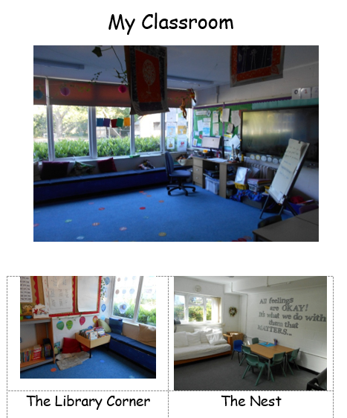
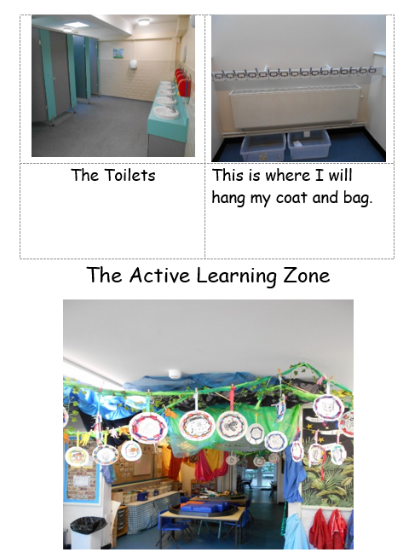
Transition Passports

Slide 41
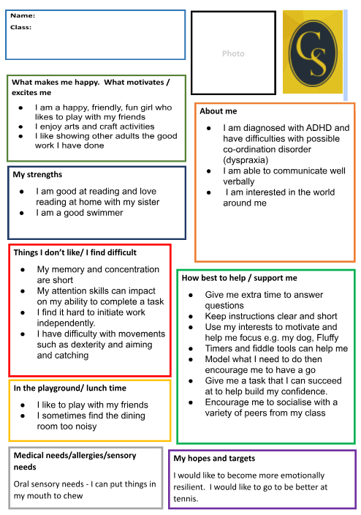
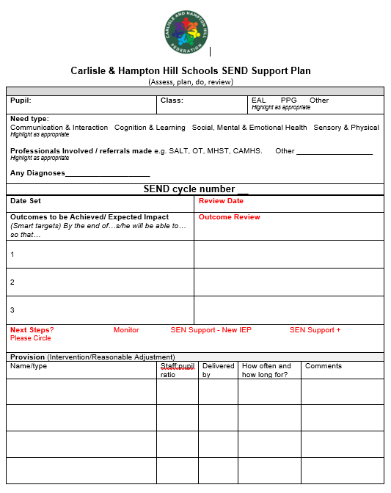
Pupil Profiles and SEN Support Plans (IEPs)

Slide 42
How can we support the transition to HHJS?
Year 2 Transition visits:
Enhanced transition tour offered for some children
Visits to HHJS for all children
Year 3 teachers visit children at Carlisle Infants
Year 3 Friendship Buddies talk to Year 2 in assembly
Transfer of information meetings (class teachers and SENCOs)
All children receive a transition document to support their move to Year 3. Additionally for children with an EHCP, they will have a photo sheet with their key adults, including lunchtime and playtime cover if required. These will be sent home so they can be shared frequently with your child over the Summer holiday.
Year 3 have exclusive use of the adventure playground in their first two weeks in September to support their transition and lunchtime ‘Friendship’ Club is open to all pupils every lunchtime.

Slide 43
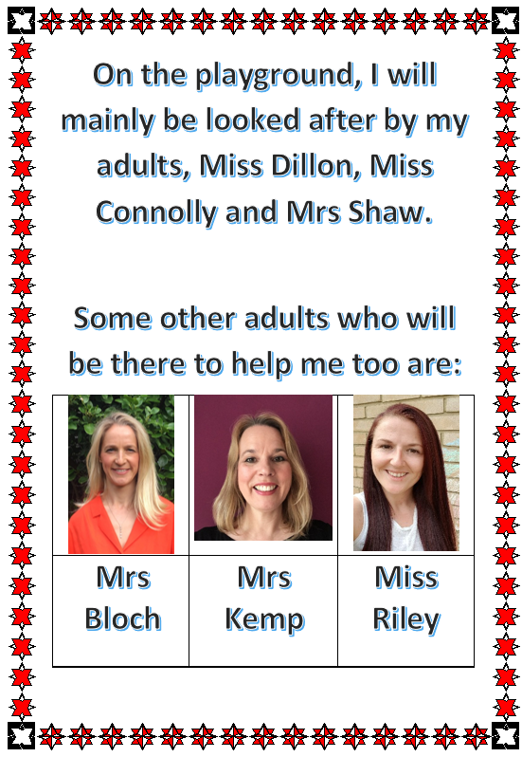
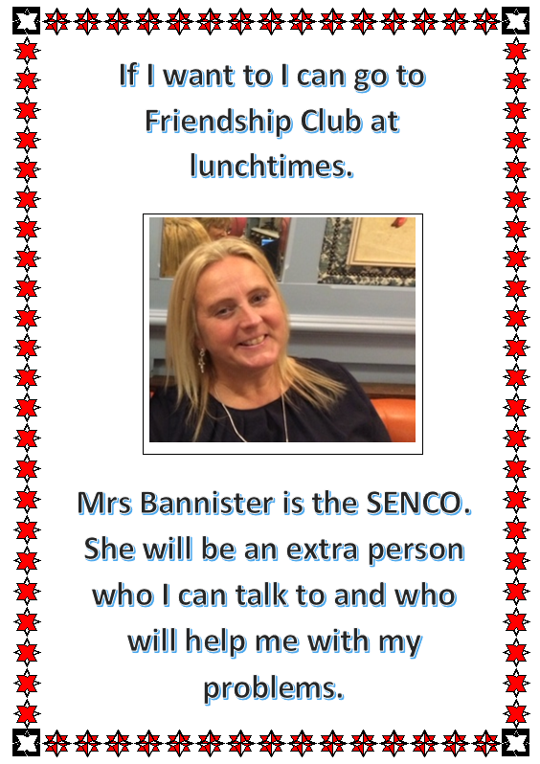
Transition Tools

Slide 44
Thank you so much for attending today!
Questions and Feedback
Please complete a feedback form

