Slide 1
Welcome
Year 2 Families
Information Meeting
Alysia Lewis Octavia Fadil Laura Irwin Linda Holloway
Natasha Vaugh-Williams Rachel Kirk
Roisin Sullivan Zoe Kaill Leanne Day Tina Priestly

Slide 2
Punctuality
Learning begins in school from 8:55am
Gates close at 9:00am and children must then come through the front entrance to ensure they are in class A.S.A.P.
Absence
It is essential that your child is in school whenever possible
If there is a reason your child is unable to be in school, please contact the school office before the school day begins to inform them that they will be absent and why.
Timetable
Morning routines
Afternoon routines

Slide 3
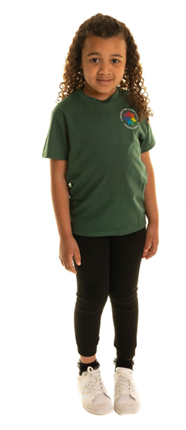
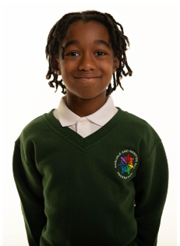
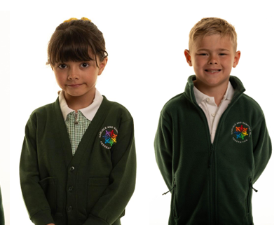
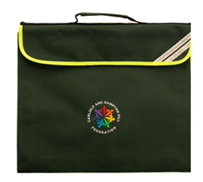
Full Uniform
School Uniform
www.schooldaysllp.co.uk
P.E. Days
Book Bags/Smart Sacks
Notes:
Children must wear: ● Whitepolo shirt ● Bottle green Carlisle and Hampton Hill Federation branded sweatshirt and/or cardigan and/or fleece ● Greyschool trousers and/or skirt and/or shorts and/or grey pinafore dress ● Greyorwhite socks ● Black school shoes (not trainers, heels, platforms or open-toed shoes) ● Children at Carlisle Infant School are required to have a bottle green Carlisle and Hampton Hill Federation branded book bag
Please note, leggings, cycling shorts and ‘Bermuda’ style shorts are not part of the uniformOptional uniform: ● Greytights (if required) ● Insummer, children may wear a green/white dress and/or playsuit with either stripes or checks ● Children at Hampton Hill Junior School may bring a bottle green Carlisle and Hampton Hill Federation branded rucksack or book bag
Physical Education (P.E.) Kits Carlisle Infant School ● Abottle green Carlisle and Hampton Hill Federation branded PE top ● Plain black sports shorts/tracksuit bottoms ● Plain trainers for outdoor PE ● Plain hair ties

Slide 4
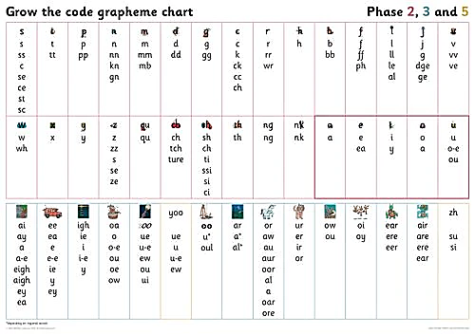
Phonics
20 minutes at the beginning of a day to revise sounds and identify alternatives
ay ou ie ea
Grow the code chart
Link with spellings
decoding and
encoding

Slide 5
Phonics
Phonics sessions typically include:
Shuffle Time – Saying Speedy Sounds
Reading words containing previously learnt and new graphemes – Digraphs and Trigraphs
Blend in your head
Reading TRICKY words – (Tricky words containing spelling patterns that are rarely found in other words or do not usually make the sound they do in the tricky word – e.g. said – in this word the digraph ‘ai’ makes the /e/ sound which is uncommon in other English spellings.)
Oral blending of sound to read words
Reading full sentences (including tricky words)
Spelling full words and sentences

Slide 6
Reading at Home
Books brought home on a FRIDAY
Book folders (with book and diary) returned on a Wednesday please
Your child will receive a familiar Reading Book that they will have read three times throughout the school week.
They will also receive a self selected ‘reading for pleasure’ book.
Books will be changed at school on a FRIDAY.
Please comment on your child’s reading in their reading diaries.
Reading Diaries will be commented in by an adult at school during the week.

Slide 7
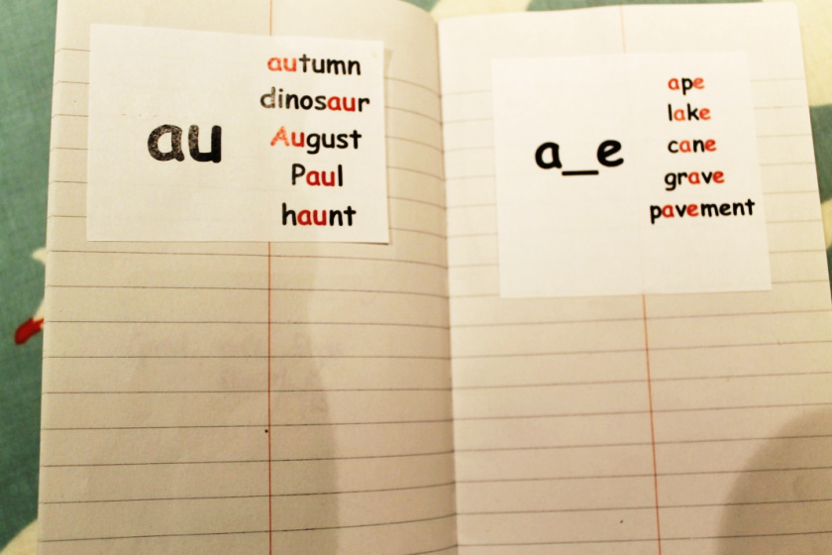
Spellings Common exception words
Weekly spellings will begin after half term

Slide 8
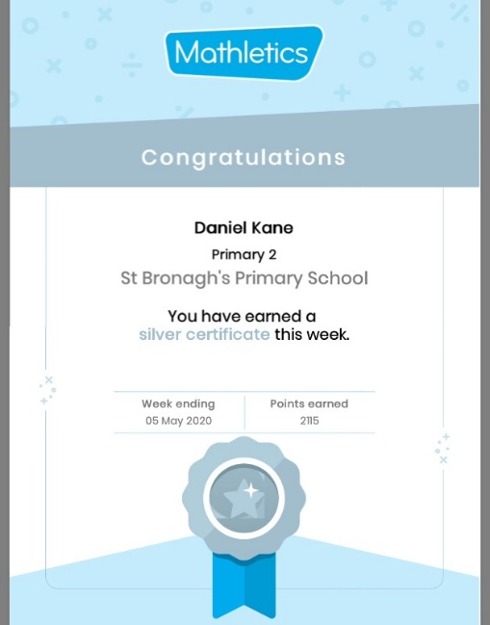
Maths
Place value
Counting in 2s 5s and 10s
Writing numbers to 100
Number bonds to 20
(and 10 should know solidly)
Mathletics
Your child will soon get their ‘Mathletics’ login (stuck in the front of their reading records)- Mathletics effort is rewarded in our Friday Celebration Assemblies
Collect 5 bronze certificates and you will be awarded a silver certificate.
Collect 4 silvers for a gold certificate.

Slide 9
Behaviour

Slide 10
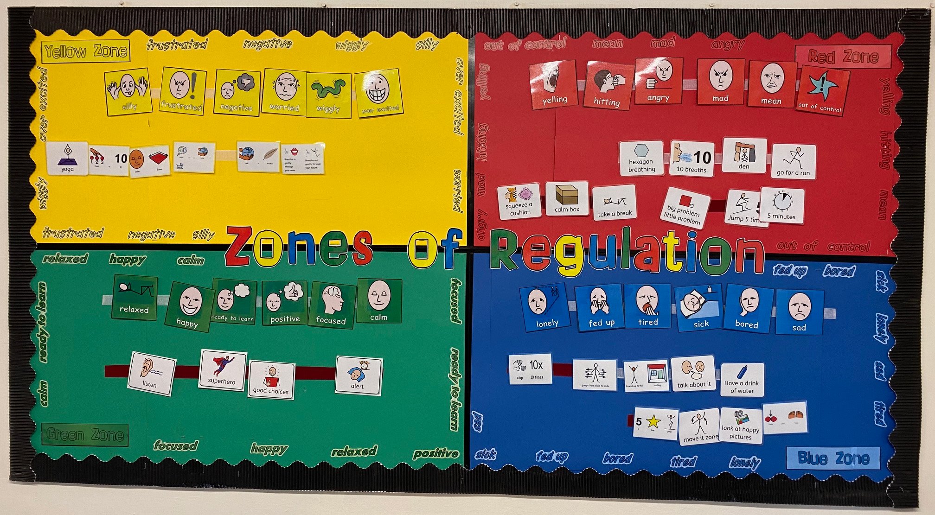
Zones of Regulation and calm areas

Slide 11
Communication
We recognise how vital communication between home and school is and we want to continue to build effective and supportive relationships with our families at Carlisle.
info@carlisle.richmond.sch.uk
Please avoid sharing any concerns in front of your child – Transition into Year 2 is quite an adjustment but we all want your child(ren) to feel positively about change!

Slide 12
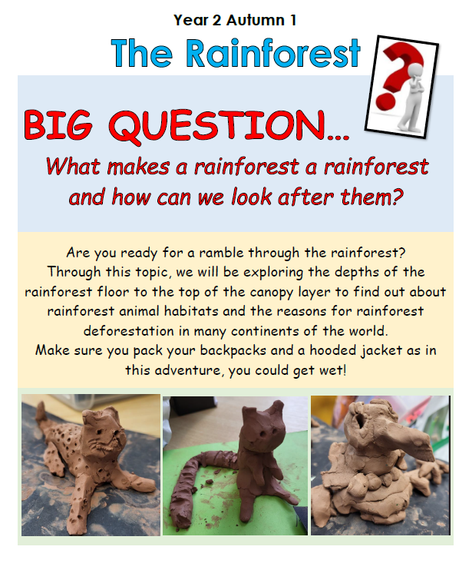
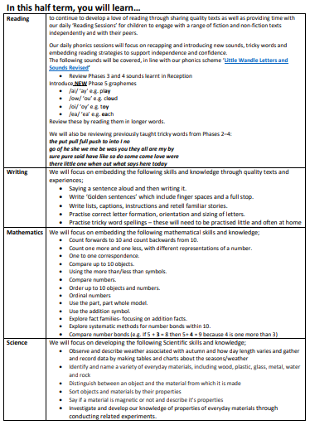
Each half term you will receive a new curriculum booklet outlining the learning that will be covered

Slide 13
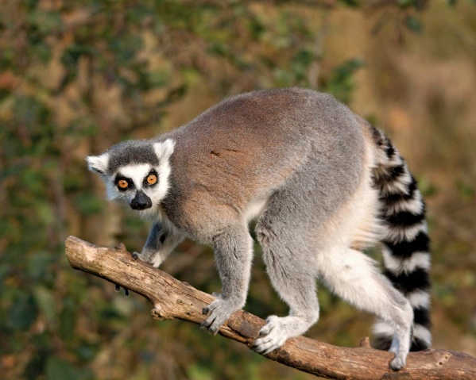
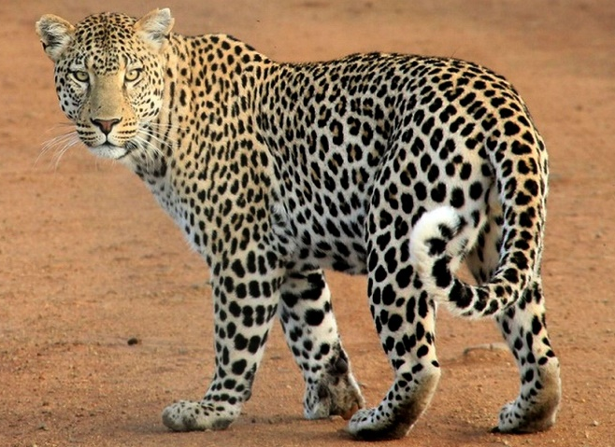
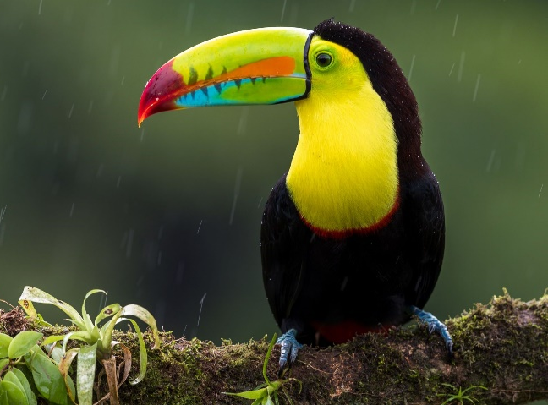
Parent helpers
Listening to readers
Trugs reading games
Maths board games ie playing snakes and ladders
Outdoor areas in Year 2
Cake sales

Slide 14
Thank you for coming this morning.

