Slide 1

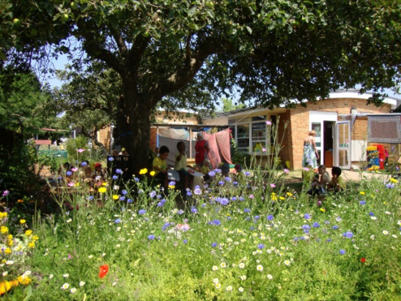

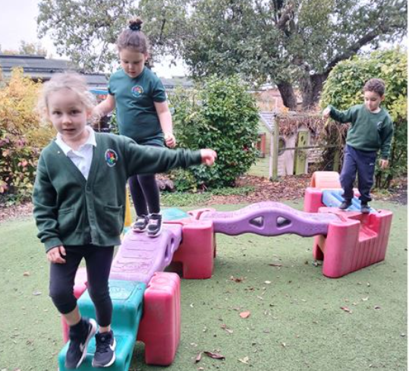


Welcome to our SEND CoFfee morning!
SENCO Infants
Lorraine Blake
SENCO Juniors
Tracey Bannister

Slide 2
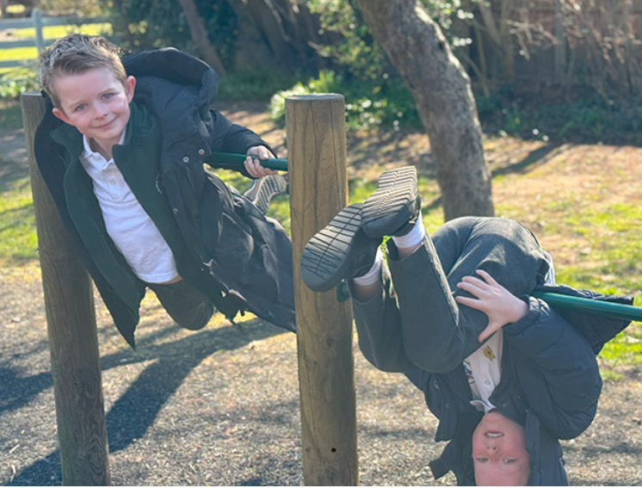



How do we support pupils with SEND?
  Quality First Teaching
  TA/LSA Support
  Interventions
  The SEND Support Plans
  EHCP Support
  Emotional Wellbeing
  The Local Offer

Slide 3

Quality first teaching
Our vision for all – Love Learning, Love Life.
‘High quality teaching is the first step in responding to pupils who have or may have SEND’ (Code of Practice, 2014)
Lessons are planned to cater for the needs of all children including those with special educational needs or disabilities.
Curriculum Access – the changes that are made to help children succeed in their learning
  provide additional resources for the child to use to complete the task
  use multisensory approaches to support a variety of learning styles
  provide the child with more time to complete the same task as their peers
  provide brain/movement breaks (whole class or individual) and increased processing time
  provide additional adults to support the child at certain times
  change the task itself, break it down into manageable steps
  use carefully targeted questions at different levels
  use pictures and visual resources to support vocabulary
Notes:
For example teachers may do one or more of the following to differentiate for a child with special educational needs:

Slide 4
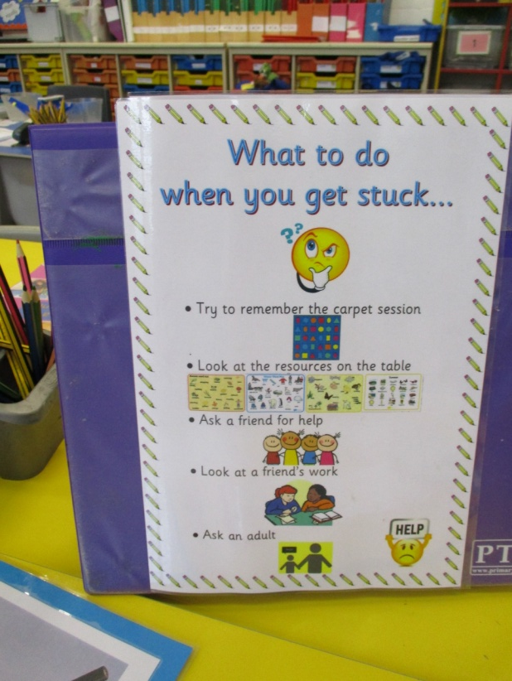
SUPPORT STAFF
Support staff are used flexibly and creatively to support learning.
  Pre and post teaching
  Targeted in class support
  Small group support in or out of class
  Observations
All staff work together to ensure consistency in their approach and in ensuring that there are no barriers to pupils achieving their full potential.

Slide 5
interventions
‘Interventions’ (support programmes) which we run to help children who are not making expected progress make as much progress as possible. We run different programmes to address different needs such as:
  Reading/phonics – Little Wandle
  writing
  handwriting
  Colourful semantics for language development
  Targeted maths support
  Numicon
  Social groups
  LEGO therapy
  fine and gross motor skills
  speech and language
  Occupational Therapy support
  Well being e.g. Nurture / mentoring / Mental Health Support Team
Notes:
Partaking in an extra learning programme does not necessarily mean the child has been identified as having special educational needs.
All chn to access broad balanced curriculum
Either short sharp interventions or some are ongoing e.g. phonics according to need
Narrow range of objectives to maximise impact
Minimise withdrawal from whole class teaching and carefully considered timetabling

Slide 6
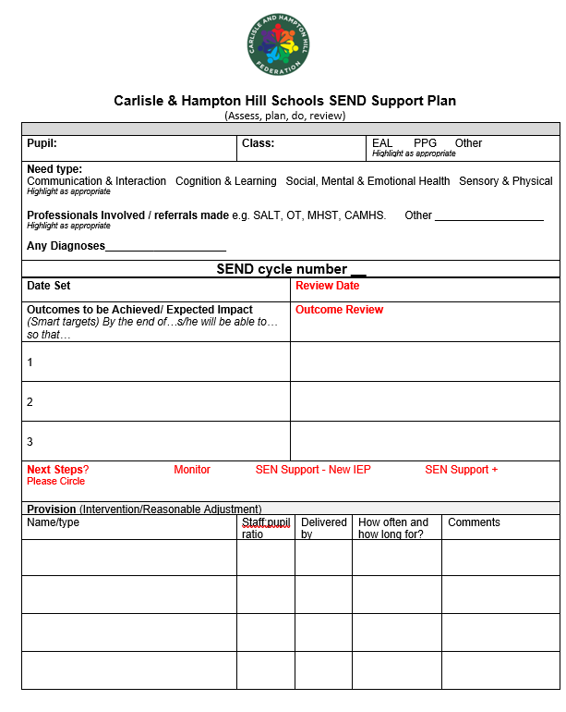
SEND Support PLANs
Shared with you by teachers
3 targets (SMART targets)
Extra provision identified
Reviewed termly
Progress tracked

Slide 7
EHCP support
Education, Health and Care Plan (EHCP) issued by the Local Authority
EHCP gives details of the needs of the child and the provision that should be put in place by a school to meet those needs.
Specialist services involvement
EHCP comes with a budget to help school to meet need and provision set out in the plan
  Resources
  Adult support
  Training
Notes:
The notional budget £6000
Coproduced document – parent and pupil voice essential part

Slide 8
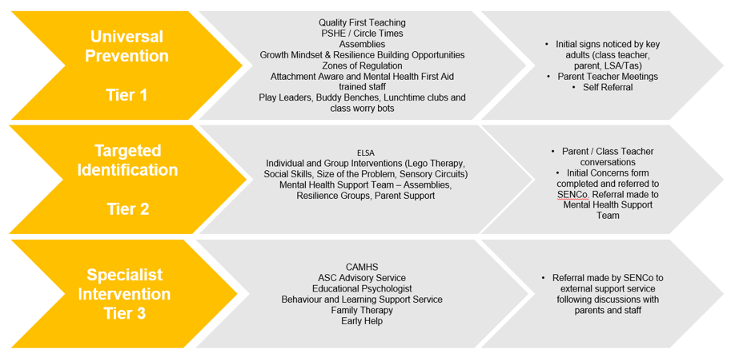
Supporting Emotional Wellbeing

Slide 9
SEND Policy and Information Report
Carlisle & Hampton Hill Federation | Policies & other important documents

Slide 10
Kingston and Richmond local offer
Have you seen it?
What is it?
  Services and support for SEND across Kingston and Richmond
www.kr.afcinfo.org.uk/local_offer

Slide 11
Thank you so much for attending today.

