Slide 1


Welcome
Year 1 Families
Key Stage 1 leader: Alysia Lewis
Elephant: Laura Irwin Tiger: Chrissy Allerston
Rachel Kirk Jo Barclay Jo Gall Ann Hedges

Slide 2
What we will cover…
Gradual transition from EYFS into Key Stage 1
Key skills & independence
Behaviour and rewards
Structure of the day & areas of the school
Phonics & reading – how to help at home
Zones of Emotional Regulation, wellbeing and social development
How you can help & community support

Slide 3

Punctuality
Learning begins in school from 8:45am
Gates close at 9:00am and children must then come through the front entrance to ensure they are in class A.S.A.P.
Absence
It is essential that your child is in school whenever possible
If there is a reason your child is unable to be in school, please contact the school office before the school day begins to inform them that they will be absent and why.
Timetable
Morning routines
Afternoon routines

Slide 4


Timetable
Morning routines
Afternoon routines
Classroom routines
Class captains
Line orders
Resources
Pegs, water bottles
PE days
School Uniform
www.schooldaysllp.co.uk

Slide 5
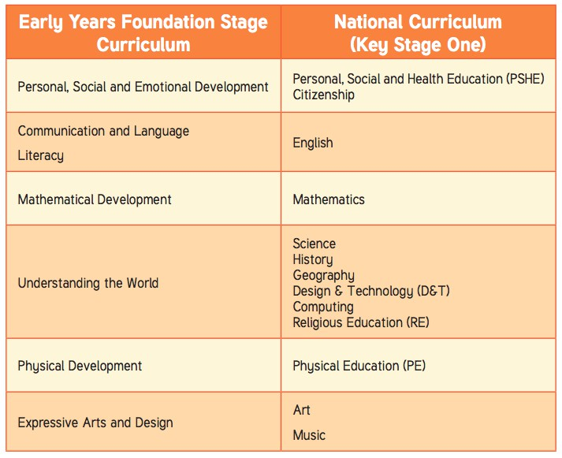
Reception and Year 1 comparison
Teaching does gradually become more formal and subject-based, though at Carlisle we base our teaching and learning around half termly ‘topics’.
Children will be taught phonics, English and maths on a daily basis.
Reading sessions are four times per week.
Wider curriculum across the week; PSHE, Geography, History etc.

Slide 6





Independence in the Classroom
In the classroom, we are learning to look after our own things.
We try to remember; choose it, use it and put it away, everyone is expected
to help at tidy up time
We are trying to work independently, to have a go at challenges and tasks.
“Don’t be shy to have a try”

Slide 7
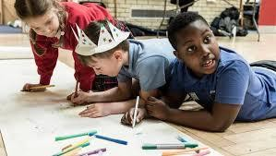
Co-operation
We are learning to share, to take turns, and to work together.
We are learning about waiting patiently for my turn to speak and to have a try.

Slide 8
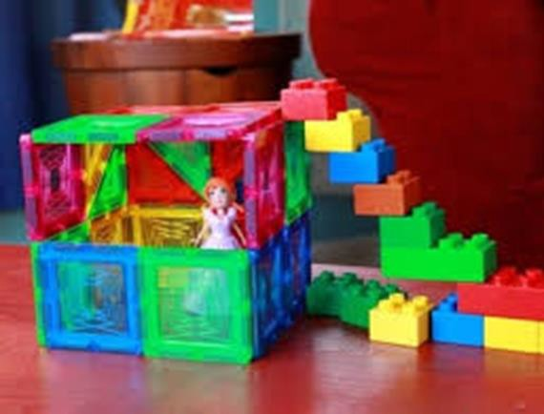

Stamina
We are working on increasing our capacity to attend to tasks and concentrate for increasing periods of time. This can include games, learning tasks, jigsaws, writing and building or making things.

Slide 9
Active learning zone
The ALZ or Active Learning Zone is a separate area to the classrooms run by Miss Barclay.
A colour group from each class access the provision each session.
Children can explore their learning in an active and practical manner and are set challenges and tasks which extend their learning and problem solving skills.

Slide 10
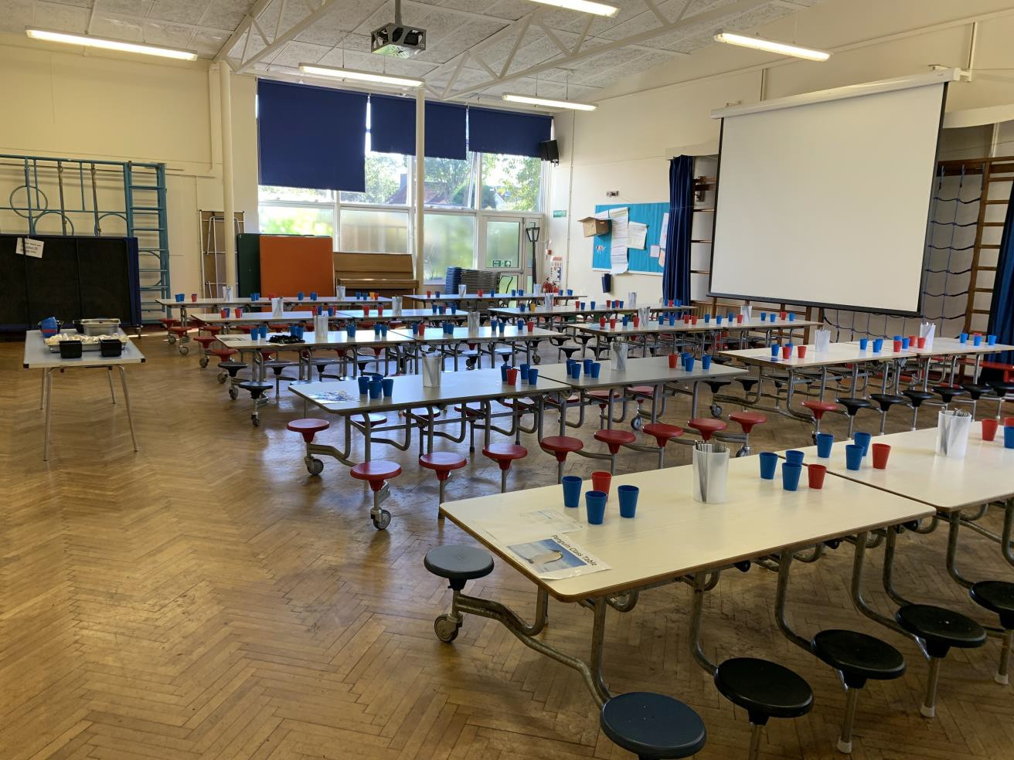
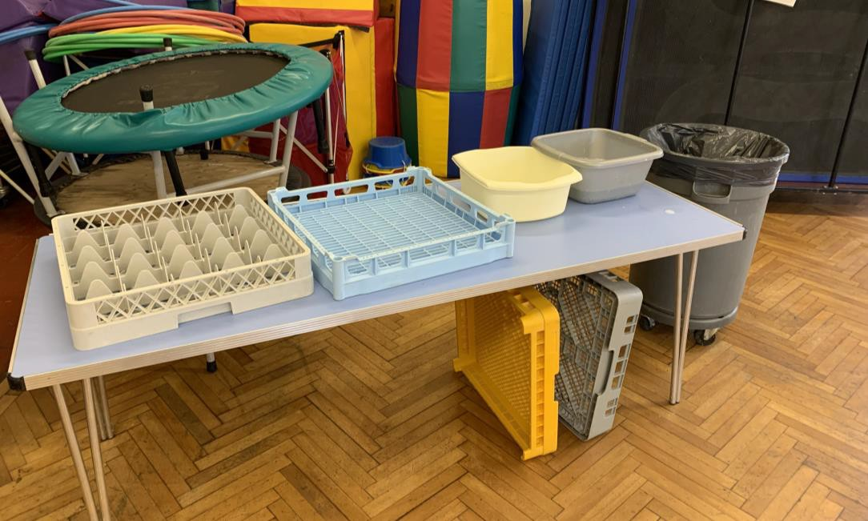
Lunchtime
Independence and polite table manners really help our lunchtimes to go smoothly.

Slide 11
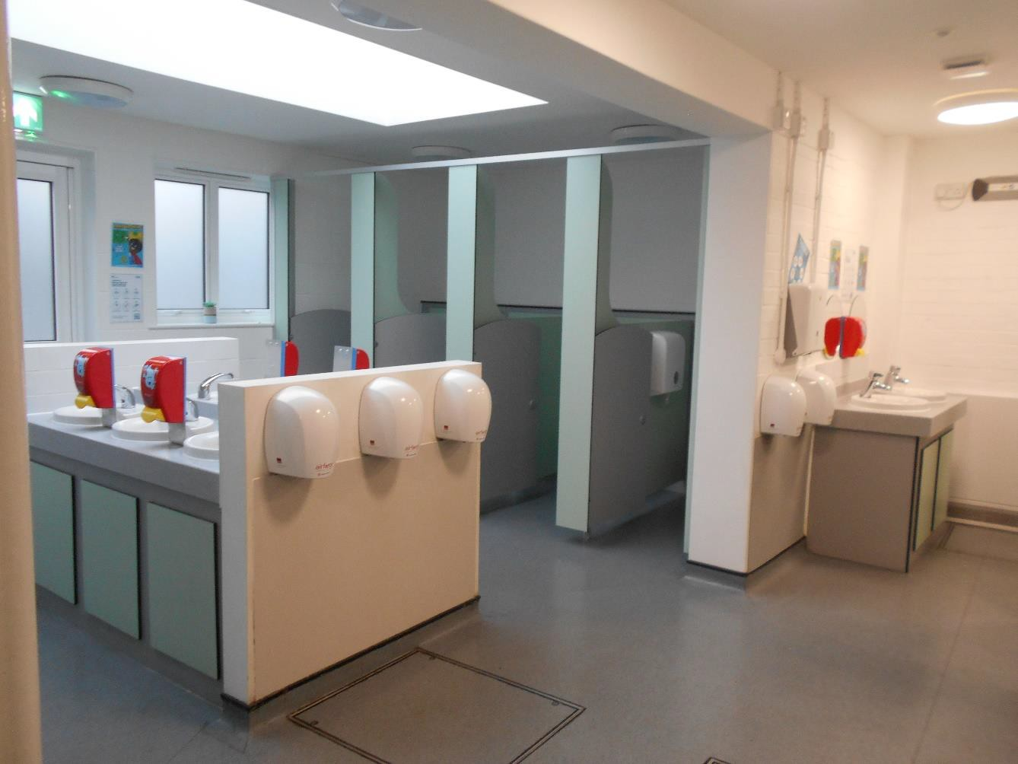
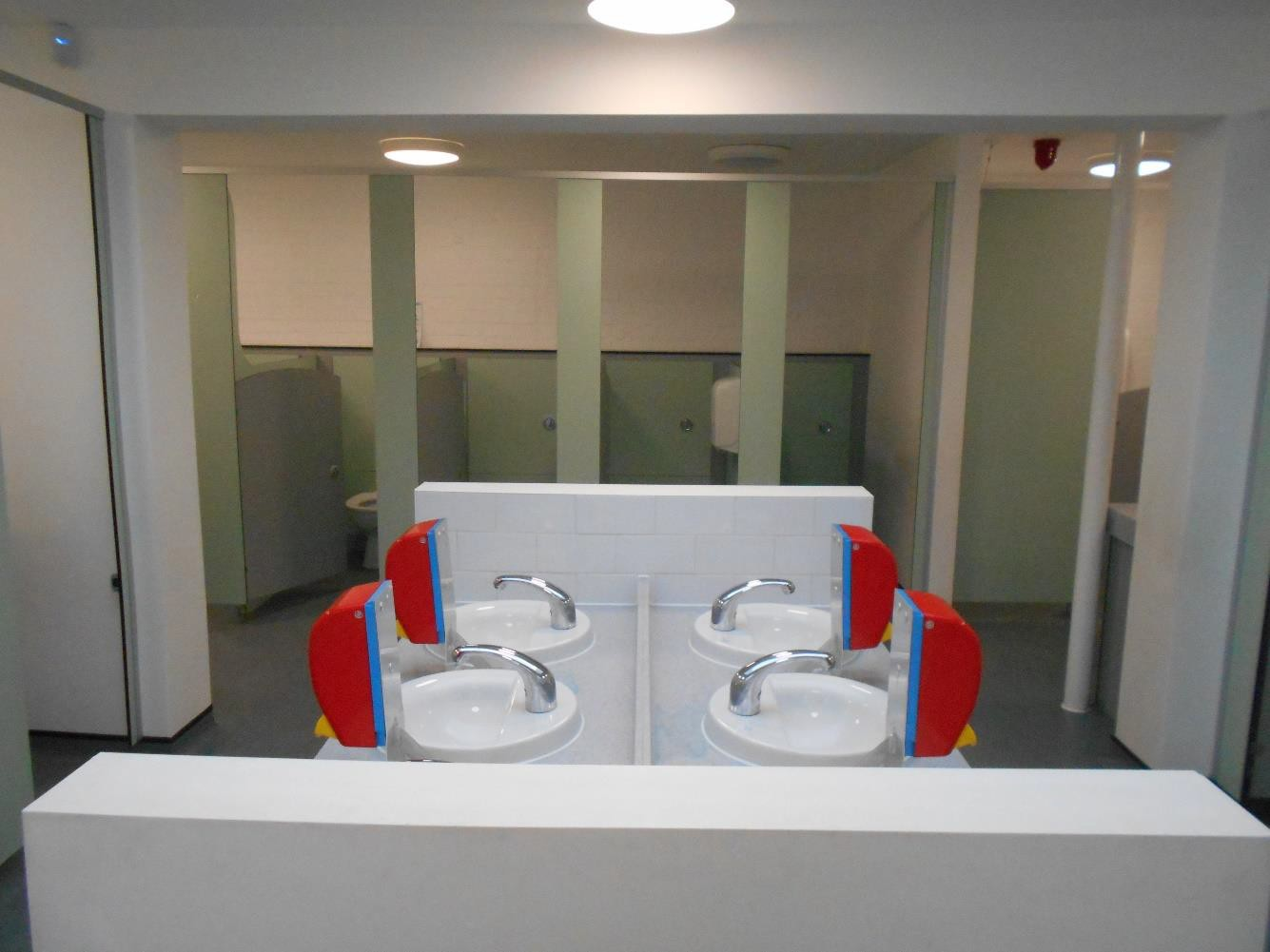
Toilets

Slide 12
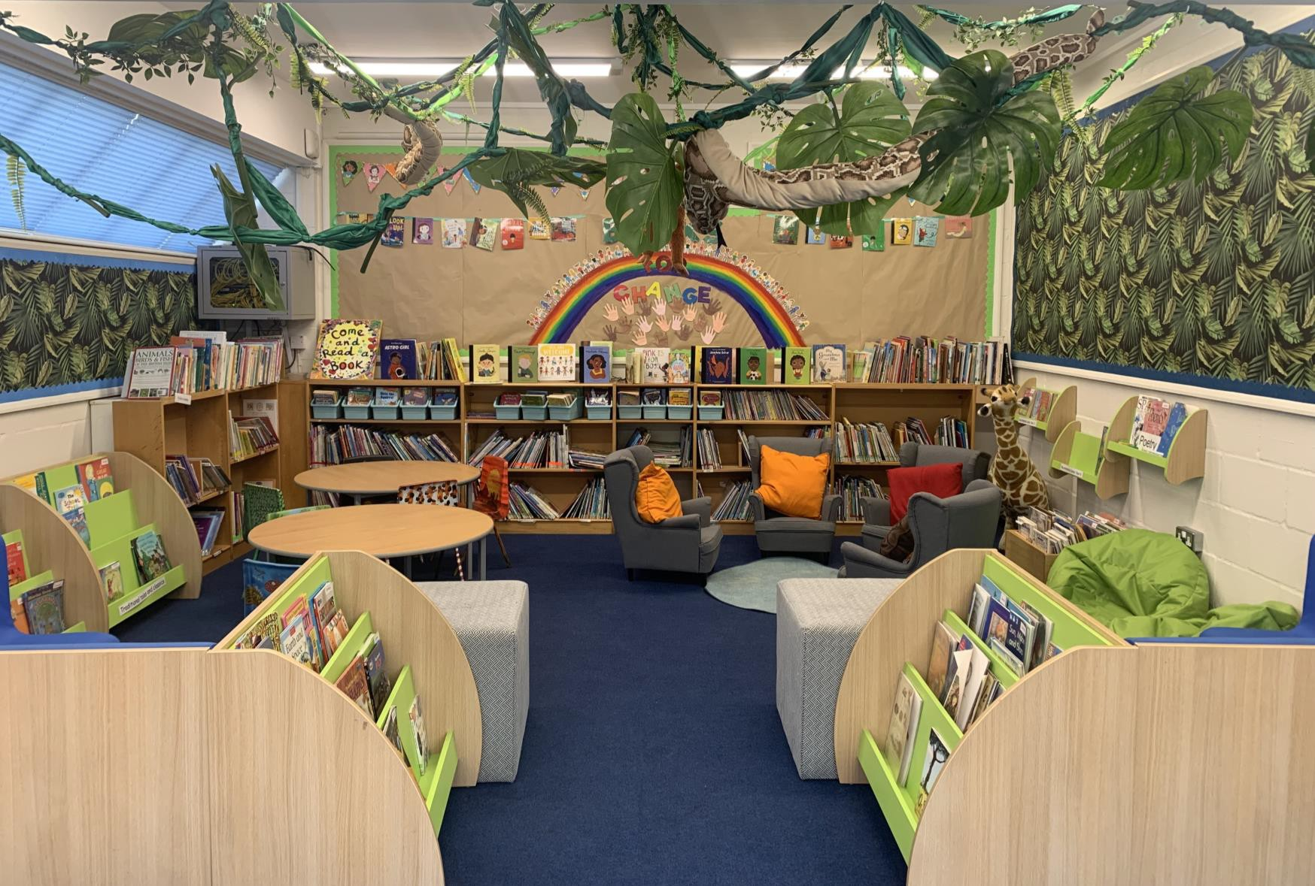
Our Carlisle library

Slide 13

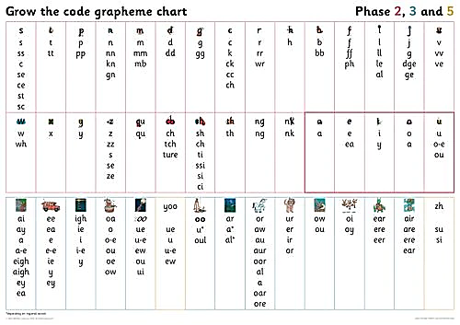
Phonics
20 minutes at the beginning of a day to revise sounds and identify alternatives
ay ou ie ea
Grow the code chart
Link with spellings decoding and
encoding

Slide 14
Phonics
Phonics sessions typically include:
Shuffle Time – Saying Speedy Sounds
Reading words containing previously learnt and new graphemes – Digraphs and Trigraphs
Blend in your head
Reading TRICKY words – (Tricky words containing spelling patterns that are rarely found in other words or do not usually make the sound they do in the tricky word – e.g. said – in this word the digraph ‘ai’ makes the /e/ sound which is uncommon in other English spellings.)
Oral blending of sound to read words
Reading full sentences (including tricky words)
Spelling full words and sentences

Slide 15

Reading
Developing a love of reading
Reading picture books to your child regularly
Reading little and often
Re-reading familiar texts
Little Wandle

Slide 16
Reading at Home
Books brought home on a FRIDAY
Book folders (with book and diary) returned on a Wednesday please
Your child will receive a familiar Reading Book that they will have read three times throughout the school week.
They will also receive a self selected ‘reading for pleasure’ book.
Books will be changed at school on a FRIDAY.
Please comment on your child’s reading in their reading diaries.
Reading Diaries will be commented in by an adult at school during the week.

Slide 17
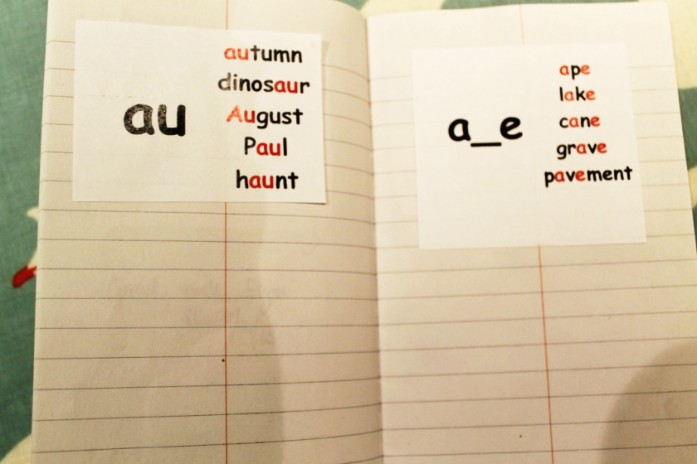
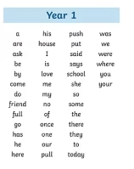
Spellings
Common exception words
Weekly spellings will begin after half term

Slide 18
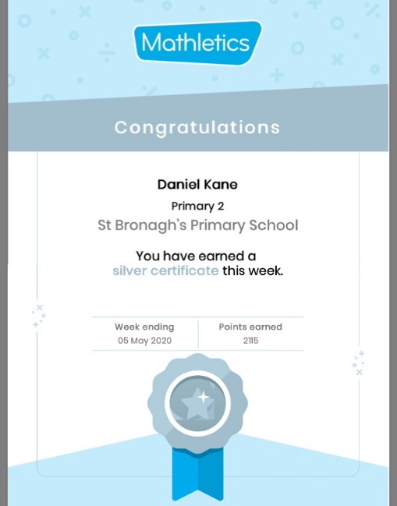
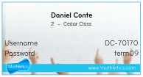
Maths
Place value
Counting in 2s 5s and 10s
Writing numbers to 50
Number bonds to 10
(should know solidly)
Mathletics
Your child will soon get their ‘Mathletics’ login (stuck in the front of their reading records)- Mathletics effort is rewarded in our Friday Celebration Assemblies
Collect 5 bronze certificates and you will be awarded a silver certificate.
Collect 4 silvers for a gold certificate.

Slide 19
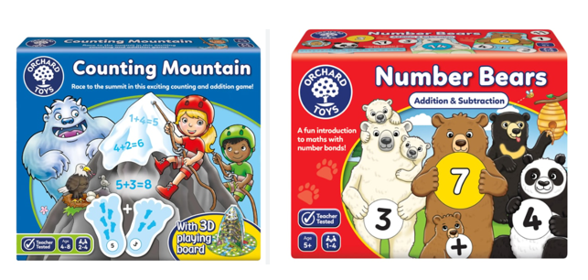
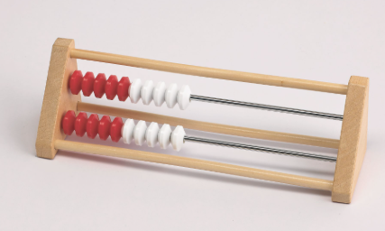
Mastering Number
10-15 minutes 4x a week (in addition to their Maths lesson)
Supports children with their composition of numbers within 10 (seeing numbers 6-9 as “5 and a bit”
Builds fluency in addition and subtraction calculations
Comparison and reasoning (comparing numbers within 20 and understanding their position on a number line)
Rekenreks are used as a visual aid to support mathematical understanding.
Orchard maths games are played in school to build maths fluency – we recommend playing these at home too!

Slide 20
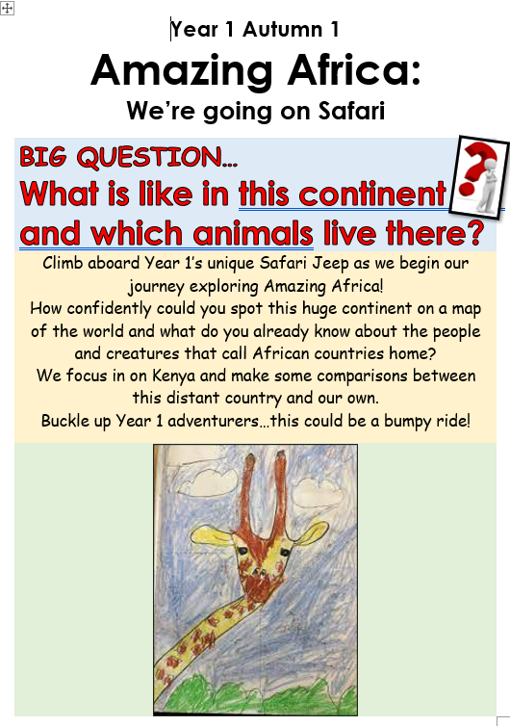

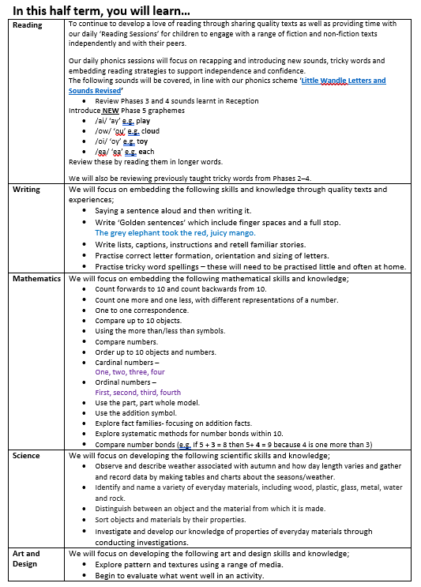
Each half term a new curriculum booklet will be available on our website
outlining the learning that will be covered

Slide 21

Our first topic is

Slide 22


Slide 23
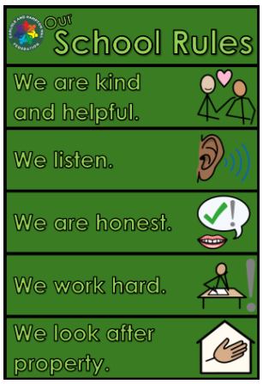
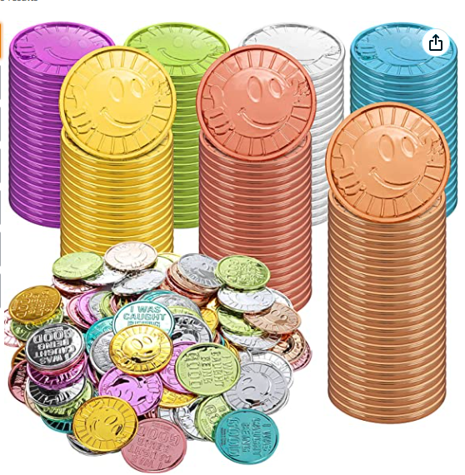
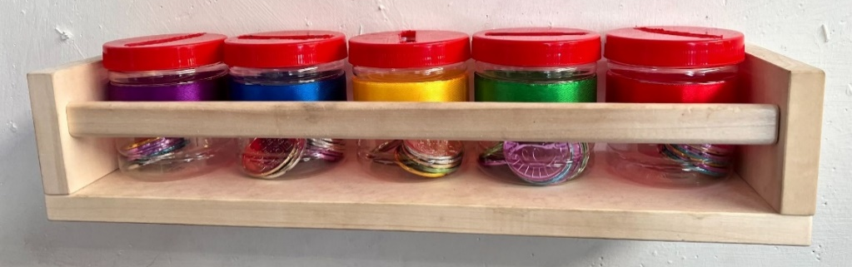
Behaviour

Slide 24
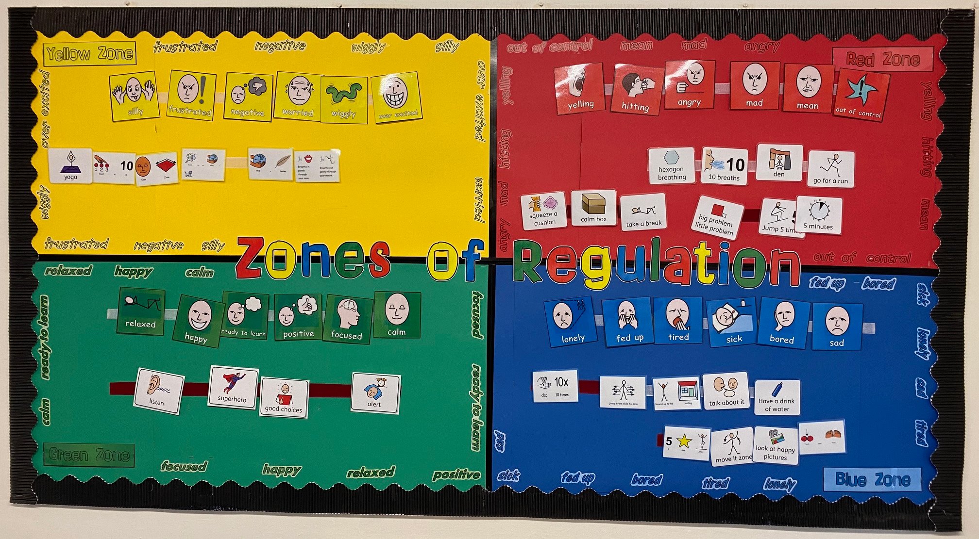
Zones of Regulation and calm areas
Notes:
Zones of regulation teaches;
Vocabulary of emotional terms
How to recognise their own
emotions
How to detect the emotions of others
What may trigger certain
emotions
Problem solving skills
There is no ‘bad’ zone
Everyone experiences all of the zones at different times and in different circumstances.
We can’t change the way children feel BUT we can help them manage their feelings/states and behaviours. “It’s ok to be angry but it’s not ok to hit…”
You can be in more than one zone at a time (e.g. sad and angry).

Slide 25



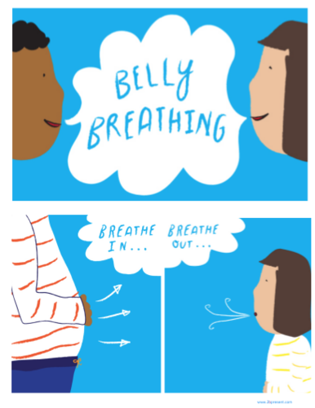

Wellbeing at school

Slide 26
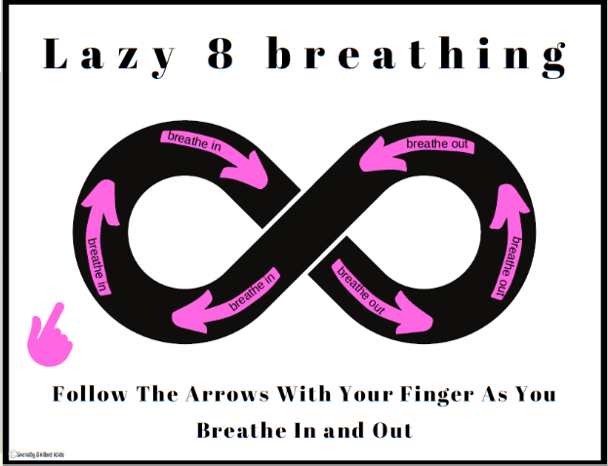
How you can help at home- Zones of regulation
Encourage your child to identify which zone they’re in at home
When reading with your child, you could ask them what zones the characters are in
If you’re watching TV with your child, ask them to identify which zone their favourite characters are in throughout the show
Lazy 8 Breathing
Start with an 8 on its side. Starting in the middle, go up the left and trace the left part of the 8 with your finger while you breathe in. When you get to the middle of the 8 again, breathe out while you trace the right part of the 8 with your finger.

Slide 27






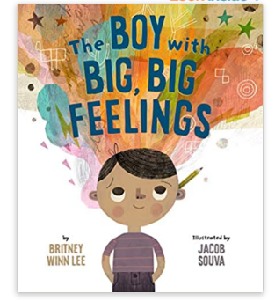
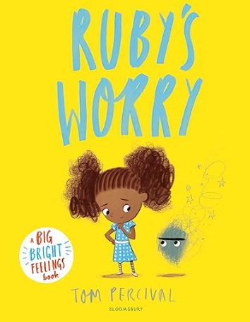

Wellbeing at home
Yoga
Cosmic Kids is a brilliant resource to practise yoga at home! They have yoga, relaxation, and mindfulness videos for children.
Calming Activities
Puzzles
Listen to music
Draw/Paint
Play-Doh/Clay
Read
Recommended Books

Slide 28


Slide 29
Parent helpers
Listening to readers
Trugs reading games
Maths board games ie playing snakes and ladders
Outdoor areas in Year 1
Cake sales
Donations for our ALZ – construction, cushions, creative resources

Slide 30
Parents we need your help ☺
We’d love to know what you’re brilliant at…Over the next week we will be sharing a QR code linked to a google form with the following if you’d like to share…
Your name:
Your child’s name:
Your profession/area of expertise:
Skills, hobbies or interests you’re happy to share:
Could you potentially support a class topic/activity/ talk?
Yes
Maybe-ask me!
Not at the moment

Slide 31

Thank you for coming this morning.

