Slide 1
Welcome to Year 2
A year of growing, learning, becoming more independent and having lots of fun along the way.
Teachers; Alysia Lewis Octavia Fadil Heatherleigh Hayman
Teaching assistants; Mrs Kirk Miss Sullivan Mrs Shera Miss Day

Slide 2
What is Year 2 all about?
Learn; building strong foundations in reading, writing and maths
Grow; becoming more independent, resilient and responsible
Communicate; explaining ideas, asking questions and working with others
Belong; feeling safe, valued and part of our class community

Slide 3

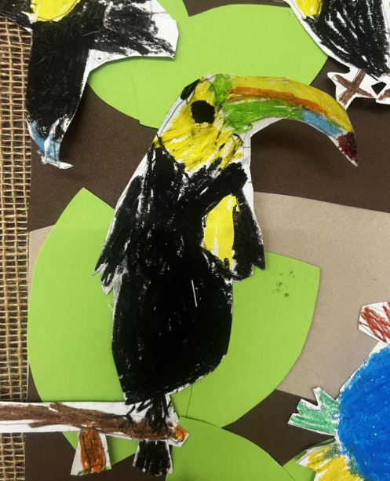
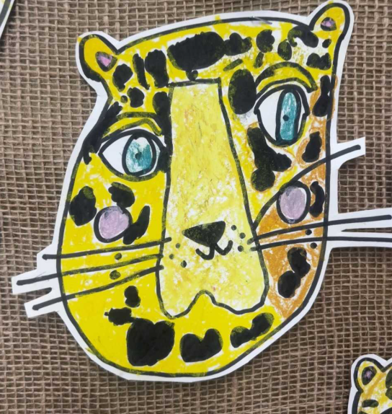
A day in the life of Year 2
8.45- arrive and settle
Register and morning maths
Phonics
Run around the track/movement break
English
Fruit, milk and story
Playtime
Reading groups
Mastering number
Maths
Lunch time
Assembly
Foundation subjects
End of day story

Slide 4
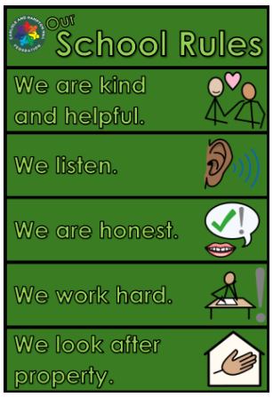
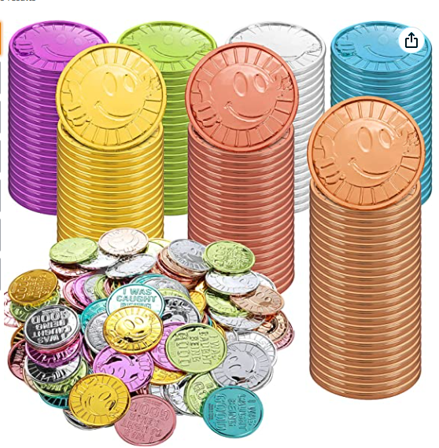
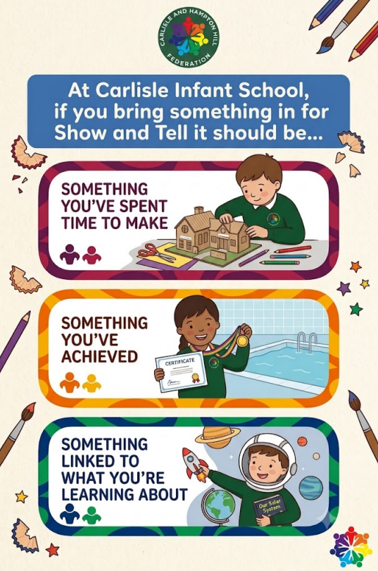
Our classroom rules and routines
Coming into school
Uniform
PE- Tuesday and Thursday
Bags
Pegs
Water bottles
Snack
Class captains
Line order
Colour groups
Reading diaries

Slide 5
Reading
Reading is the key that unlocks everything
Read regularly – little and often makes a huge difference
Talk about books- ask questions, predict, explain, discuss vocabulary
Read for pleasure- stories, comics, non-fiction, magazines
In Year 2 – reading diaries, Little Wandle books and free choice books.
Go home on a Friday, come back on a Wednesday

Slide 6
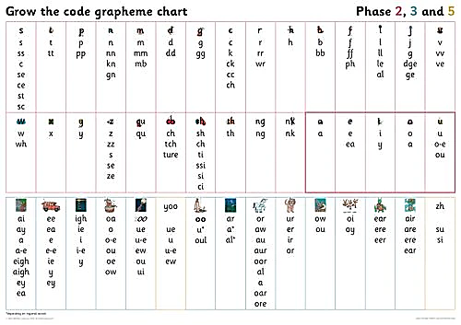
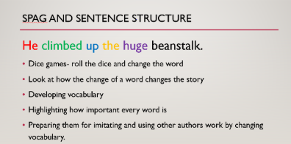
English- more than writing
Vocabulary
Sentence construction
Spelling
Punctuation
Editing

Slide 7
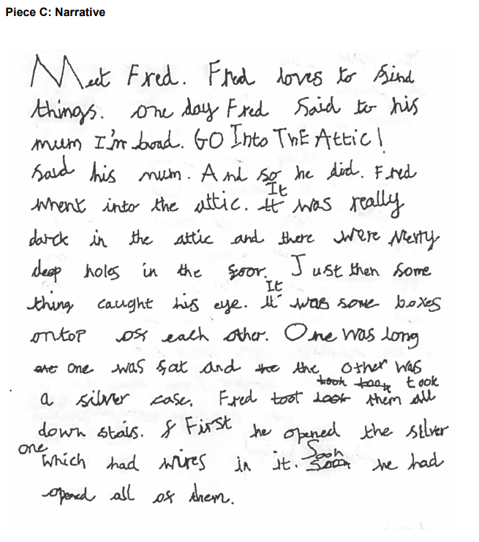
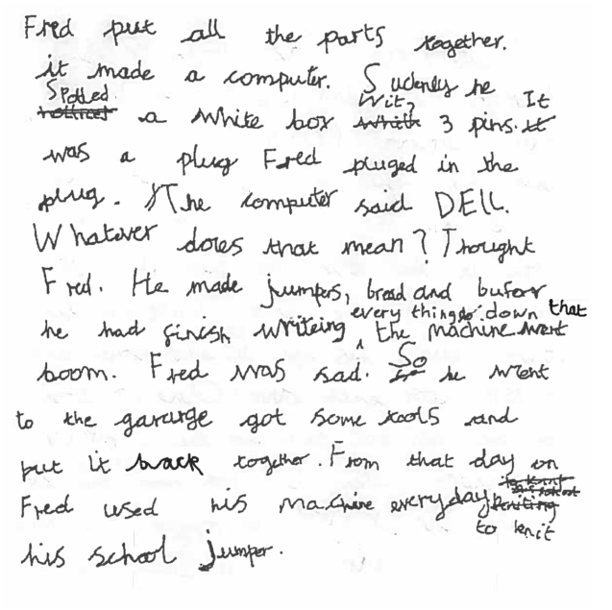
Expected writing end of Year 2

Slide 8
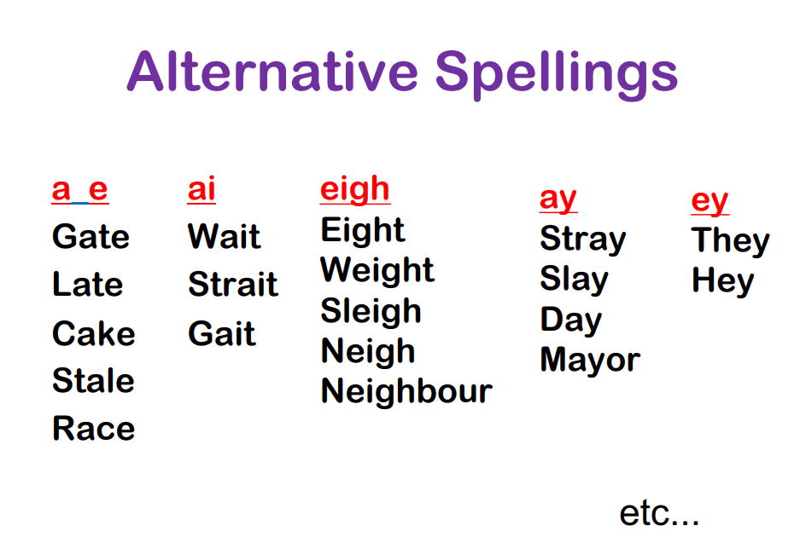
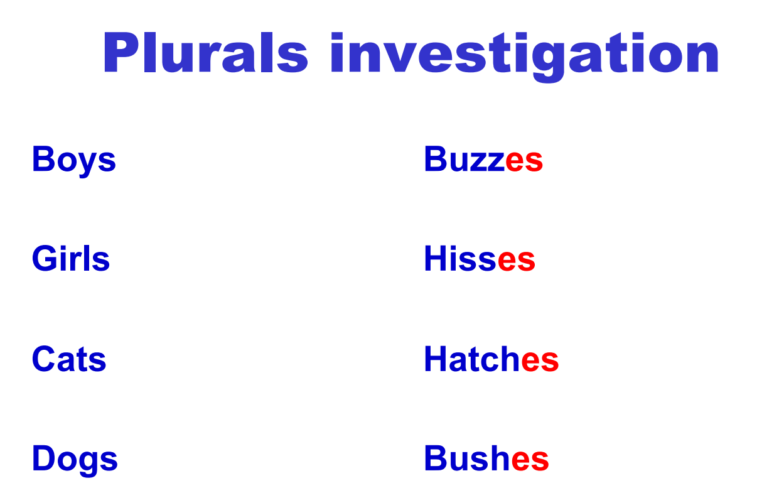
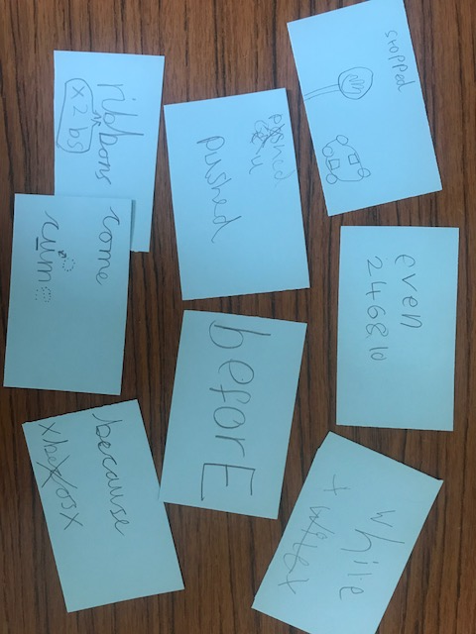
Spelling- investigating and noticing patterns

Slide 9
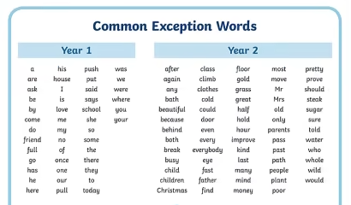
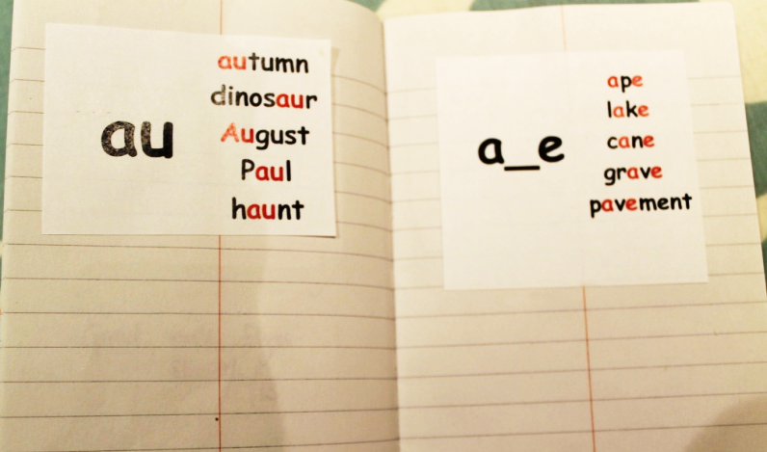
Spelling- how can you help?
Using a ‘spelling voice’
Drawing pictures
Thinking of rhymes
Noticing syllables
Short and long vowel sounds
Weekly spellings in Year 2

Slide 10
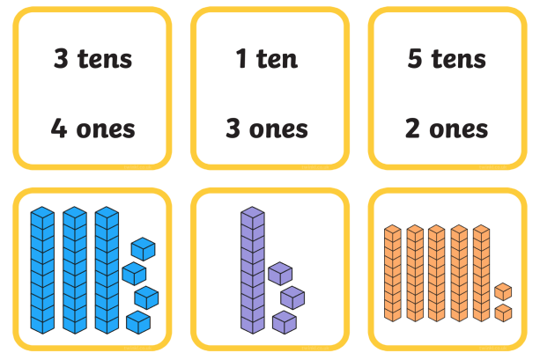
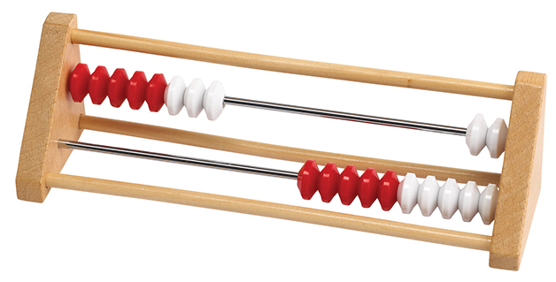
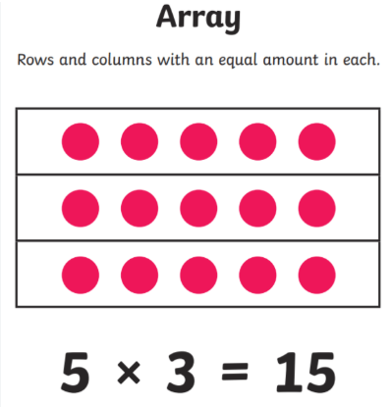
Maths-What does learning actually look like?
Place value- partitioning
Tens and ones
100 square
Number line
Dienes
Rekenreks (mastering number)
Number bonds
Arrays
Coins
Measuring equipment
We’re developing;
Number and place value
Addition and subtraction
Multiplication and division
Shape, measure, fractions and time

Slide 11
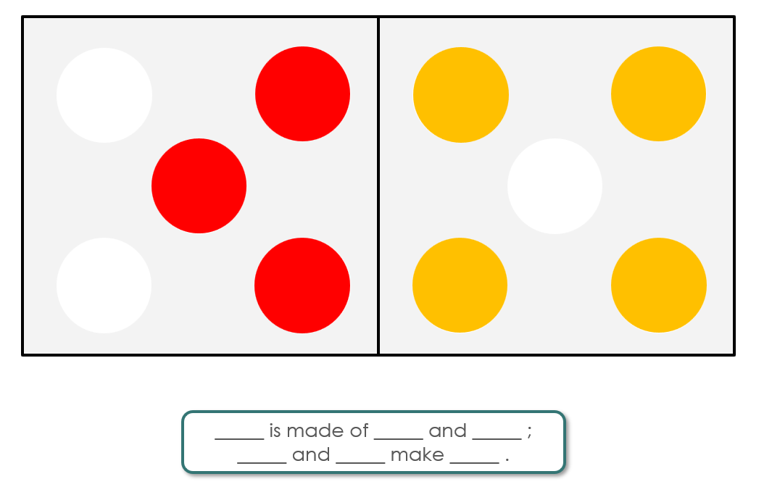

Slide 12
Our Year 2 topics
Autumn
Spring
Summer
The Rainforest
Journeys through the ocean
Mythical creatures
Fire, fire
Japan
Back to nature

Slide 13
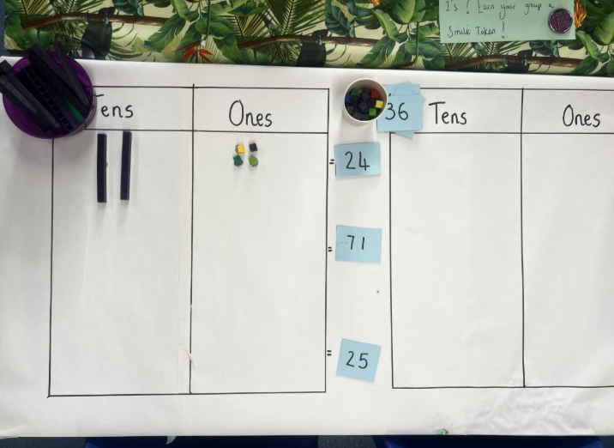
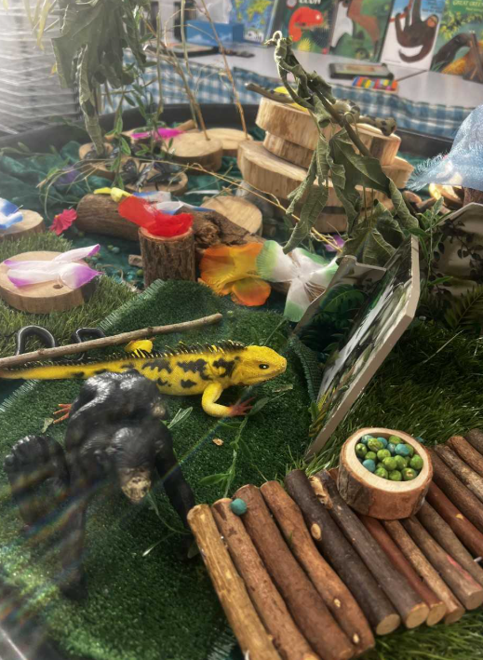
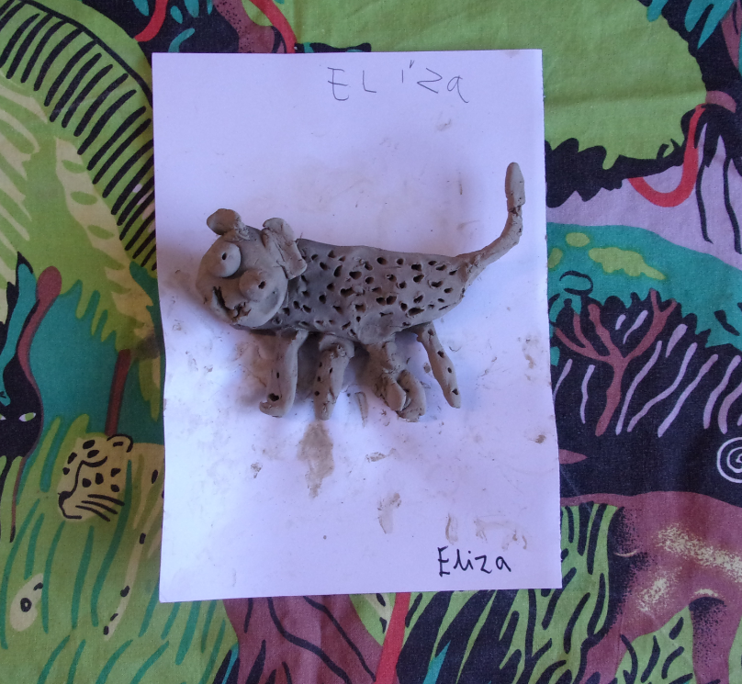
Active Learning Zone (ALZ)
Run by Mrs Kirk
Learning experiences linked
to our topic and the curriculum
Children access in the afternoons in
their colour groups

Slide 14
Developing independence in Year 2
Looking after their belongings
Manage coats/shoes/uniform
Organise resources in the classroom
Ask for help when needed
Have a go before asking an adult – ie using grapheme mats for spelling
Solve little problems independently – developing understanding of ‘size of the problem’

Slide 15
How can you help at home?
Everyday; Read Talk Count/notice numbers Encourage independence
Regularly; Practise spellings Tell the time Use money Play games Cook/measure
Importantly ask your child what they think not just what they did…
What was interesting today?
What did you find tricky?
What did you try really hard at?
What would you like to learn more about?

Slide 16
Parents we need your help ☺
Listening to readers
Trugs reading games
Maths board games ie playing snakes and ladders
Outdoor areas in Year 2
Cake sales – let’s get one booked in asap!

Slide 17
Parents we need your help ☺
We’d love to know what you’re brilliant at…Over the next week we will be sharing a QR code linked to a google form with the following if you’d like to share…
Your name:
Your child’s name:
Your profession/area of expertise:
Skills, hobbies or interests you’re happy to share:
Could you potentially support a class topic/activity/ talk?
Yes
Maybe-ask me!
Not at the moment

Slide 18


Slide 19
