Slide 1


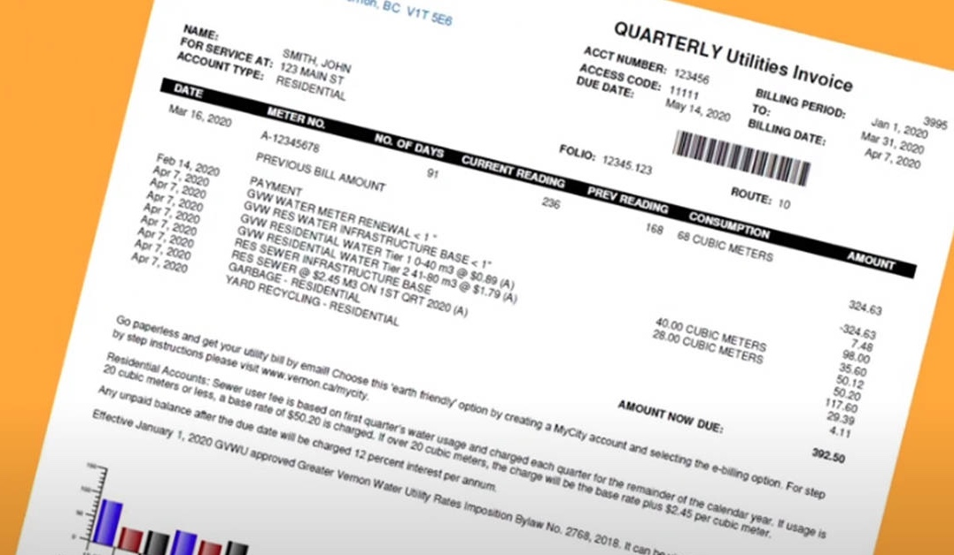
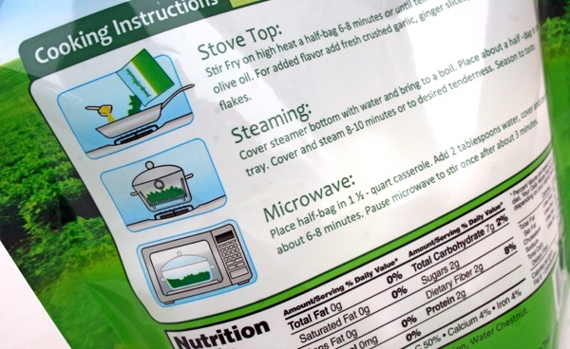
How many times have you already read today?
Notes:
CHLOE
Just think about how many times you have already read things today. It really is a vital skill.

Slide 2
Workshop Aims
Provide a greater understanding of phonics and early reading
• Share insight into the changes of our new phonics scheme and a chance to look at some of the resources
• Explain how your child will read at school
• Share ideas about how you can help at home
Notes:
ALYSIA

Slide 3
Key vocabulary modelled in our lessons:
Phoneme - smallest unit of sound in a word
Grapheme – a sequence of written letters that represent one single phoneme
Digraph – a phoneme represented by 2 letters e.g. oi, er, aw
Trigraph – a phoneme represented by 3 letters e.g. igh, ear, oor
Split digraph – two letters that represent one phoneme but are split by another letter e.g. a-e in game, i-e in time, o-e in bone
Blend – blending is the skill required for decoding words by saying each individual phoneme in a word and merging them together to say the word
Segment – segmenting is the opposite of blending and is the skill used for spelling by splitting word into its individual phonemes
Adjacent consonant – two or more consonant phonemes adjacent in a word to create ccvc, cvcc, cccvc words e.g. swim, post, string
Notes:
CHLOE

Slide 4
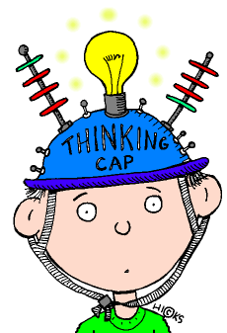
How many?!
26 letters in the English alphabet
44 different phonemes (19 vowels, 25 consonants)
More than 150 commonly used graphemes
Notes:
CHLOE

Slide 5
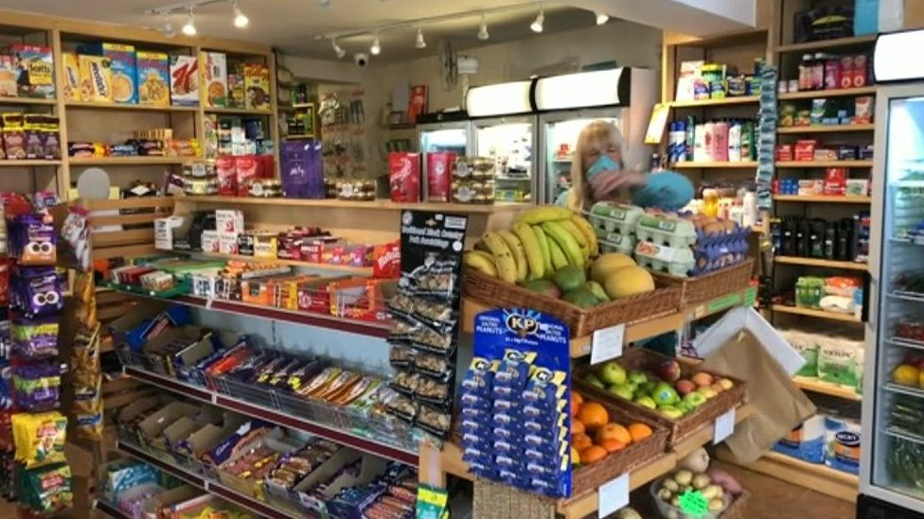

The English language is hard…
sh-o-p ch-i-p-s
Phonemes can be represented by more than one letter...
Notes:
CHLOE

Slide 6
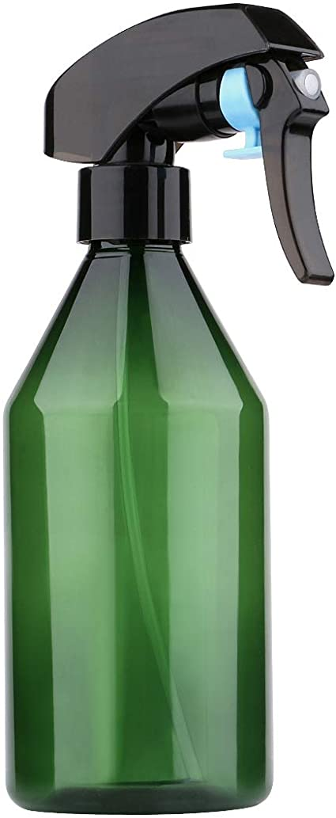

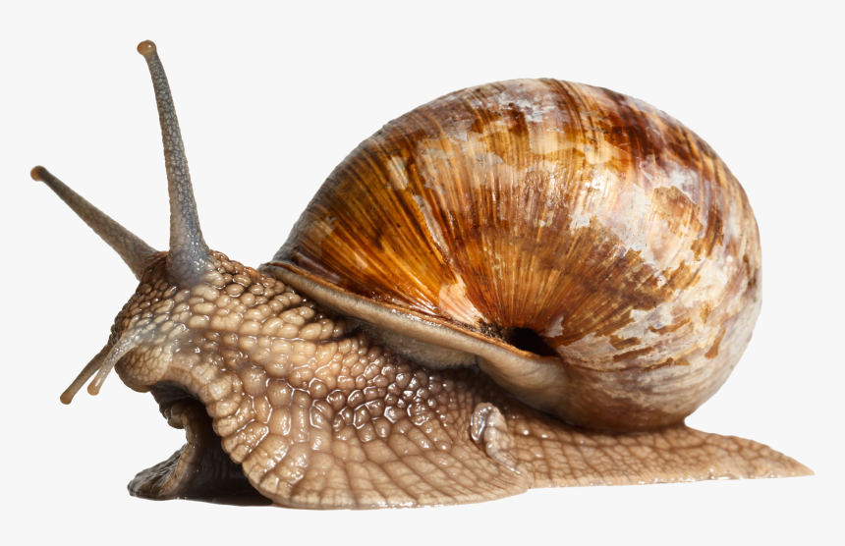

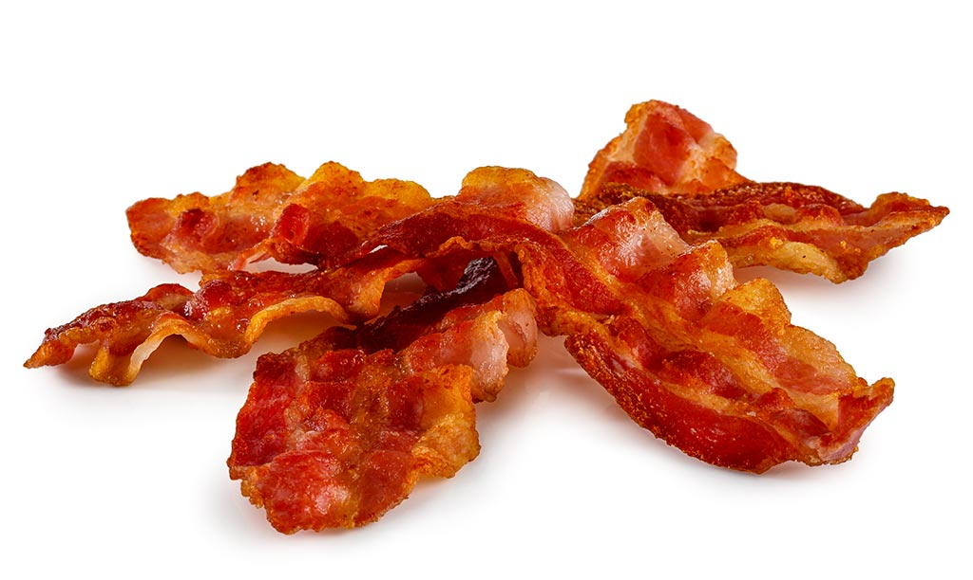
One phoneme can be represented in many ways
a – e (cake) ai (snail) ay (spray)
a (bacon) eigh (eight) ey (grey)
Notes:
CHLOE The English language is hard…

Slide 7


‘oo’ in moon ‘oo’ in book
Notes:
CHLOE

Slide 8
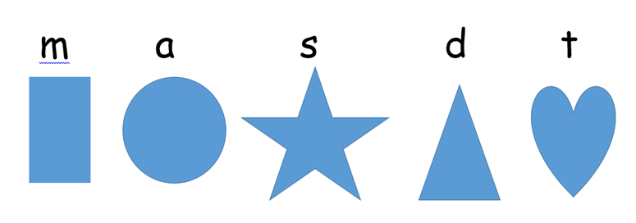
And may seem just like symbols…
Notes:
CHLOE

Slide 9
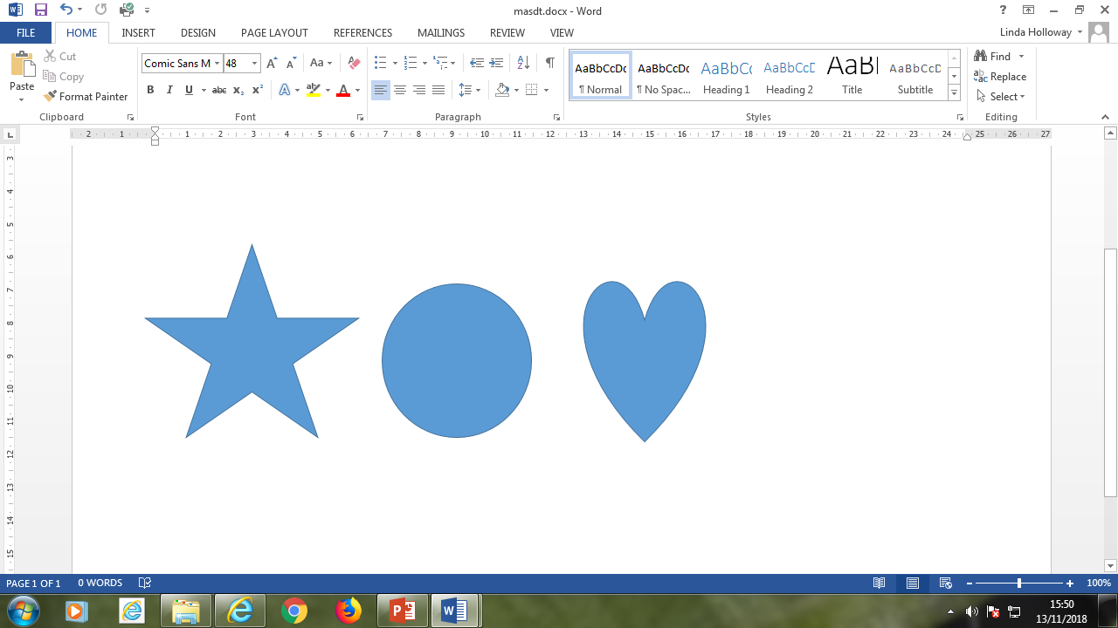
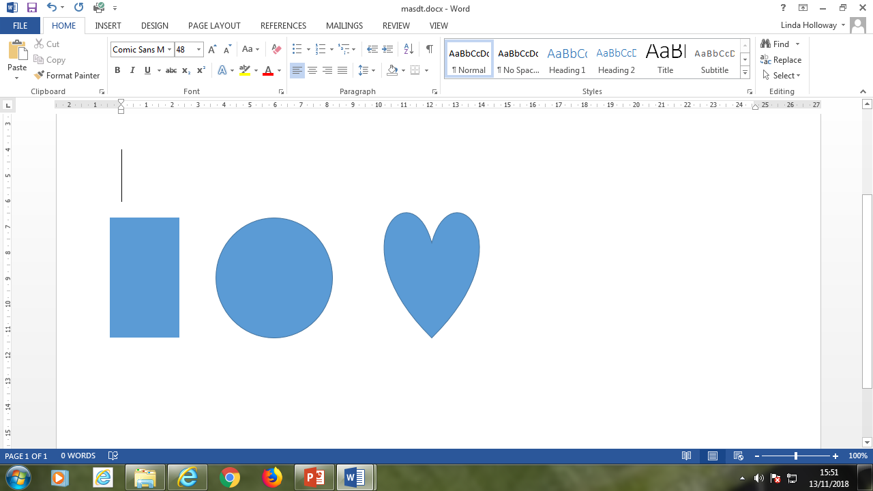
Can you decode the words?
s a t
m a t
Notes:
CHLOE

Slide 10
What is phonics?
Reading and writing are like a code: phonics is teaching children to crack the code.
Notes:
CHLOE

Slide 11
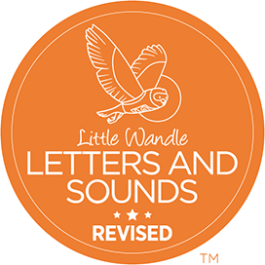
What is Little Wandle Letters and Sounds Revised?
• An exciting, new DfE commissioned phonics scheme that puts emphasis on ensuring every child can read by the time they leave Year 1.
• New resources, decodable reading books, letter formation phrases, mnemonics.
• Built in ‘Keep Up’ sessions to ensure all children are supported.
Notes:
CHLOE

Slide 12
Overview of our phonics teaching
Notes:
CHLOE We usually teach four new representation of phonemes a week and have a review lesson on a Friday.
.

Slide 13
Our phonics lesson structure
Revise: The children revisit previously taught graphemes.
Teach: New grapheme/spelling rule is taught.
Practise: The children have the opportunity to practise the new learning by reading and/or writing the words.
Apply: The children will apply their new learning by reading or writing words. Every opportunity is taken to apply these skills across the curriculum and through our learning environment.
Notes:
CHLOE Every phonics lesson is taught in 4 parts.

Slide 14

How to say the phonemes…
Saying the phonemes correctly with the children is extremely important.
We say the shortest form of the phoneme – no schwa.
Notes:
CHLOE
Let’s practise together!
The phonemes are learnt in a specific order (not the order of the alphabet) – this is so the children can apply their knowledge almost immediately

Slide 15
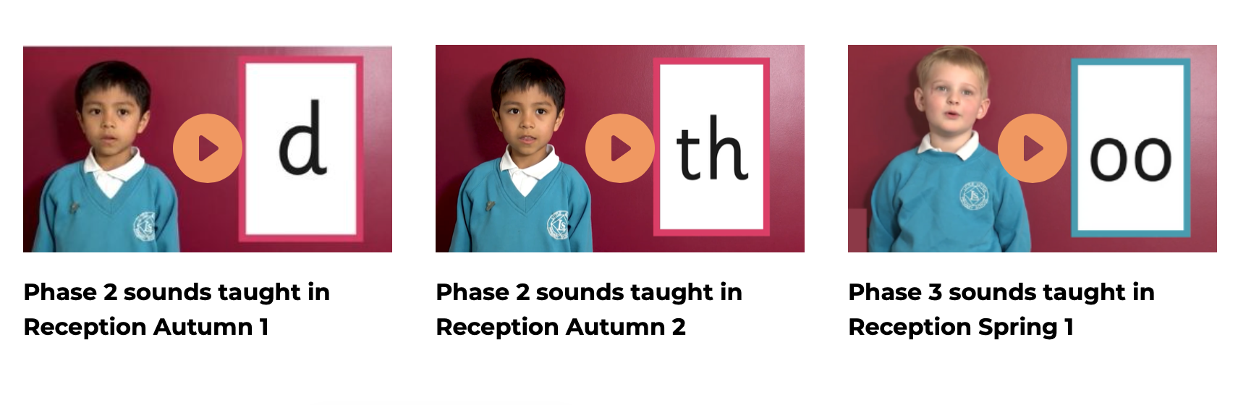
Supporting your child with phonics
Notes:
CHLOE
It is really important that you pronounce the sounds correctly at home if you are supporting your child. These videos are on the website for you to refer to and if you are unsure, please ask your child’s teacher.
Show the parents where to access the videos on the website and play them!
https://www.littlewandlelettersandsounds.org.uk/resources/for-parents/

Slide 16

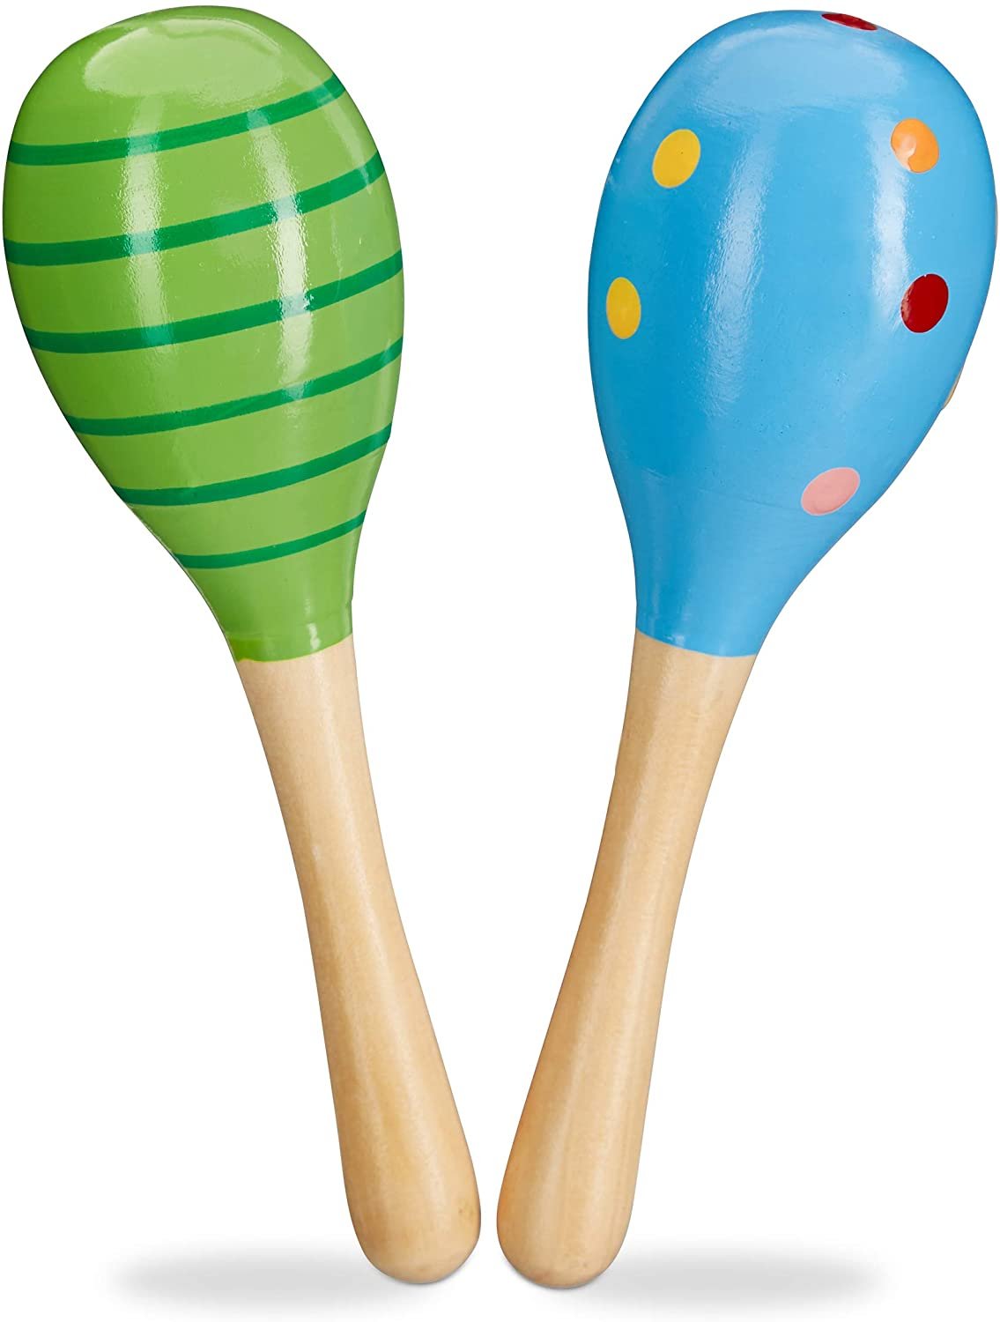



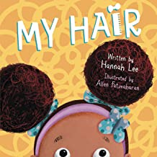
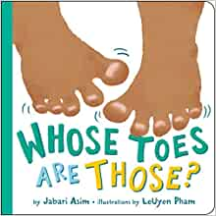
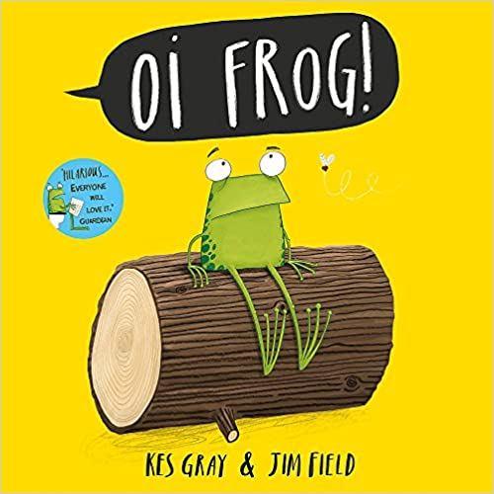
Before we begin…
Environmental sounds
Instrumental sounds
Body percussion
Rhythm and rhyme
Alliteration
Voice sounds
Oral blending and segmenting
Notes:
ALYSIA
The teaching of phonics is broken down into 6 phases
Aspect 1 – go on a listening walk , what sounds to animals make etc
Aspect 2 – can children discriminate between the different instruments?
Aspect 3 – action songs, what sounds do you make with your feet? Your hands?
Aspect 4 – read lots of rhyming books – can they hear the different rhyming words?
Aspect 5 – alliteration – can you describe the object e.g. blue bee, or create nonsense names for a cuddly toy e.g. fluffy, funny fox
Aspect 6 – can the children copy your sounds/ facial expressions etc.
Aspect 7 – ‘fred talk’ he can only talk in segmented words. Sid likes to h-o-p and j-u-m-p

Slide 17
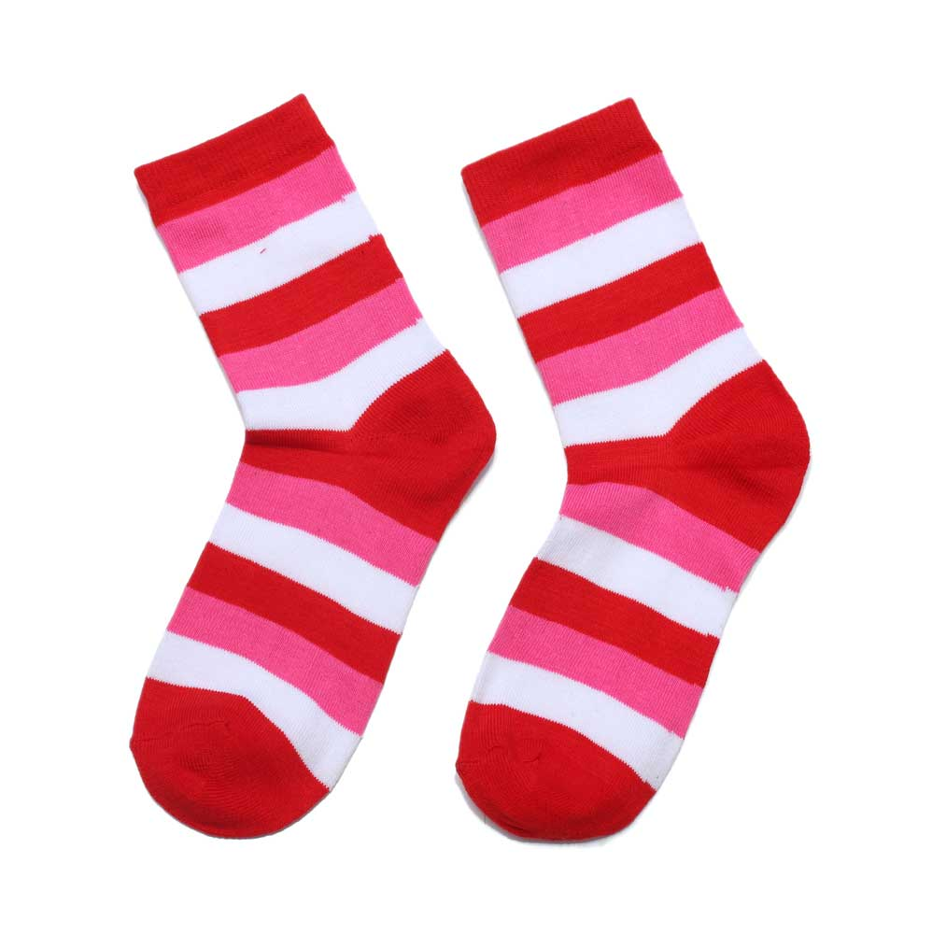

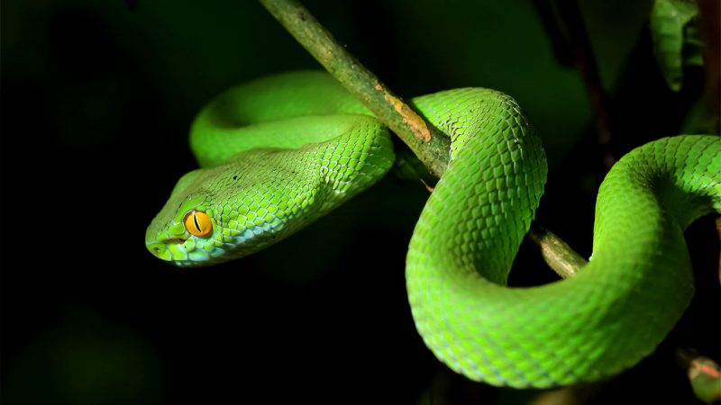
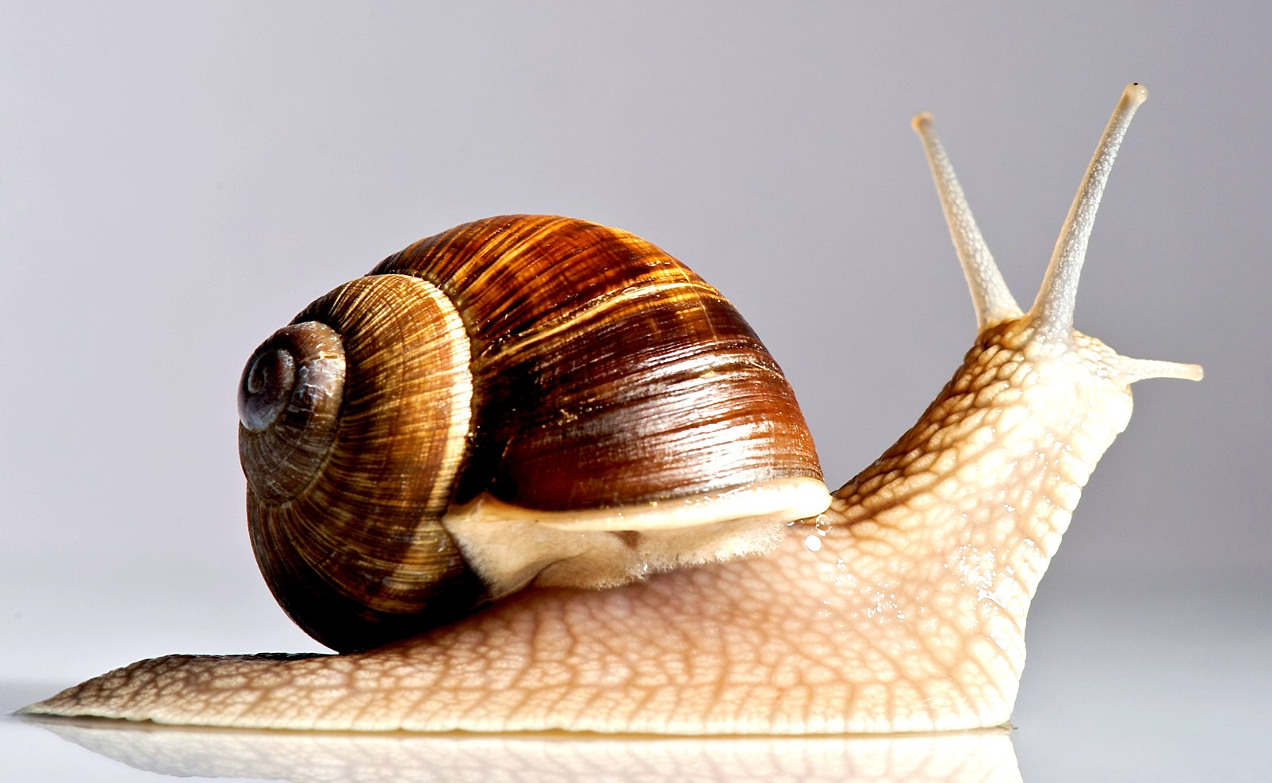
How do we teach a new phoneme?
Notes:
CHLOE
How is a phoneme taught?
Model lesson
Show the children pictures which include the phoneme we wish to teach.
Can they talk to their partner about the pictures?
Children feedback what they think each picture is
The teachers says each word following the my turn, your turn model e.g.

Slide 18

What is a grapheme?
Notes:
CHLOE
It’s the phoneme written down

Slide 19
What is oral blending?
s a t
Notes:
CHLOE

Slide 20
What is blending?
Blending is the skill required for decoding words by saying each individual phoneme in a word and merging them together to say the word.
s a t →sat
Notes:
CHLOE
To combine individual phonemes into a whole word, working all the way through from left to right. Once the GPCs involved have been learned, blending is the key process involved in reading words effectively. It is a skill that needs extensive practice. Practice in oral blending is very helpful, both before and during the process of learning to read. It is important to understand that blending sounds into a word is not simply a matter of saying them more quickly, nor of mixing them together like paint. Phonemes need to be joined into one continuous stream of sound to make a spoken word. Extensive practice, following teacher modelling, is the key.

Slide 21
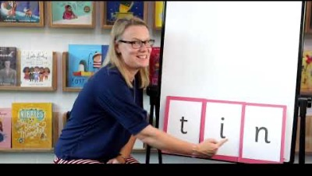
Blending to read words
Notes:
CHLOE
Show parents this video from the website: https://www.littlewandlelettersandsounds.org.uk/resources/for-parents/

Slide 22
What is segmenting?
Segmenting is the opposite of blending and is the skill used for spelling by splitting word into its individual phonemes
sh
o
p
Notes:
CHLOE
segmenting ‘Chopping Up’ the word to spell it out.
To identify each of the individual phonemes in a word, working all the way through from left to right. This is an important first stage of writing (spelling) a word but needs to be practised orally first. Counting the phonemes is often helpful in reinforcing this process.
Challenge for you now

Slide 23
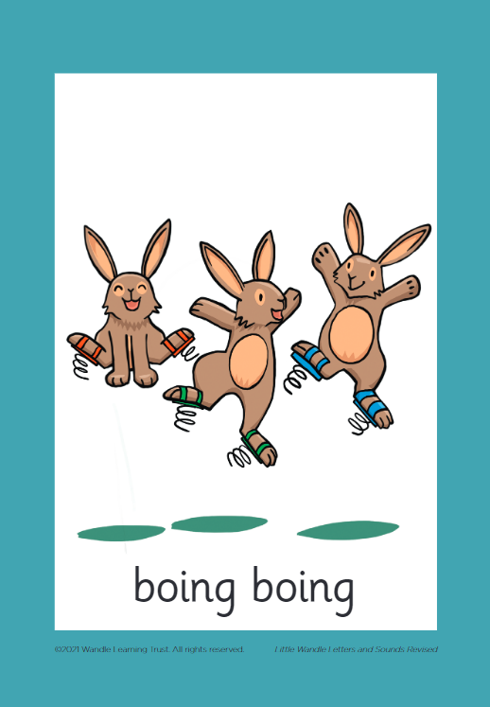
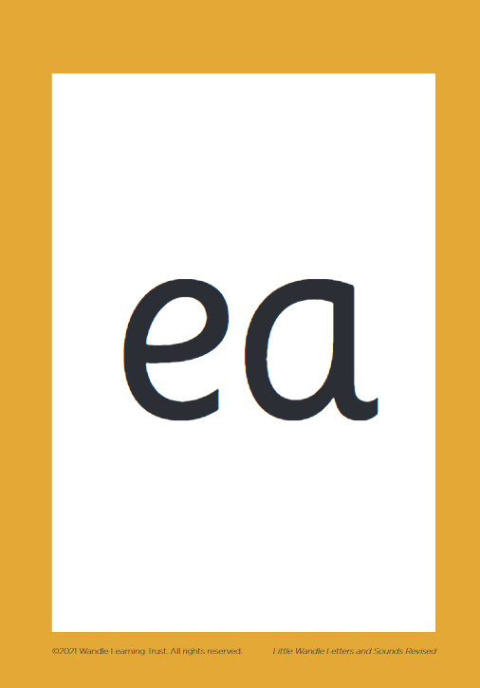
What is a digraph?
Notes:
CHLOE

Slide 24
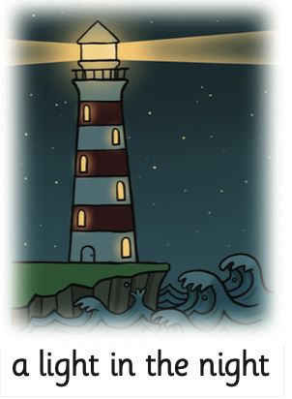
What is a trigraph?
igh
Notes:
CHLOE

Slide 25
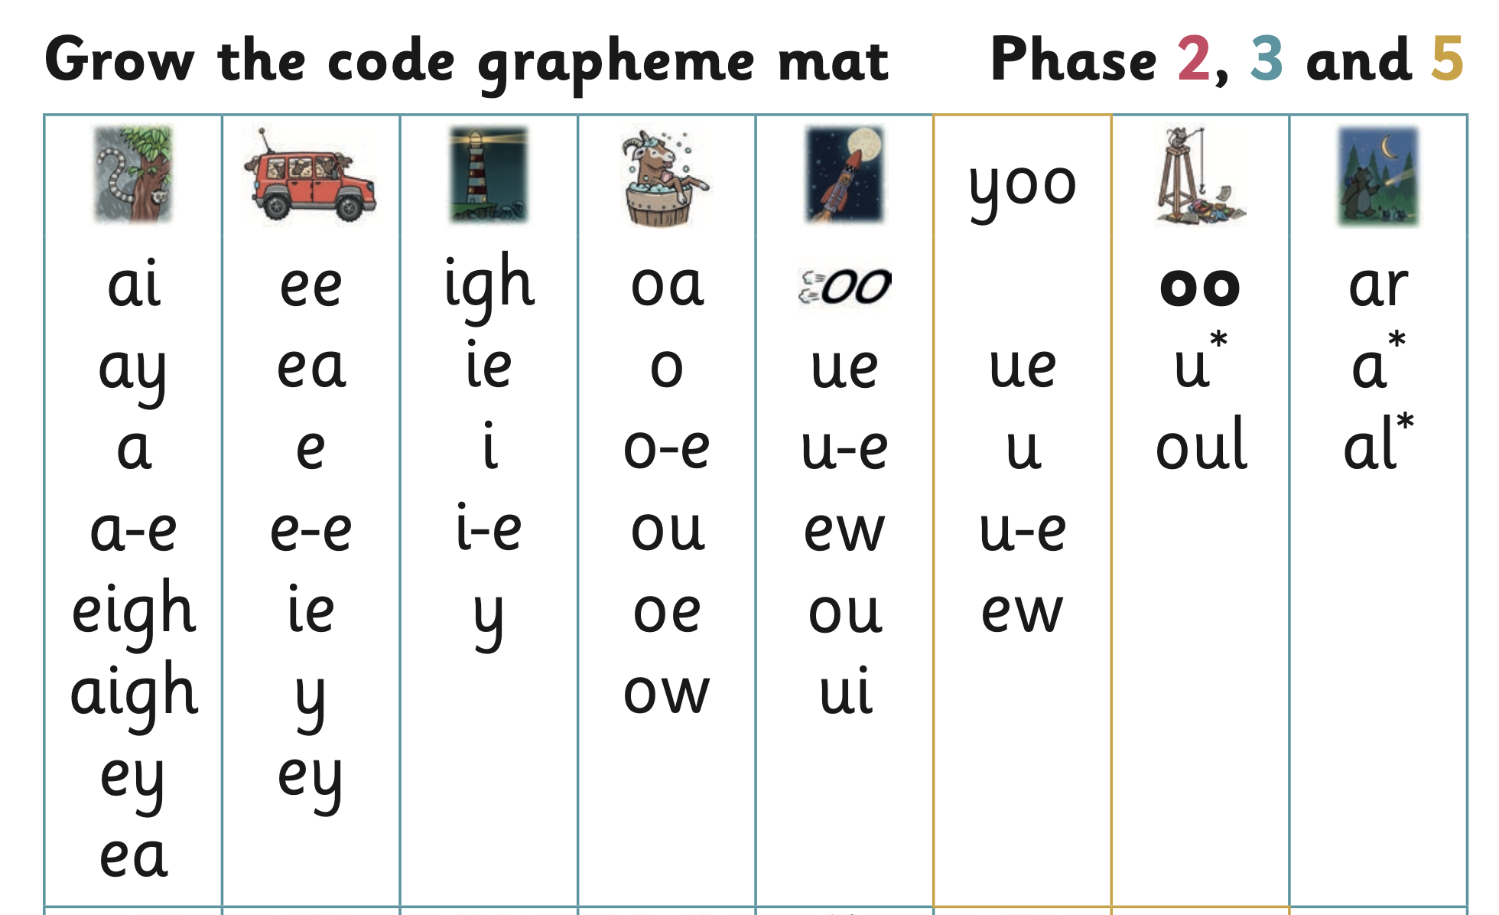
Notes:
ALYSIA
All the phonemes….

Slide 26

Challenge time…
Say the word.
Segment the sounds.
Count the sounds.
Write them down.
Notes:
ALYSIA
Model the process on a flipchart for the parents to see.

Slide 27
Using sound buttons to support
b l a ck
Notes:
ALYSIA

Slide 28
ladder | pond
sheep | church
scream | foil
Notes:
ALYSIA

Slide 29
l/a/dd/er (4) | p/o/n/d (4)
sh/ee/p (3) | ch/ur/ch (3)
s/c/r/ea/m (5) | f/oi/l (3)
Notes:
ALYSIA

Slide 30
How many different ways can the ‘sh’ phoneme be represented?
Notes:
ALYSIA

Slide 31
And all the different ways to write the phoneme sh:
shell
chef
special
caption
mansion
passion
Notes:
ALYSIA

Slide 32
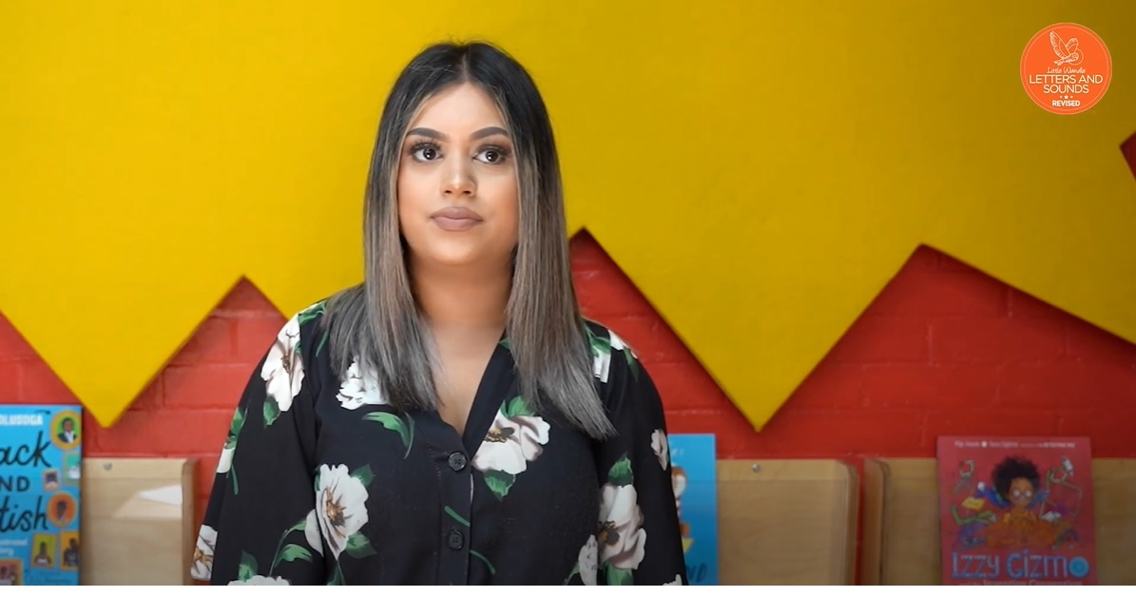
Tricky words
Notes:
ALYSIA
Have a look at this video on the website: https://www.littlewandlelettersandsounds.org.uk/resources/for-parents/

Slide 33
How do we teach reading?
Reading practice sessions are:
timetabled two times a week
taught by a trained teacher/teaching assistant
taught in small groups.
Notes:
ALYSIA
The children read the same book two times in a week.
The first time we work on decoding (sounding out) the words, the second time we work on prosody which is reading with expression – making the book sound more interesting with our story-teller voice or our David Attenborough voice – and the third time we look at comprehension.
We read the books three times at school because we want to develop the fluency. The more they see words the more they begin to read them automatically without having to sound them out.

Slide 34
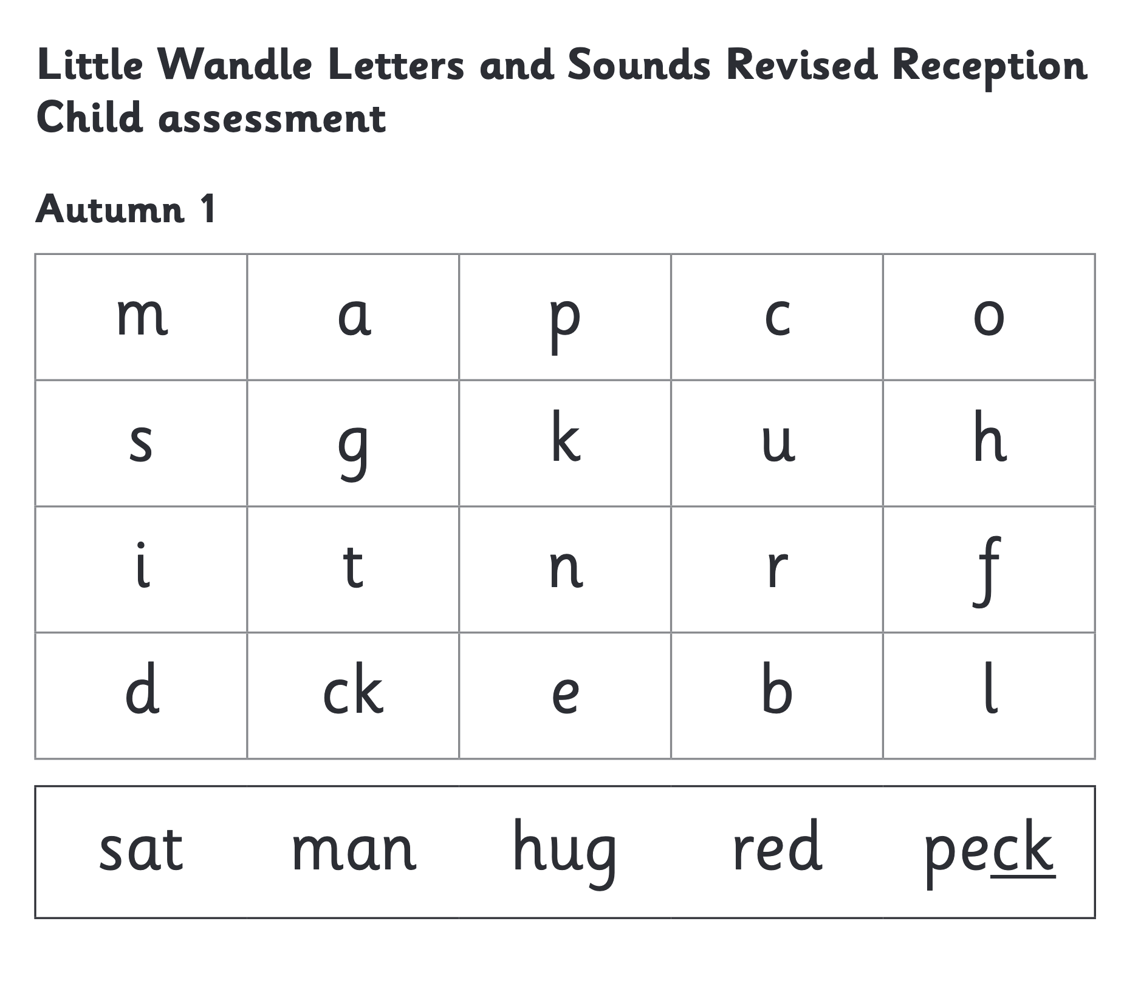
We use assessment to match your child the right level of book
Notes:
CHLOE
We assess your child every six weeks to check progress. Any child who needs extra support has daily keep-up sessions planned for them.

Slide 35
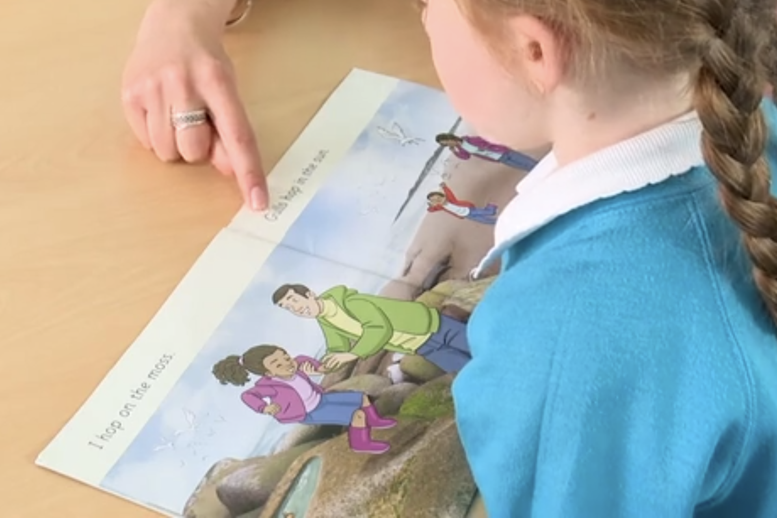
Reading a book at the right level
This means that your child should mostly:
Know all the sounds and tricky words in their phonics book well
Read many of the words by silent blending (in their head) – their reading will be automatic
Only need to stop and sound out some of the words by the time they bring the book home .
Notes:
CHLOE

Slide 36
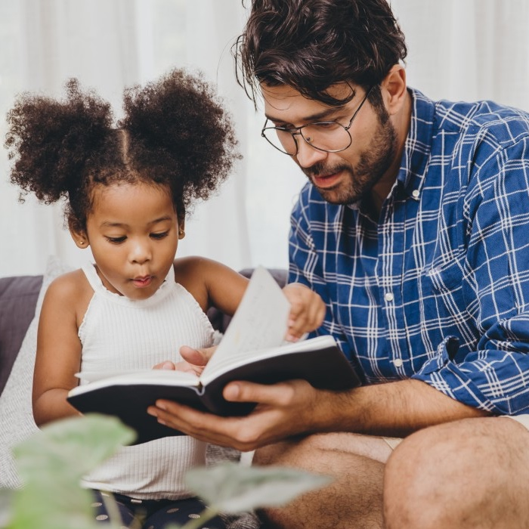
The most important thing you can do is read with your child
Reading a book and chatting had a positive impact a year later on children’s ability to…
understand words and sentences
use a wide range of vocabulary
develop listening comprehension skills.
The amount of books children were exposed to by age 6 was a positive predictor of their reading ability two years later.
Parental involvement in the development of children’s reading skills: A five-year longitudinal study (2002) Senechal, M. and Lefvre, J
Notes:
ALYSIA
Celebrate child’s success at school, make time for reading at home!

Slide 37

Read to your child…
A shared book is for YOU to read, from the library or from your home collections.
Make the story sound as exciting as you can by changing your voice.
Talk with your child as much as you can:
  Introduce new and exciting language
  Encourage your child to use new vocabulary
  Make up sentences together
  Find different words to use
  Describe things you see.
Notes:
ALYSIA

Slide 38
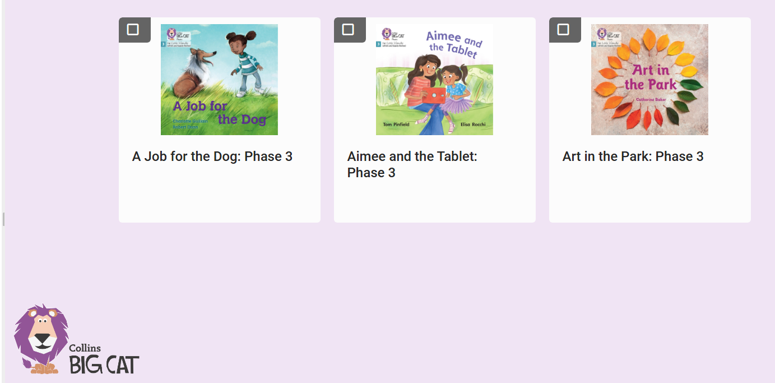
Collins Big Cat Ebooks
Notes:
CHLOE
Free to them
All children have account – ask office if any probs
Stickers in reading diaries with login details
Teachers get notifications of who is logging in
We update & reassign books – we might assign same ones again – don’t worry!
Notes page at start with some key words to share. Read page – then ‘read to me button’ to check - Little games (look for bug symbol)

Slide 39
“One of the greatest gifts adults can give is to read to children”
Carl Sagan
Notes:
CHLOE

Slide 40
Key vocabulary modelled in our lessons:
Phoneme - smallest unit of sound in a word
Grapheme – a sequence of written letters that represent one single phoneme
Digraph – a phoneme represented by 2 letters e.g. oi, er, aw
Trigraph – a phoneme represented by 3 letters e.g. igh, ear, oor
Split digraph – two letters that represent one phoneme but are split by another letter e.g. a-e in game, i-e in time, o-e in bone
Blend – blending is the skill required for decoding words by saying each individual phoneme in a word and merging them together to say the word
Segment – segmenting is the opposite of blending and is the skill used for spelling by splitting word into its individual phonemes
Adjacent consonant – two or more consonant phonemes adjacent in a word to create ccvc, cvcc, cccvc words e.g. swim, post, string
Notes:
CHLOE

Slide 41

Thank you for your time
Any questions?

