Slide 1



Welcome
Year 1 Families
Key Stage 1 leader: Alysia Lewis
Elephant: Laura Irwin Giraffe: Heatherleigh Hayman Tiger: Chrissy Allerston
Debra Bray
Rachel Kirk Roisin Sullivan Leanne Day Megan Murphy

Slide 2
What we will cover…
Gradual transition from EYFS into Key Stage 1
Key skills & independence
Behaviour and rewards
Structure of the day & areas of the school
Phonics & reading – how to help at home
Zones of Emotional Regulation, wellbeing and social development
How you can help & community support

Slide 3

Punctuality
Learning begins in school from 8:45am
Gates close at 9:00am and children must then come through the front entrance to ensure they are in class A.S.A.P.
Absence
It is essential that your child is in school whenever possible
If there is a reason your child is unable to be in school, please contact the school office before the school day begins to inform them that they will be absent and why.
Timetable
Morning routines
Afternoon routines

Slide 4
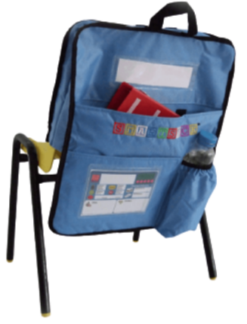




Full Uniform
School Uniform
www.schooldaysllp.co.uk
P.E. Days
Book Bags/Smart Sacks
Notes:
Children must wear: ● Whitepolo shirt ● Bottle green Carlisle and Hampton Hill Federation branded sweatshirt and/or cardigan and/or fleece ● Greyschool trousers and/or skirt and/or shorts and/or grey pinafore dress ● Greyorwhite socks ● Black school shoes (not trainers, heels, platforms or open-toed shoes) ● Children at Carlisle Infant School are required to have a bottle green Carlisle and Hampton Hill Federation branded book bag
Please note, leggings, cycling shorts and ‘Bermuda’ style shorts are not part of the uniformOptional uniform: ● Greytights (if required) ● Insummer, children may wear a green/white dress and/or playsuit with either stripes or checks ● Children at Hampton Hill Junior School may bring a bottle green Carlisle and Hampton Hill Federation branded rucksack or book bag
Physical Education (P.E.) Kits Carlisle Infant School ● Abottle green Carlisle and Hampton Hill Federation branded PE top ● Plain black sports shorts/tracksuit bottoms ● Plain trainers for outdoor PE ● Plain hair ties
Named clothes please- even shoes.
PE days –Monday and Thursday, PE kit and Velcro trainers.
Water bottles- named please.

Slide 5

Reception and Year 1 comparison
Teaching does gradually become more formal and subject-based, though at Carlisle we base our teaching and learning around half termly ‘topics’.
Children will be taught phonics, English and maths on a daily basis.
Reading sessions are four times per week.
Wider curriculum across the week; PSHE, Geography, History etc.

Slide 6





Independence in the Classroom
In the classroom, we are learning to look after our own things.
We try to remember; choose it, use it and put it away, everyone is expected to help at tidy up time
We are trying to work independently, to have a go at challenges and tasks.
“Don’t be shy to have a try”

Slide 7
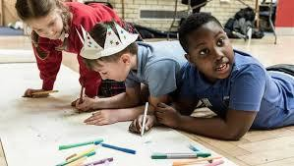
Co-operation
We are learning to share, to take turns, and to work together.
We are learning about waiting patiently for my turn to speak and to have a try.

Slide 8
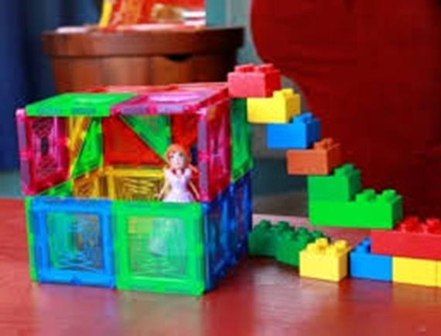

Stamina
We are working on increasing our capacity to attend to tasks and concentrate for increasing periods of time. This can include games, learning tasks, jigsaws, writing and building or making things.

Slide 9
Active learning zone
The ALZ or Active Learning Zone is a separate area to the classrooms run by Mrs Bray.
A colour group from each class access the provision each session.
Children can explore their learning in an active and practical manner and are set challenges and tasks which extend their learning and problem solving skills.

Slide 10
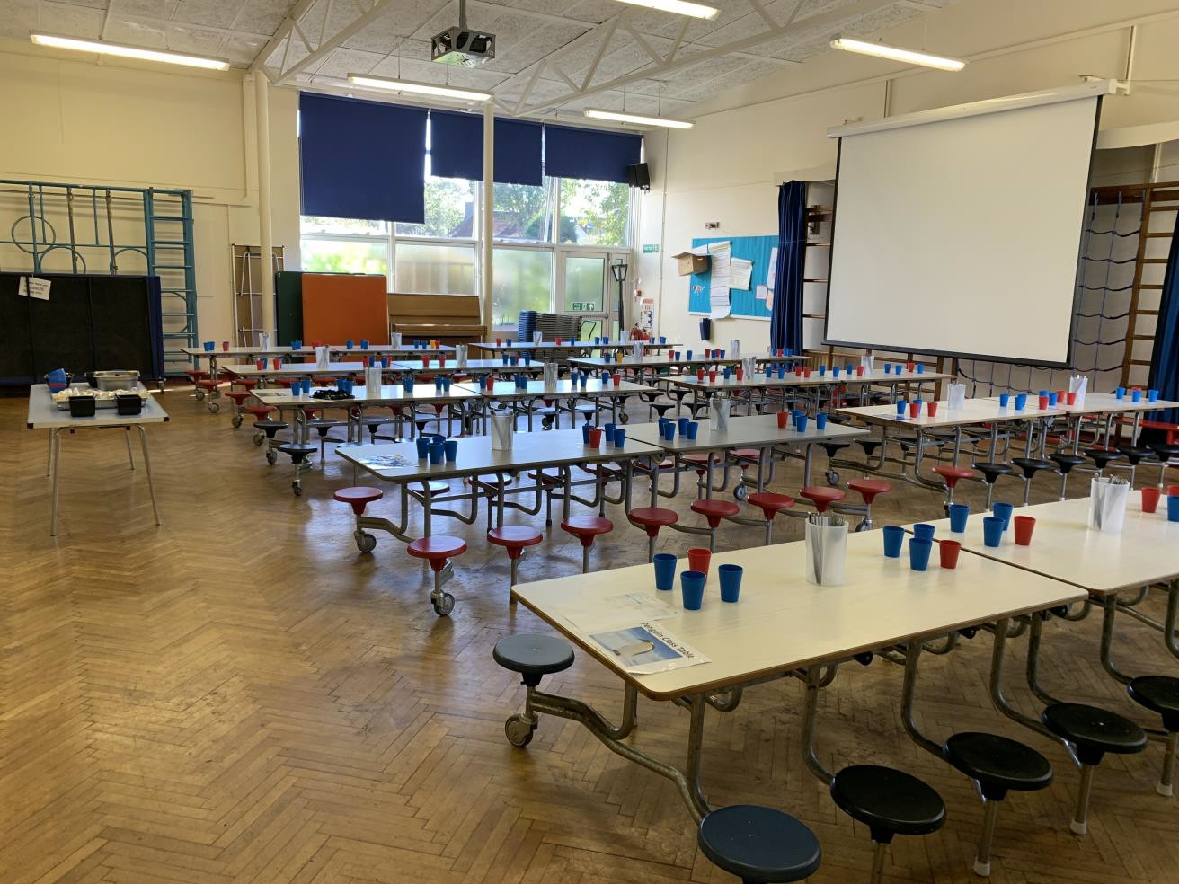
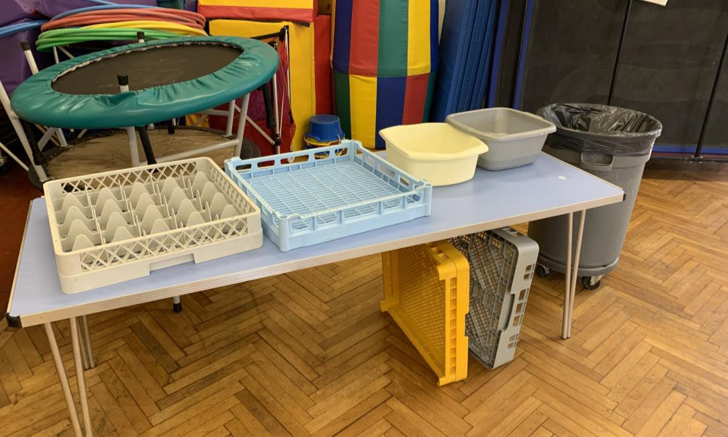
Lunchtime
Independence and polite table manners really help our lunchtimes to go smoothly.

Slide 11
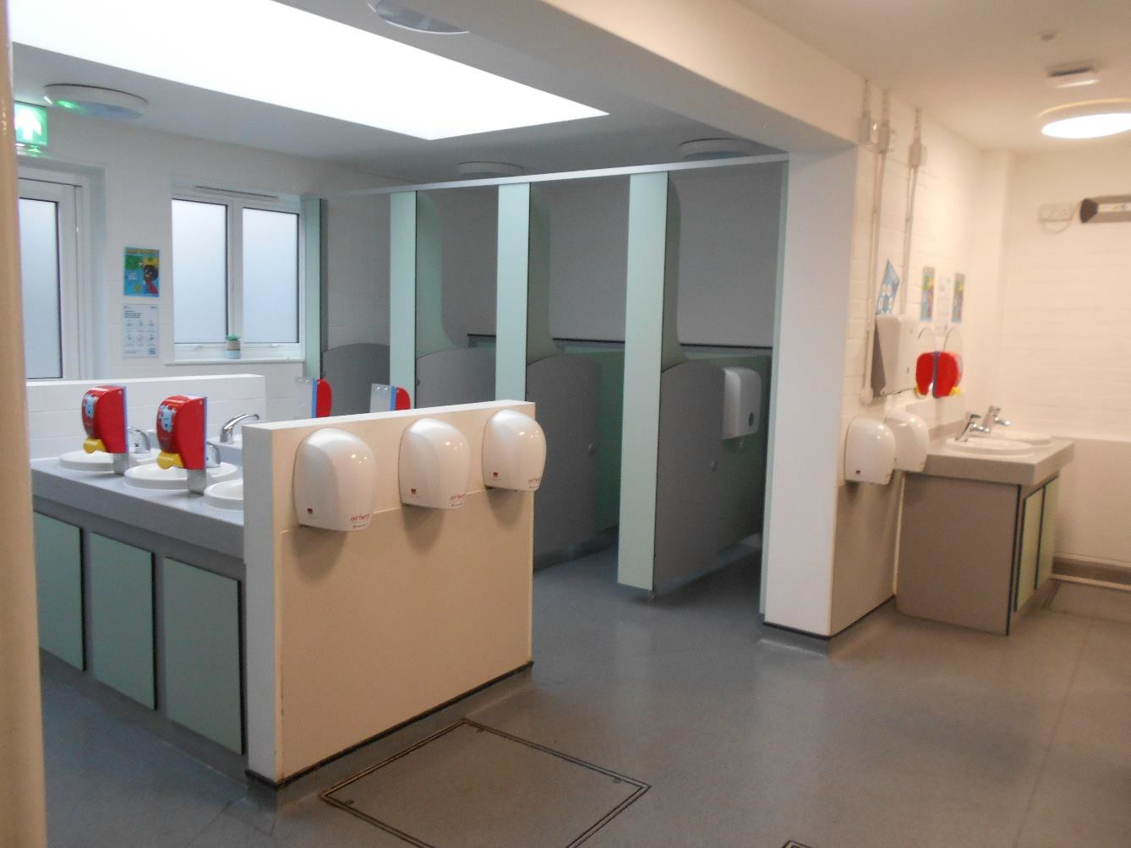
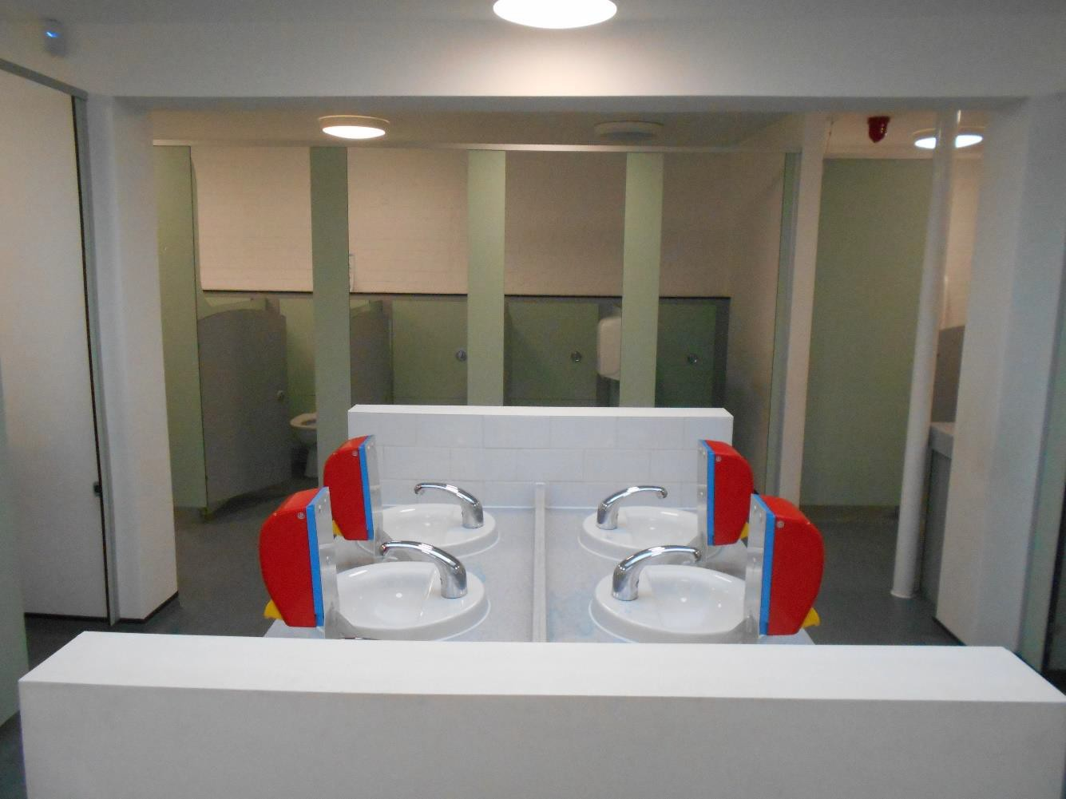
Toilets

Slide 12
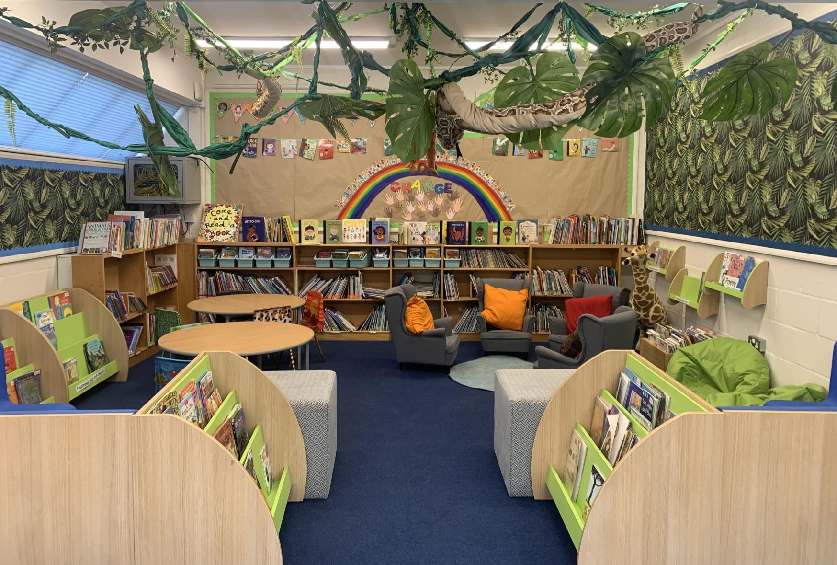
Our Carlisle library

Slide 13

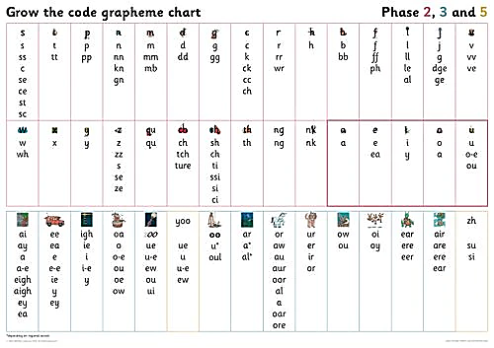
Phonics
20 minutes at the beginning of a day to revise sounds and identify alternatives
ay ou ie ea
Grow the code chart
Link with spellings
decoding and
encoding

Slide 14
Phonics
Phonics sessions typically include:
Shuffle Time – Saying Speedy Sounds
Reading words containing previously learnt and new graphemes – Digraphs and Trigraphs
Blend in your head
Reading TRICKY words – (Tricky words containing spelling patterns that are rarely found in other words or do not usually make the sound they do in the tricky word – e.g. said – in this word the digraph ‘ai’ makes the /e/ sound which is uncommon in other English spellings.)
Oral blending of sound to read words
Reading full sentences (including tricky words)
Spelling full words and sentences

Slide 15

Reading
Developing a love of reading
Reading picture books to your child regularly
Reading little and often
Re-reading familiar texts
Big Cat and Little Wandle

Slide 16
Reading at Home
Books brought home on a FRIDAY
Book folders (with book and diary) returned on a Wednesday please
Your child will receive a familiar Reading Book that they will have read three times throughout the school week.
They will also receive a self selected ‘reading for pleasure’ book.
Books will be changed at school on a FRIDAY.
Please comment on your child’s reading in their reading diaries.
Reading Diaries will be commented in by an adult at school during the week.

Slide 17
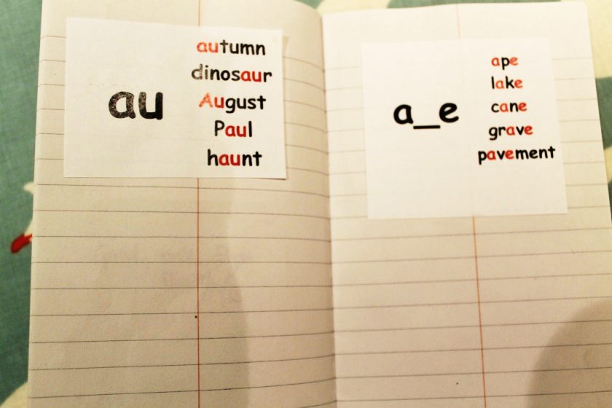
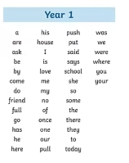
Spellings Common exception words
Weekly spellings will begin after half term

Slide 18
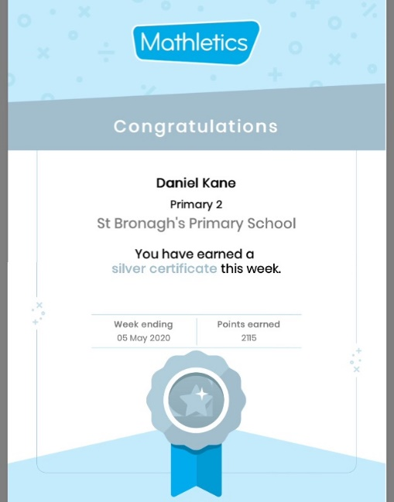
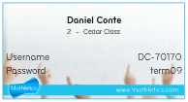
Maths
Place value
Counting in 2s 5s and 10s
Writing numbers to 50
Number bonds to 10
(should know solidly)
Mathletics
Your child will soon get their ‘Mathletics’ login (stuck in the front of their reading records)- Mathletics effort is rewarded in our Friday Celebration Assemblies
Collect 5 bronze certificates and you will be awarded a silver certificate.
Collect 4 silvers for a gold certificate.

Slide 19
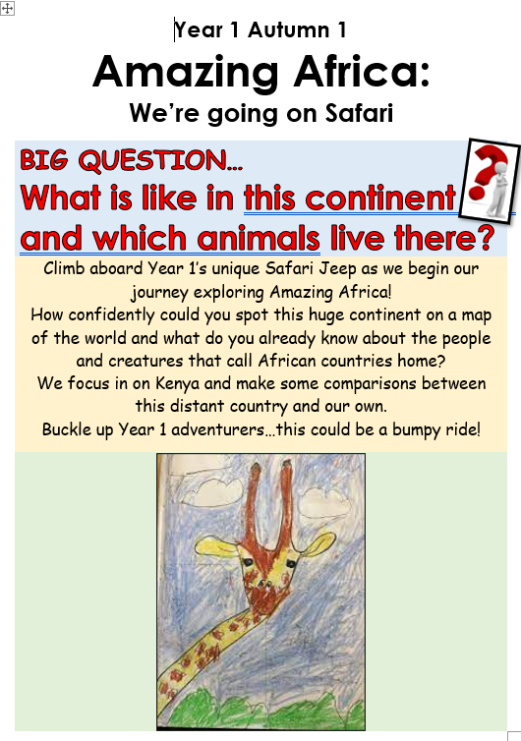

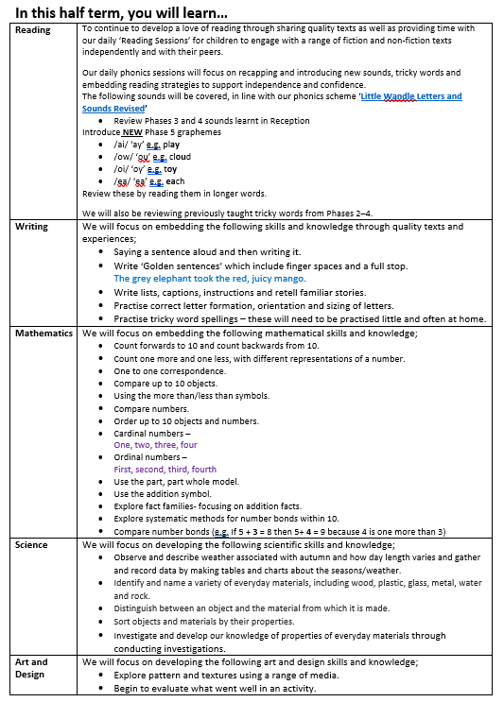
Each half term a new curriculum booklet will be available on our website
outlining the learning that will be covered

Slide 20

Our first topic is

Slide 21

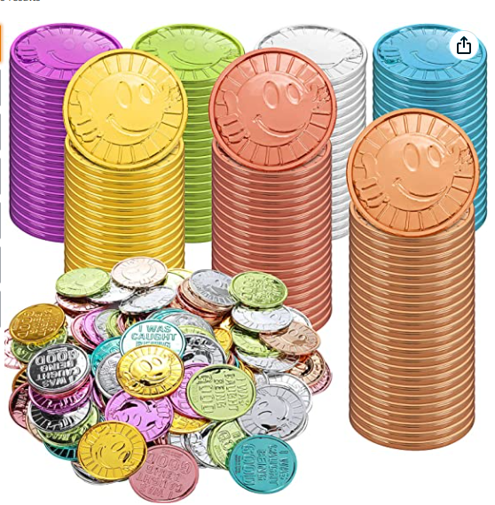
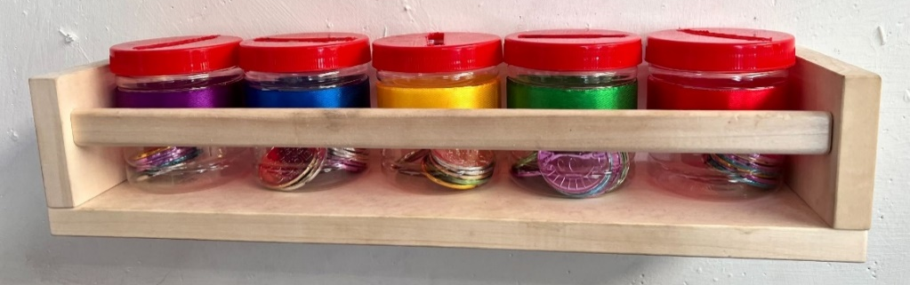
Behaviour

Slide 22
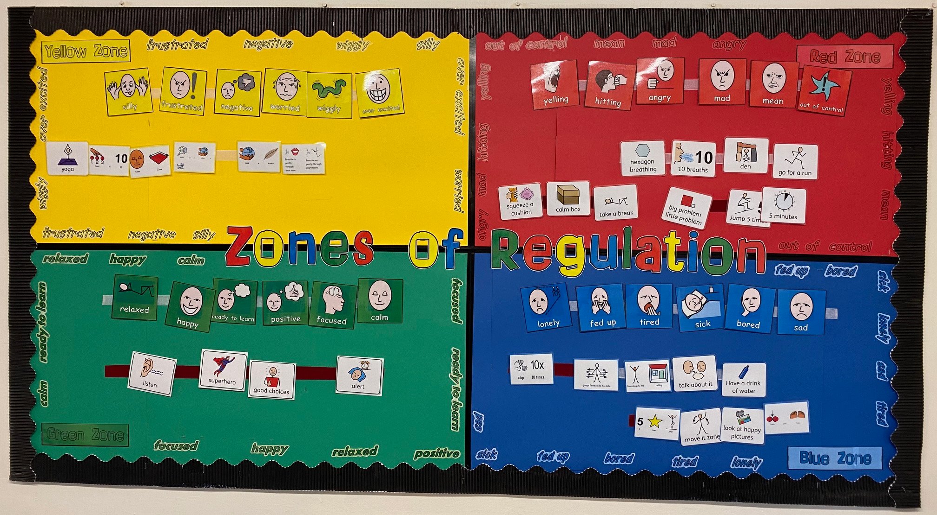
Zones of Regulation and calm areas
Notes:
Zones of regulation teaches;
Vocabulary of emotional terms
How to recognise their own
emotions
How to detect the emotions of others
What may trigger certain
emotions
Problem solving skills
There is no ‘bad’ zone
Everyone experiences all of the zones at different times and in different circumstances.
We can’t change the way children feel BUT we can help them manage their feelings/states and behaviours. “It’s ok to be angry but it’s not ok to hit…”
You can be in more than one zone at a time (e.g. sad and angry).

Slide 23



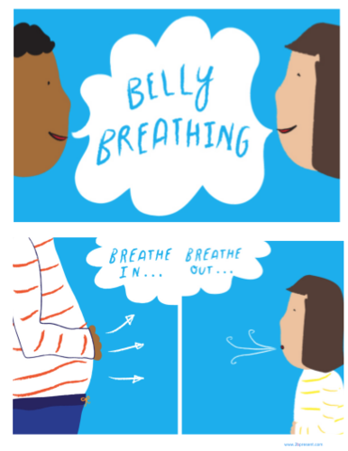

Wellbeing at school

Slide 24
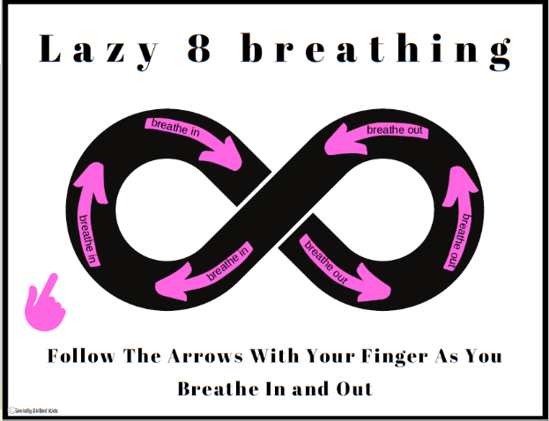
How you can help at home- Zones of regulation
Encourage your child to identify which zone they’re in at home
When reading with your child, you could ask them what zones the characters are in
If you’re watching TV with your child, ask them to identify which zone their favourite characters are in throughout the show
Lazy 8 Breathing
Start with an 8 on its side. Starting in the middle, go up the left and trace the left part of the 8 with your finger while you breathe in. When you get to the middle of the 8 again, breathe out while you trace the right part of the 8 with your finger.

Slide 25






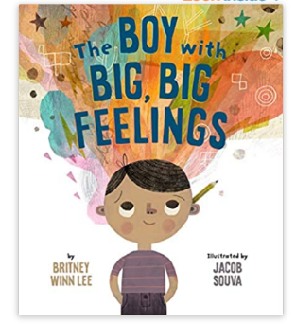
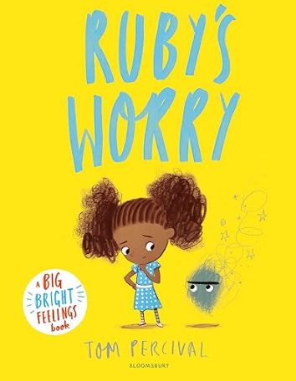

Wellbeing at home
Yoga
Cosmic Kids is a brilliant resource to practise yoga at home! They have yoga, relaxation, and mindfulness videos for children.
Calming Activities
Puzzles
Listen to music
Draw/Paint
Play-Doh/Clay
Read
Recommended Books

Slide 26
Parent helpers
Listening to readers
Trugs reading games
Maths board games ie playing snakes and ladders
Outdoor areas in Year 1
Cake sales

Slide 27

Thank you for coming this morning.

